Slide 1
Geography of the
Hebrews & Phoenicians

Slide 2
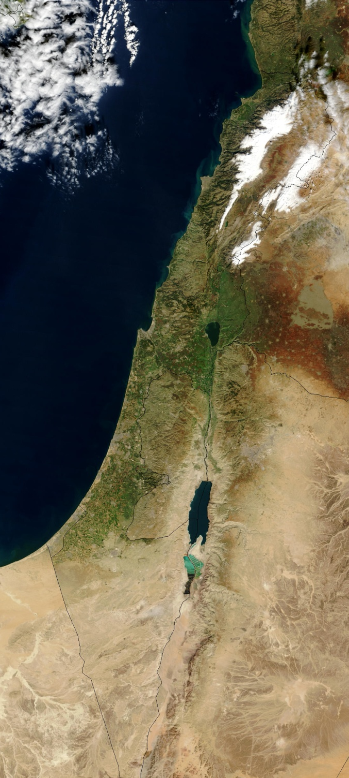
Brainstart for today…
Answer the questions below using the picture to the right:
What part of the world do you believe this is? Why?
What geographic features do you see?
What do you think the environment of this place looks like?
What natural resources might be limited here? In high supply here?
Source

Slide 3
Turn to the next page in your notebook…
Title the page “Mapping the Ancient Hebrews”
Locate map “A” at the top of page 14 in the atlas.

Slide 4
Mapping the Ancient Hebrews (Map A, p. 14)
In your notebook, draw the map. Be sure to label
Mediterranean Sea
Egypt
Red Sea
Nile River
Arabian Desert
Syrian Desert
Mount Sinai
Persian Gulf
Canaan
On the map identify:
Hebrew migration ( use a dark color, include arrows)
Include a compass rose
Use the map scale, estimate how far the Hebrews traveled during their migration. Include that number on the map.
DON’T FORGET to COLOR your map (one color for land, another color for water)

Slide 5
Phoenician Trade
Title the next page in your notebook “Mapping the Phoenicians”
Recreate the map on page 15 in your notebook.

Slide 6
Mapping the Phoenicians (p. 15)
Label
  compass rose
  Spain
  Italy
  Greece
  Atlantic Ocean
  Mediterranean Sea
  Phoenician settlement area (use a light color)
  Phoenician trade route
  Phoenician cities
  DON’T FORGET to COLOR your map (one color for land, another color for water)
Identify the sources of trade & location of each item on the map
  Silver
  Oil
  Copper
  Glass
  Gold
  Dye
  Salt
  Grain
  Ivory
  Cedar
  Cloth

Slide 7
Mapping Reflection Questions
hypothesis – an educated guess; a proposed or possible explanation for an observable phenomenon
Rewrite the question to the right in your notebook.
Use the maps you created to help answer this question.
Your answer should be in complete sentences.
Your argument should be backed up by evidence.
Based on the maps you have created, what role do you hypothesize geography will play in the development of ancient Hebrew and Phoenician religion, politics, economics, and social structure?

