Slide 1
Geography
Chapter 11

Slide 2

Section 1

Slide 3
Essential Questions
What are the physical features of Pacific South America?
What are the climates and natural resources of Pacific South America?
Notes:
Jacob is reading this

Slide 4
Vocabulary
Altiplano- a broad high plateau called altiplano lies between the ridges.
Strait- is a narrow body of water connecting two larger bodies of water
El Nino- an ocean and weather pattern that affects the Pacific Coast
Atacama Desert- this desert is about 600 miles long
Notes:
Ty is reading this

Slide 5
Andes Mountains
Runs through Ecuador, Peru, Bolivia, and Chile
Ridges and volcanic peaks in the Andes rise more than 20,000 ft. above Sea level
Plate tectonics formed the Andes mountains
When an earthquake hits, it sends ice and mud rushing down the mountain slopes
Notes:
Quincy

Slide 6
Atacama Desert
600 miles long
Rain falls less than 5 times per century
Cloud cover keeps the air near the ground from being warmed by the sun
Makes Chile the coldest and driest

Slide 7
Strait of Magellan
Links the Atlantic Ocean and the Pacific Ocean
350 miles long
2-20 miles wide
Cold and foggy climate

Slide 8
Climate and Vegetation
Climate and Vegetation varies widely in Pacific South America
Elevation caused climates to vary
Coastal regions have desert climates
El Nino causes the Pacific Ocean waters to warm
Notes:
Quincy

Slide 9
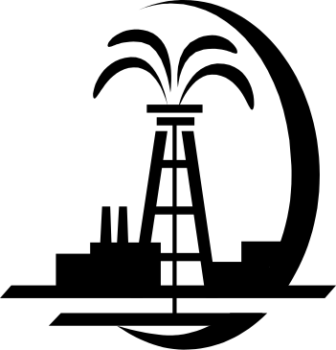
Natural Resources
Forests in southern Chile and in eastern Peru and Ecuador provide lumber.
Coastal Pacific waters are rich with fish
Ecuador has large oil and gas reserves. Oil is the country’s main export
Bolivia has some deposits of tin, gold, silver, lead, and zinc
Chile has copper, Chile exports more copper than any other country
Notes:
Braedon

Slide 10
Assessment Questions
1a. What is the main physical feature of Pacific South America?
The main physical feature is the Andes Mtns.
1b. How is Bolivia’s location unique in the region?
Bolivia has many rivers, lakes, and mineral deposits.
2a. What is El Nino, and what are some of its effects?
El Nino is an ocean and weather pattern that affects the Pacific coast. It causes ocean waters to warm.
Notes:
Quincy

Slide 11
Assessment Questions
2b. Why are some parts of Ecuador, in the tropics, cooler than parts of southern Chile?
Ecuador has a higher elevation than Chile, and high elevations cause colder climates.
3a. What country in this region has large oil reserves?
Ecuador.
3b. Why do you think much of the region is not good for farming?
The region is mostly cool, arid lands that are bad for farming.
Notes:
Quincy

Slide 12
Assessment Questions
3c. What effects do you think copper mining in Chile might have on the environment?
It is going to lower the elevation and create pits.
Notes:
Quincy

Slide 13
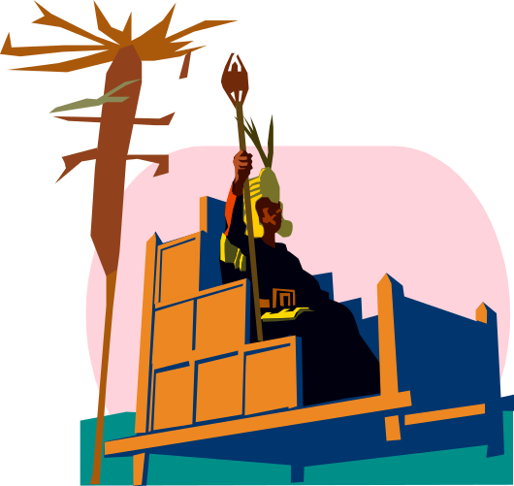
Section 2

Slide 14
Essential Questions
What are the early cultures of South America?
What did the Inca Empire build?
Notes:
Jacob

Slide 15
Vocabulary
Viceroy- governor
Creoles- American-born descendants of Europeans
Notes:
Ty

Slide 16
Early Cultures
Peru’s first advanced civilization reached its height in 900 BC
They built stone terraces to farm on the steep mountainsides
Notes:
Braedon

Slide 17
The Inca Empire
In the Early 1500s, the Inca people controlled an area that stretched from northern Ecuador to central Chile
It was home to as many as 12 million people
Irrigation turned deserts into rich farmland
Stone-paved roads connected the empire
Messages were carried by relay runners who could run as much as 150 miles per day.
Notes:
Braedon

Slide 18
Spanish Rule
By 1535, the Spanish had conquered the Inca Empire
The Spanish dealt with the natives harshly, forcing them to work in gold mines or on plantations
A Viceroy, or governor, was appointed by the king of Spain to make sure the natives followed the Spanish laws
Notes:
Ty

Slide 19
Independence
In the early 1800s, people began to revolt against Spanish rule
Creoles were the main leaders of the revolts.
Chile, Ecuador, Peru, and Bolivia were independent by 1825
Notes:
Lucas

Slide 20
Culture
Spanish and native cultures have left their marks on the region
Most people in the area speak Spanish
Most are Roman-Catholic
Practice ancient religious customs
Notes:
Lucas

Slide 21
Assessment Questions
1a. What ancient empire built paved roads through the Andes?
The Inca Empire
1b. What role did Creoles play in the history of Pacific South America?
They were the main leaders of the revolts.
1c. How might the Inca empire have been different if they had wheels and horses?
They could travel faster.
2a. What country has the highest percentage of South American Indians in its population?
Peru.

Slide 22
Assessment Questions
2b. What aspects of culture in Pacific South America reflect Spanish influence, and what aspects reflects Indian Heritage?
Spanish is the main language of all countries in the region, but most people speak they native language.

Slide 23
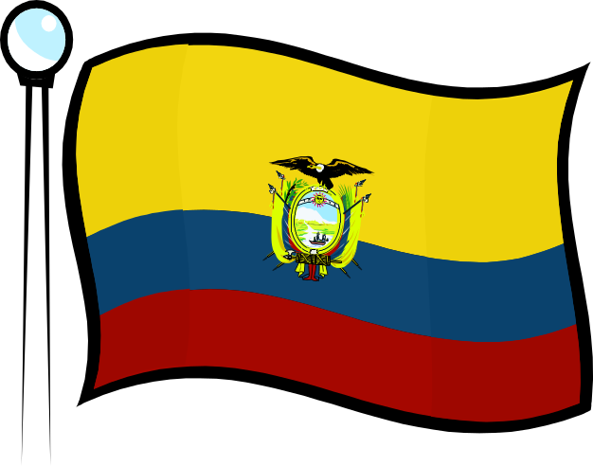
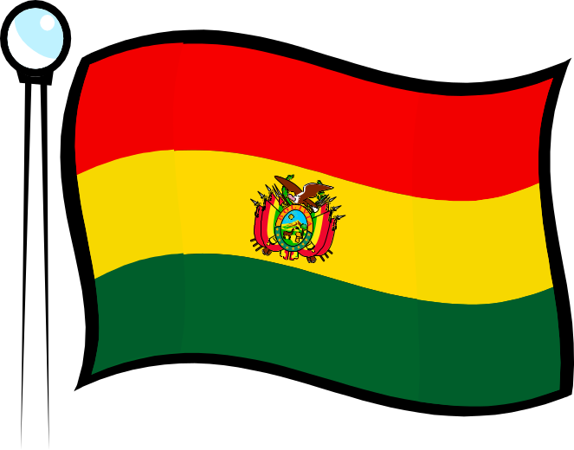
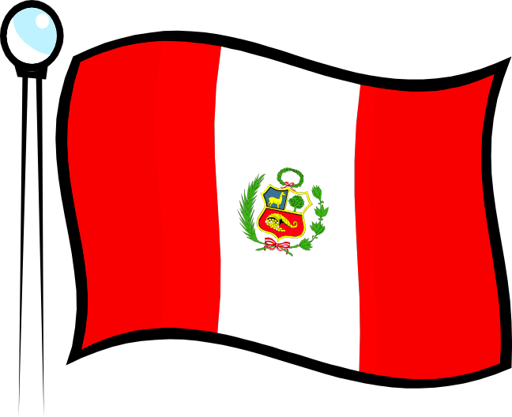
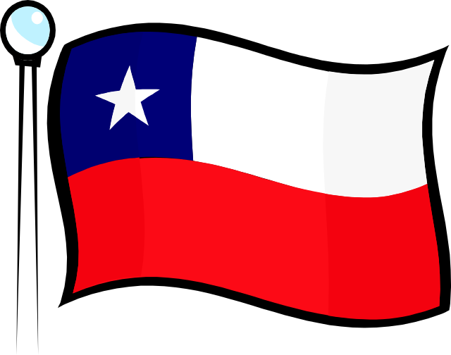
Section 3

Slide 24
Essential Questions
What is Ecuador like today?
What is Bolivia like today?
What is Peru like today?
What is Chile like today?
Notes:
Jacob

Slide 25
Vocabulary
Quito- Ecuador’s capital
La Paz- Bolivia’s capital city, highest capital in the world
Lima- Capital of Peru
Coup- sudden overthrow of a government
Santiago- Capital of Chile
Notes:
Ty

Slide 26
Ecuador
Ecuador has been a democracy since 1979
In 2004, the president fired most supreme court judges because they did not support him
In 2009, Rafael Correa was the first president to be re-elected in more than 30 years

Slide 27
Bolivia
Bolivia is a poor country
Many years of military rule
Now a democracy
Capital is La Paz
Highest capital city in the world(12,000 ft.)

Slide 28
Peru
Largest country
Capital is Lima
1980s and 1990s terrorism caused 70,000 deaths
Peru’s resources cause the economy to progress
Notes:
Lucas

Slide 29
Chile
Chile has a democratic government and growing economy
In 1970, the president of Chile was overthrown in a U.S. backed coup
1980s new democratic government formed
2010 first female president elected

Slide 30
Assessment Questions
1a. What is Ecuador’s largest city?
The largest city is Quito.
1b. Why have Ecuadorians been unhappy with their government in recent years?
They’ve had many different presidents.
2a. What are Bolivia’s two capital cities?
Sucre and La Paz.
2b. Why might Bolivia’s economy improve in the future?
Foreign aid has provided funds for a developer.
Notes:
Lucas

Slide 31
Assessment Questions
3a. Why did many Peruvians move to Lima from the Highlands in the 1980’s?
They moved due to industry, universities, and government jobs.
3b. What challenges do you think people who moved to Lima from the Highlands face?
They have a hard time getting water and electricity.
4a. What is a coup?
A coup is a sudden overthrow of a government.
4b. What might happen to Chile’s economy if the price of copper drops?
Chile will become more poor.

Slide 32
Citations
“Football in Ecuador and Other Sporting Activities.” Sports in Ecuador. N.p., n.d. Web. 29 Jan. 2014
“Ecuador.” News. N.p., 29 Jan. 2014. Web. 29 Jan. 2014.
“Straight of Magellan(channel,South America).” Encyclopedia Britannica Online. Encyclopedia Brittanica, n.d. Web. 28 Jan. 2014.
“Ecuador Official, National, and Public Holidays.” Ecuador Travel: Your Ecuadorian Guide for Things to Do, Hotels, Dining, Shopping, Events & More. N.p., n.d. Web. 28 Jan. 2014

Slide 33
Citations
“The Observatory of Economic Complexity :: Ecuador Exports, Imports and Trade Partners.” The Observatory of Economic Complexity :: Ecuador Exports, Imports, and Trade Partners. N.p., n.d. Web. 29 Jan. 2014.
“Economy of Peru.” Wikipedia. Wikimedia Foundation, 15 Jan. 2014. Web. 28 Jan. 2014
“Peru This Week.” Peru This Week. N,p., 28 Jan. 2014. Web. 26 Jan. 2014
“Maps of World.” Maps of World: South America. N.p., 18 Jan. 2013. Web. 26 Jan. 2014

