Slide 1
Geography of India, The Aryans, The Caste System and Hinduism

Slide 2
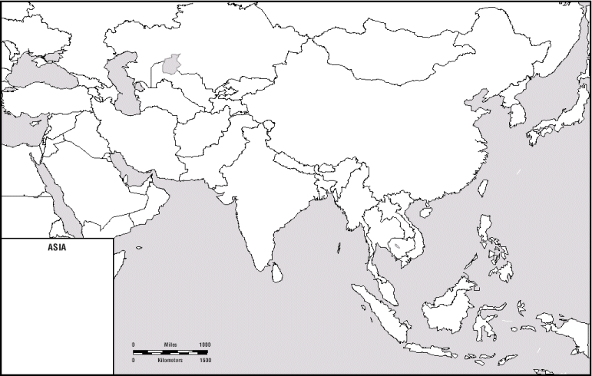
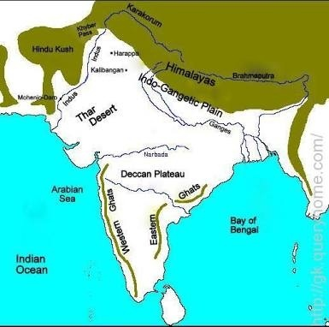
Why were physical geography and location important to the development of Indian civilization?
Be sure you can label:
Himalayas, Hindu Kush, Indian Ocean, Ganges River, Indus River

Slide 3
Indian civilization began in the ­­­­­­­­­­­Indus River Valley and spread to the Ganges River Valley, then through the Indian subcontinent. It continued with little interruption because of its geographic location.
Physical barriers such as the Himalayas, the Hindu Kush, and the Indian Ocean made invasion more difficult.
Mountain passes in the Hindu Kush provided migration routes into the Indian subcontinent.
The Indus and Ganges were the most important rivers in the Indian subcontinent.

Slide 4
The Aryans
About 1500 B.C., people from central Asia crossed the Hindu Kush Mountains and invaded India. Those people were called Aryans.
The Aryans conquered the people living in northern India. (Those people were probably the descendants of the Indus Valley people.) The Aryans built an important civilization in India.
At first, they were nomadic herders who raised cattle and sheep. But gradually the Aryans settled into villages and began to farm. By about 700 B.C., the Aryans were living in cities and had developed a written language called Sanskrit.

Slide 5
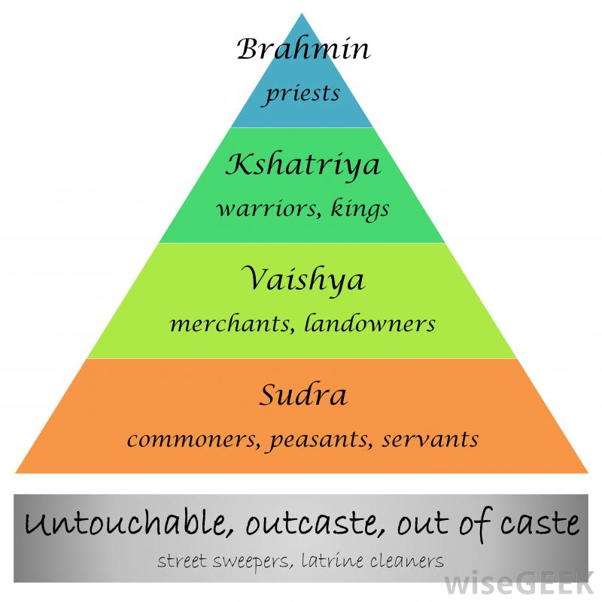
The Caste System
The Aryans developed a system of social classes known as the caste system.
Under the caste system, Aryans divided people, into castes, or groups, according to their ­occupation.
Aryans created four main castes. The top castes were made up of priests, kings, and warriors. The lowest caste was made up of workers who served the higher castes.
Under the caste system, people could not rise to a higher caste.
People remained in their caste for life. Children became members of their parents' caste.
Each caste had strict rules of conduct for caste members to follow.
People in a caste could not eat with people of other castes. They could not marry people from other castes.
The caste system has been a part of Indian life for thousands of years. Today, the caste system is not as strong as in the past. But it still affects the way many Indians live.

Slide 6
Hinduism
Major Hindu Beliefs:
Hindus worship many gods who are all part of one supreme spirit known as Brahman.
Hindus believe the spirit of Brahman is in all living things.
After one life is over, the soul is reborn or born again, in another body, known as reincarnation.
Karma: actions in current life determine status in next life. Hindus believe that people who obey the rules of their caste are reborn into a higher caste. But people who fail to obey the rules are reborn into a lower caste. Hindus believe that after many rebirths, some people reach the highest caste. Their souls become pure and clean. Hindus believe that such people are ready to leave the earth.
Their souls join forever with the spirit of Brahman (known as Moksha)
Vedas and Upanishads are the sacred writings of Hinduism
Spread along major trade routes

