Slide 1
Ancient Kush
World Geography

Slide 2
Main Ideas
Physical geography helped develop the Kushite
Kush and Egypt traded but they also fought
Many factors led to the decline of their civilizations
Big Idea
The Kingdom of Kush arose out of Egypt in land called Nubia, they developed an advanced society due to their large trade network.

Slide 3
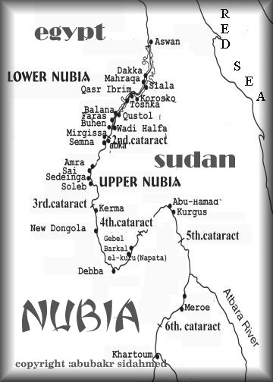

Slide 4
The Land of Nubia
Mostly Desert
Developed along the Nile River
Kush was located by the third cataract of the Nile
Yearly Floods brought rich fertile soil
Rich in minerals such
  Gold, copper, and stone

Slide 5
Early Nubia/Kush
Depended on agriculture
  Summer & winter crops
    Wheat, barley, and other grains
Livestock
Capital: Kerma
Nile served as a defense against Invaders

Slide 6
Kush & Egypt
Kush is located just south of Egypt
Trade relationship
Thumose II sent Egyptian soilder s to overtake Kush they succeed and take over the northern part of Kush.
Kerma is destroyed
450 years reign over the Kushites

Slide 7
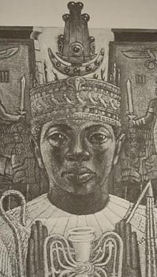
Piankhi
Kush military leader
Fierce Warrior
Overtook parts of Egypt including their capital
Extended Kush to the Nile delta
After his death his brother Shabaka took control and named himself pharaoh
25th dynasty

Slide 8
Kush Exports
Natural Resources | How Might have been used
Gold | Coins, jewelry
Copper | Coins, pots, tools
Stone | Pyramids, temples, statues
Ebony | Furniture, decorative items
Ivory | Small statues, jewelry, decorative items

Slide 9
Vocbulary
Trade network: a system of people in different lands who trade goods
Merchants: traders
Exports: items sent out to other regions
Imports: goods brought in from other regions

Slide 10
Kush Culture
Egyptian Influence
New capital Meroe
Wood homes
Writing system: Meroitic

Slide 11


Slide 12


Slide 13


