Slide 1
Is ½ of the whole shaded?
Yes No
Explain how you know.

Slide 2
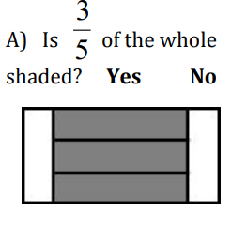
Explain how you know.

Slide 3
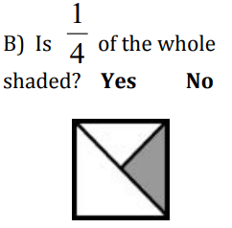
Explain how you know.

Slide 4
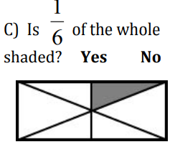
Explain how you know.

Slide 5
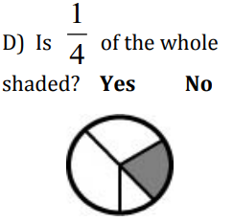
Explain how you know.

Slide 6
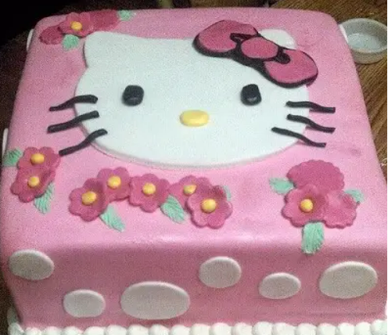
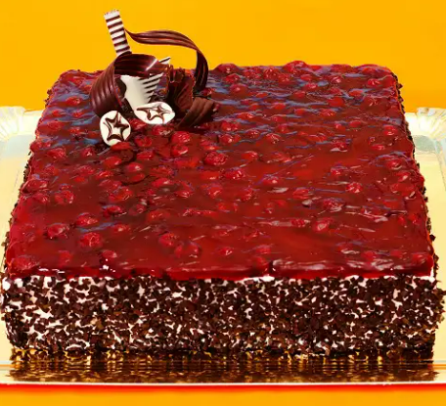
George is a retired math teacher who makes cakes. He likes to cut the cakes differently each day of the week,. On the order board, George lists the fraction of the piece, and next to that, he has the cost of each piece. This week, he is selling whole cakes for $10 each.
Determine the fractions of each piece of cake and how much each costs if the whole cake is $10.
Whole Cake
$10

