Slide 1
EARTHQUAKES
OCCUR ALONG CRACKS IN EARTH’S CRUST CALLED ______

Slide 2
FAULTS

Slide 3
EARTH’S
OUTER
LAYER

Slide 4
THE CRUST

Slide 5
THE HOT LAYER JUST
UNDER THE CRUST THAT MOVES SLOWLY.

Slide 6
MANTLE

Slide 7
THE WAVES THAT TRAVEL THROUGH THE EARTH AFTER AN EARTHQUAKE

Slide 8
SEISMIC WAVES

Slide 9
ALSO CALLED “P” WAVES FASTEST WAVES FIRST TO
ARRIVE AT DISTANT POINTS

Slide 10
PRIMARY
WAVES

Slide 11
“S” WAVES TRAVEL SLOWER THAN PRIMARY WAVES, ARRIVE LATER, ONLY TRAVEL THROUGH SOLIDS

Slide 12
SECONDARY
WAVES

Slide 13
A DEVICE USED BY SCIENTISTS TO
DETECT AND MEASURE EARTHQUAKE STRENGTH.

Slide 14
SEISMOGRAPH

Slide 15
THE PRINTED
RECORD OF AN EARTHQUAKE’S STRENGTH
PRODUCED BY A
SEISMOGRAPH

Slide 16
SEISMOGRAM

Slide 17
SPHERE OF SOLID MATERIAL AT EARTH’S CENTER.

Slide 18
INNER
CORE

Slide 19
LIQUID LAYER
BELOW THE MANTLE, PROBABLY MELTED IRON

Slide 20
OUTER
CORE

Slide 21
WHAT
IS IT?

Slide 22
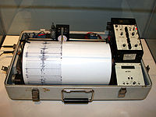
Hint: It measures earthquakes.
It’s a SEISMOGRAPH

Slide 23
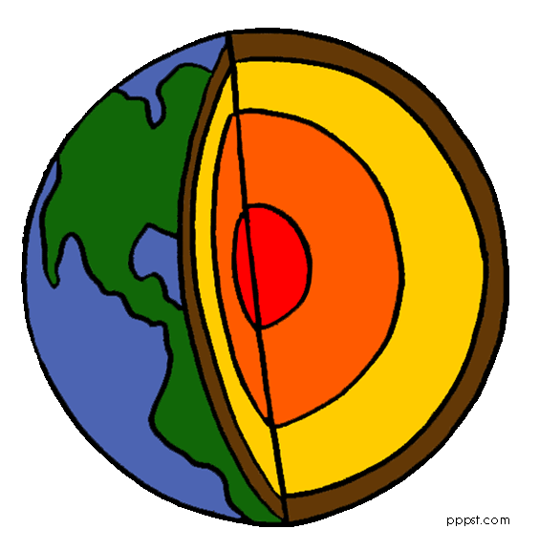
Hint: It’s the solid center of the Earth.
It’s the INNER CORE!

Slide 24
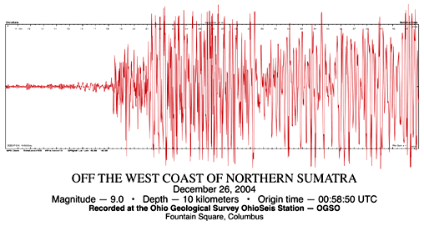
Hint: It is printed out by a SEISMOGRAPH.
It’s a SEISMOGRAM!

Slide 25
Hint: It’s the outermost and coolest layer of the Earth.
It’s the CRUST!

Slide 26
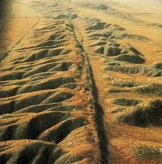
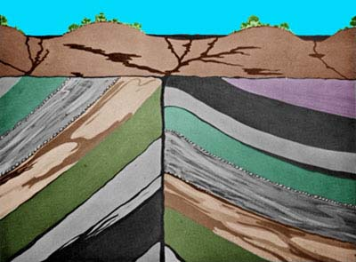
Hint: It’s a crack in the crust where two
plates collide.
It’s a FAULT!

Slide 27
Hint: It’s more than half the Earth’s mass.
It’s the MANTLE!

Slide 28
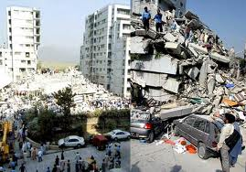
Hint: It’s a movement of the Earth’s crust.
It’s an EARTHQUAKE!

Slide 29
Hint: It’s the liquid iron layer that creates
Earth’s magnetic field.
It’s the OUTER CORE!

Slide 30
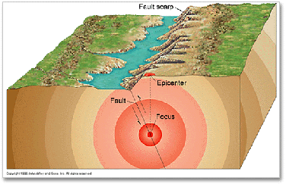
Hint: All the energy from the earthquake starts here.
It’s the FOCUS!

Slide 31
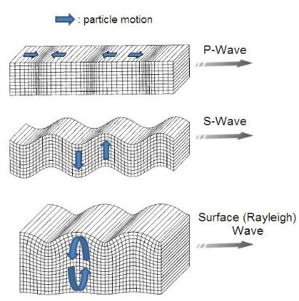
Hint: These move away from the focus in all directions.
They’re SEISMIC WAVES!

