Slide 1
Family Night 2015-2016
Kindergarten welcomes you!!

Slide 2
Reading in Kindergarten
Before we can start reading, we have to know:
  Uppercase and lowercase letters
  Letter sounds
Sight word recognition is a biggie!
  3 second rule
  Try the app: Sight Word Ninja
  Flashcards are always helpful!

Slide 3
35
30
25
20
15
10
5
Knows 0-17 letters
Knows 18-36 letters
Knows 37-51 letters
Knows all 52 letters

Slide 4
What we have for you…
Letter flashcards
  Letters are mastered? Go to letter sounds!
  Build words!

Slide 5
Reading questions?

Slide 6
Math in Kindergarten
How high can your child count? 100 is the goal!
What does “3” really mean?
Math today is VERY different than what we learned!
How many numbers can your child recognize?

Slide 7
35
30
25
20
15
10
5
Knows 0-7 numbers
Knows 8-14 numbers
Knows 15-20 numbers
Knows all 21 numbers

Slide 8
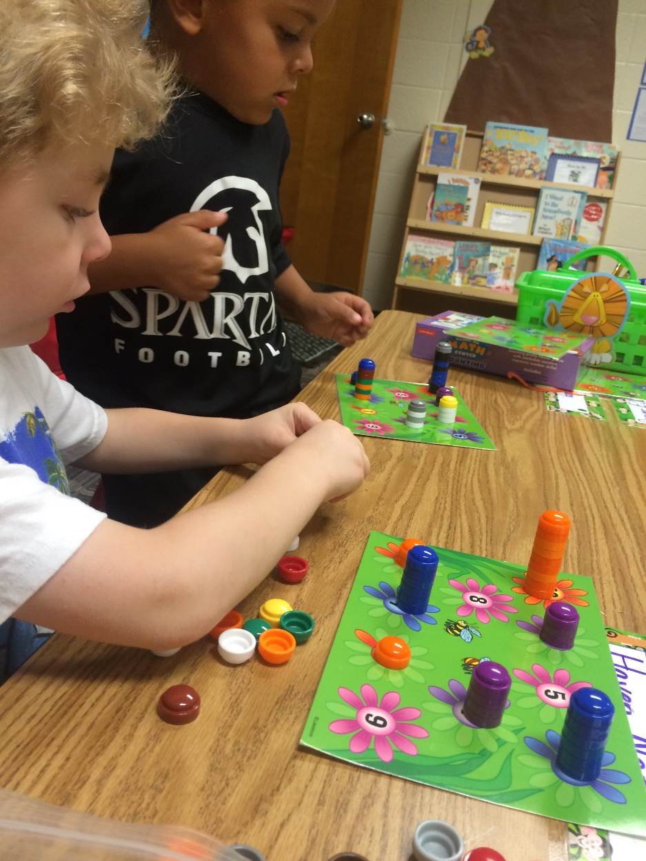
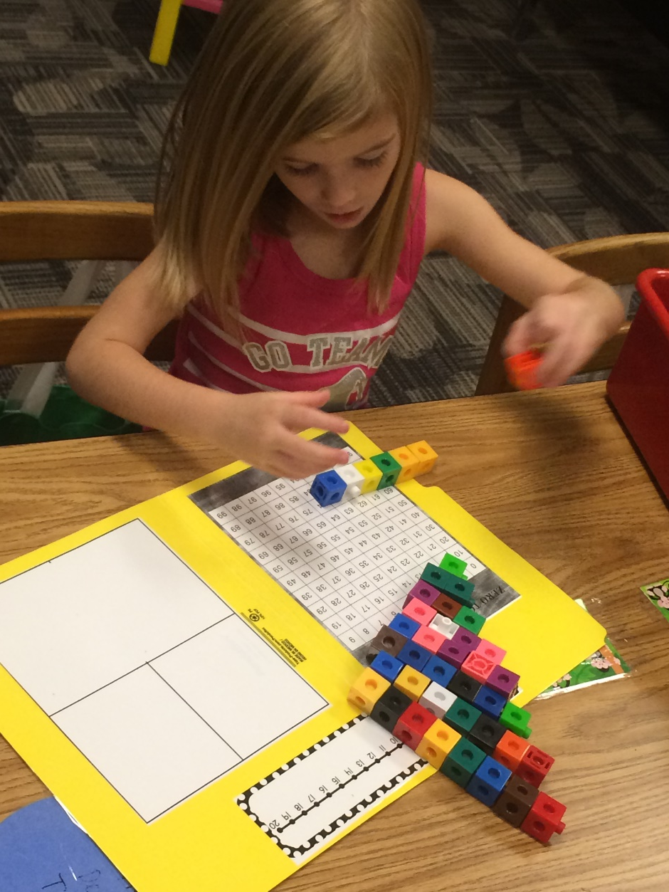

Slide 9
Math questions?

