Slide 1
A Gathering of Old Men
Vocabulary Flashcards
Period 1

Slide 2
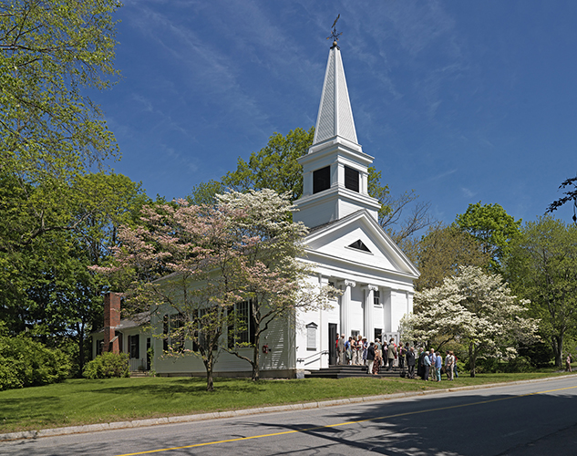
Parish
“There’s not a black family in this parish Fix and his crowd hasn’t hurt sometime or other.”

Slide 3
Parish
An ecclesiastical district having its own church and member of the clergy

Slide 4

Trifling (trifle)
We thought they was too trifling never doing anything for themselves.

Slide 5
Trifling (trifle)
Shiftless, worthless

Slide 6
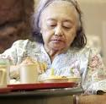
Sallow
I had another customer at the bar, a sallow, thoughtful- looking fellow, but he stayed quiet.

Slide 7
Sallow
A sickly, yellowish color

Slide 8
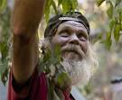
Cajun
A Cajun dead over there at Marshall.

Slide 9
Cajun
a member of a group of people with an enduring cultural tradition whose French Catholic ancestors established permanent communities in Louisiana and Maine after being expelled from Acadia in the late 18th century

Slide 10
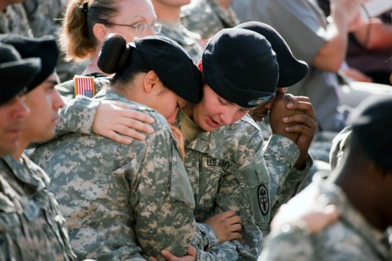
Console
Sentence: I held on to one of his arms, and Cal was patting him on the back to console him.

Slide 11
Console
Definition: To allay the sorrow or grief of.

Slide 12

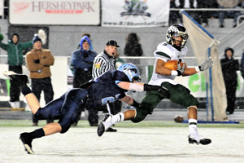
Gridiron
Sentence: On the gridiron they depended on each other on each other the way one hand must depend on the other to swing a baseball bat.

Slide 13
Gridiron
Definition: the field of The game of football

Slide 14
Conspirators
Pg. 125- “I supposed she felt that since we were all conspirators together, one was no better than the others, so she just started dishing out the sandwiches to the first person she got to and fussing all the time.”

Slide 15
Conspirators
People who take part in a plot.

Slide 16
Charade Sentence
Pg. 128- “How long is this charade going on?” Miss Merle snapped back at Mapes.

Slide 17
Charade
A deception.

Slide 18
Quintessence
Pg. 186- “He was the quintessence of what you would picture as the super buck n*****.

Slide 19
Quintessence
The most perfect example of something.

Slide 20

Pawn
You’re just a pawn. Somebody they’re playing with.

Slide 21
Pawn - A piece small size use in a bigger plot.

Slide 22
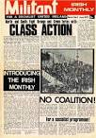
Militant
Isn’t it a little bit to late to be getting militant around here.

Slide 23
Aggressive in support of political or social causes

Slide 24

Trustee
Monk jack was a colored trustee

Slide 25
A prisoner who has earned privileges by good behavior

Slide 26

decorate
We got decorated, kissing on the jaw and all that.

Slide 27
Awarded medals for military service

Slide 28

chifforobe
I used to put on my old uniform and look at myself in the chifforobe glass

Slide 29
A furniture having both drawers and a clothes rod for hanging clothing

Slide 30
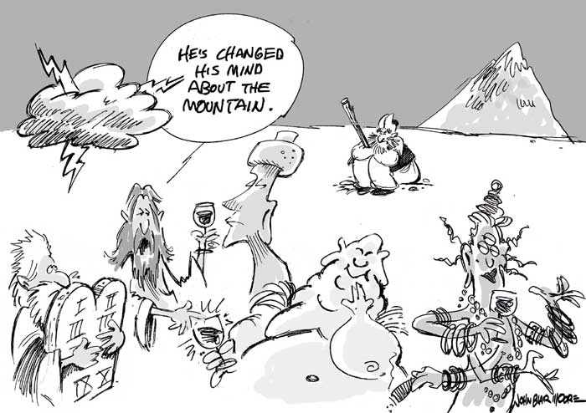
blaspheme
Don’t blaspheme him at a time like this.

Slide 31
To speak impiously ( god & scared things)

Slide 32
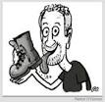
bootlicker
Old bootlicker shut up.

Slide 33
To seek the favor or good will in a servile way.

