Slide 1
Abiotic vs. Biotic Factors
Another relationship in Ecosystems
What are the other relationships?

Slide 2
What is an Ecosystem?
The living and non-living components of an environment
But… What is living? What is non-living?

Slide 3
Biotic Factors
The living or once-living components in an ecosystem.
Examples: plants, animals, insects, bacteria

Slide 4
Still not sure????
Living things all have 7 things in common:

Slide 5
Characteristics of living things
Growth
Movement
Sensitivity
Nutrition
Reproduction
Respiration
Excretion

Slide 6
Abiotic Factors
The non-living components in an ecosystem.
Examples: dirt, rocks, sand, air, rain, water

Slide 7
Why are abiotic factors important?
Because they help the biotic factors survive.
Examples: oxygen allows animals to breathe
rocks help fish hide
water gives fish a home

Slide 8
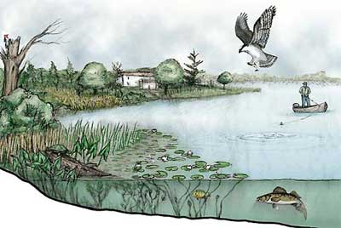
Practice

Slide 9
Limiting factors
A factor that controls populations in its environment.
~ can be living or non-living
Examples: food, shelter, oxygen, sunlight

Slide 10
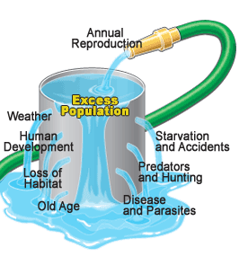

Slide 11
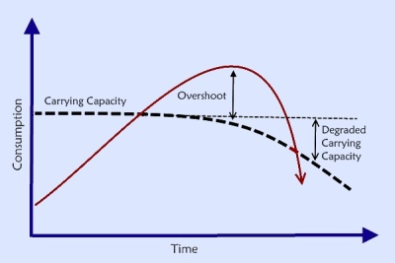
Carrying capacity
The number of organisms an environment can support

Slide 12
More Practice….
Go to Quizlet.com
Search “srittmeyer”
Practice using the Abiotic/Biotic Factors flashcards and games

