Slide 1
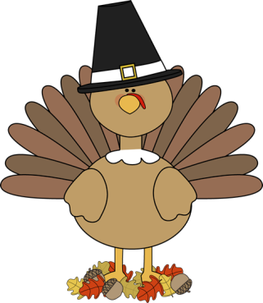
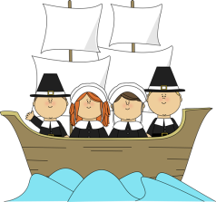
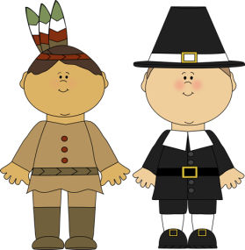
November
2nd Grade Newsletter
Nov.28th- Dec.2nd
2nd grade lunch: 11-11:25 Plan time:12:45-1:35
ELA
I can write an original fairy tale that includes a setting, characters, problem and solution.
I can choose a just right book. (On my reading level)
I can describe characters, setting, and beginning, middle, end of a text. I can compare and contrast two versions of a fairy tale.
I can identify a word as a noun, adjective, or verb.
Math
I can use different strategies to solve subtraction problems.
I can subtract two, two digit numbers without regrouping.
Spelling
first 11. way
birds 12. find
turn 13. use
start 14. may
short 15. water
north Test Friday
are Dec. 2nd
8. were
9. word
10. world
Social Studies
I can identify and locate the seven continents and four oceans.
Important Dates
--Practice spelling and math flashcards EVERY night as homework.

