Slide 1
Fearless with Fluency
Because Math is Fun!
By: Taajah Witherspoon
March 3, 2015

Slide 2
Learn math without fear, Stanford expert says….
Misconception: Strong math students are fast math students.
Fact: Students learn math combinations working on problems they enjoy rather than through exercises and drills they fear.
Speed pressure, timed testing, and blind memorization damage children’s experience of math.
Notes:
Fearless with Fluency by Jo Bolar

Slide 3
Number Sense (NS)
When the focus is on memorization multiplication table, they often memorize without number sense and are more prone to making errors.
NS is critical for to higher mathematics.
Overemphasis on math facts inhibits number sense and decreases the likelihood to think about numbers and their relationships.

Slide 4
Why is Math Different
If a student can call words quickly without understanding the text, would they be considered Readers?
If a student recites math facts without understanding, should we consider them mathematicians?

Slide 5
Automaticity
..achieved through consistent support and application at home and school
..prepares students to meet challenges in learning with energy in reserve, rather than being pressured to use problem –solving skills on a continual basis
…when acquired, arrested development occurs
Shift control from a conscious to an automatic function
Notes:
Visible Learning and the Science of How we Learn by John Hattie

Slide 6
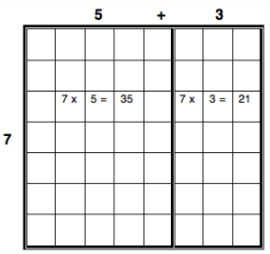
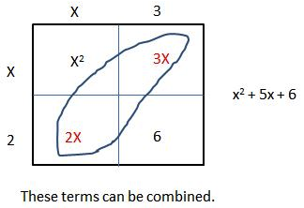

Learning Progression – Multiplication
7 x 8
Conceptual
Skip Counting
8, 16, 24, 32, … 56
Fluency
Distributive Property
Automaticity
7 x 8 = 56

Slide 7
Activities to Develop
Number Facts and Number Sense
We should help students develop math facts, NOT emphasizing facts for the sake of facts or using timed tests but by encouraging students to use, work with, and explore numbers.
As students work on meaningful number activities they will commit math facts to heart while understanding number and math.
They will enjoy and learn important mathematics rather than memorize, dread, and fear mathematics.
Notes:
You cubed Jo Bolar

Slide 8
Activities to Build
Number Facts with Number Sense
How many are Hiding?
Double, Double, Rock (like Rock Paper Scissors)
Take turns hiding a designated amount in a cup and displaying the remaining items.
Kindergarten 3 – 5
First grade: 6 – 10
Partners say “Double Double” and display desired number with “Rock.” Take turns finding the sum and doubling the amount.
Plus and or minus one from sum
Second grade – up to 20

Slide 9
Activities to Build
Number Facts with Number Sense
Meaningful Multiplication
Multiplication Cards
Use interview sheet to determine needed
Grades 3 – 4th 9 weeks - fluency
Grade 4 – see results - automaticity
Grade 5 – see results - automaticity
Print (Appendix A)
Match the cards with same product.

Slide 10
Enjoy the process!
The more knowledge one has the easier it is to learn even more.
References:
Fluency Without Fear: Research Evidence on the Best Ways to Learn Math Facts
http://youcubed2.s3-website-us-west-2.amazonaws.com/wordpress/wp-content/uploads/FluencyWithoutFear-Jan-28-2015.pdf?0ab6bd

