Slide 1
Fallacy notes

Slide 2
Argument is made up into 3 different parts…
And you already know the first two!
Argumentative Techniques
  Ethos, Pathos, Logos
Rhetorical Devices
  Anaphora, imagery alliteration, symbolism, etc.
Fallacies
  Everything today!

Slide 3
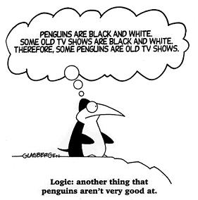
What’s a fallacy?
A fallacy is an error in reasoning
Fallacies in an argument can make it totally invalid
  But, if the audience doesn’t realize a fallacy is used, they might just believe whatever the writer/speaker asks them to!
Fallacies can be found in each part of the triangle (ethos, pathos, logos)

Slide 4

Faulty Ethos
What is ethos?
The author’s credibility!
Two types:
  Poisoning the Well (name calling)
  False Credibility

Slide 5
Poisoning the Well (can include name calling)
An attack on the person, not the issue
How is President Clinton supposed to help the US economy? He cheated on his wife!
  The president and his economic policies have nothing to do with his wife.

Slide 6

False Credibility
The author/speaker may be an authority in one field, but might know nothing about another
Example: An actor could be great at acting, but not know anything about being a doctor…or the science behind body odor…

Slide 7
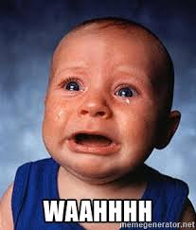
Faulty Pathos
What’s pathos?
Emotions of the audience!
Two types:
Appeal to pity (ad misericordiam)
Bandwagon

Slide 8
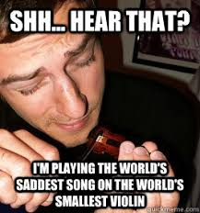
Appeal to Pity (ad misericordiam)
Making the audience agree with the message by making them feel sorry for the writer/speaker
Example: I know that the project that is worth 20% of my grade is due today, but I would really like an extension. I don’t have it because my goldfish was sick, I didn’t wear pink on Wednesday so I couldn’t eat lunch with my friends, I can’t get the “Let it Go” song out of my head and I think my parents love my brother more than they love me. Can I turn it in tomorrow?

Slide 9
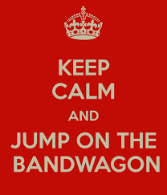
Bandwagon
Claiming that the idea is good because it is possible
People don’t want to feel left out, so they’ll join in
  (Everybody else is doing it!)

Slide 10
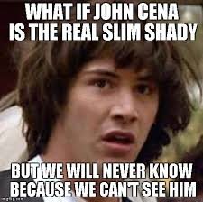
Faulty Logos
What’s Logos?
Logic!
5 types
Sweeping generalization
Hasty Generalization
Oversimplification
Slippery Slope
False Analogy

Slide 11
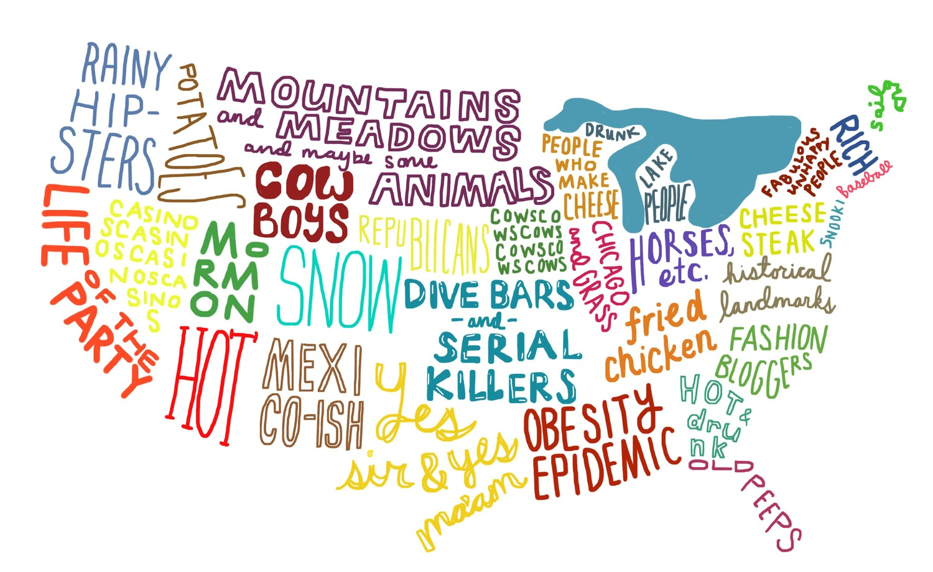
Sweeping Generalization (Dicto Simpliciter)
The author describes a situation in a manner that is too broad
  Everyone failed the test!
Look for words like all, everyone, every time, anything, no one, and none
Everyone who lives in Oregon is a hipster
Oil, Oil. Oil. Oil.

Slide 12
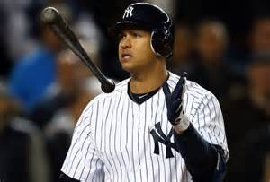
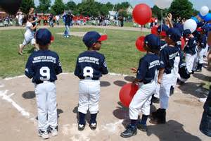
Hasty Generalization
An assumption is made based on too little evidence
Example:
  Alex Rodriguez used steroids during his baseball career…so that means, all baseball players must use steroids.

Slide 13
Sweeping vs. Hasty Generalization
Sweeping Generalization=Everyone → One
  All of this applies to one person
Hasty Generalization=One → Everyone
  One person made everyone like this

Slide 14

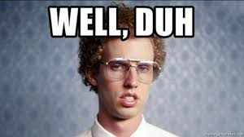
Oversimplification
The author describes a complex situation as being much simpler than what it is
  Could be combined with another fallacy
Example: World hunger can be solved by giving everyone food.

Slide 15
Slippery Slope
The author argues should one event occurs, so will lots of other events.
There is no proof that the harmful events are caused by the first event
Direct TV:
  http://www.bing.com/videos/search?q=direct%20tv%20commercial&qs=n&form=QBVR&pq=direct%20tv%20commercial&sc=8-20&sp=-1&sk=#view=detail&mid=3CCE0F46DA327AF5AB753CCE0F46DA327AF5AB75

Slide 16
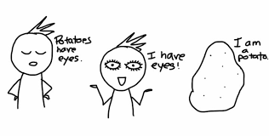
False Analogy
The author incorrectly makes an analogical (comparison) connection between two unconnected items
    I think you should give me credit for this class because Joe comes to class only three days out of the week and I’m here everyday.
    You passed everyone else in the class so I should receive credit like my fellow classmates.

