Slide 1

Margaret Fain Elementary Strategic Plan
2018-2019
101 Hemphill School Road, NW
Atlanta, Georgia 30331
(404) 802- 8600 Main Office
(404) 802-8627 Fax

Slide 2
MARGARET FAIN ELEMENTARY SCHOOL 2018-2019 PLAN
FOR IMPROVING STUDENT SUPPORT AND ACHIEVEMENT
SCHOOL LEVEL CONTINUOUS IMPROVEMENT PLANNING TEAM
NAME | ROLE
Desmond M. Moore | Principal
Mrs. Annette Muhammad | Assistant Principal
Ms. Nicole Porter | Math/Science Instructional Coach
Dr. Erica Pike | Reading/SS Instructional Coach
Dr. Francine Samuels | Counselor
Ms. Nicole Smith | Special Education Lead Teacher
Mr. Monterio Reid | Media Specialist
Ms. Armanda Griffie | K-2 Chairperson
Ms. Gena Wiley | Turnaround Reading Specialist
Ms. Ariel Bishop | Turnaround Reading Specialist
Ms. Kimberly Ivory | Program Specialist
Ms. Dacia Lampkin | Turnaround Math Specialist
Ms. Kendra Flounoy | Turnaround Math Specialist
Mr. Reuban Barkley | Instructional Technology Specialist
Ms. Laverne Nash | Clerk/Bookkeeper
Ms. Glenda Evans | Secretary
Ms. Adriana Perez | ESOL Instructor
Ms. Tamika Nash | Social Worker
Ms. Yawnita Williams | School Nurse
Mr. Leno | Site Manager
Ms. Lakesha Beasley | Physical Education Lead Teacher

Slide 3
Margaret Fain Elementary
STATEMENTS OF BELIEF
VISION
Margaret A. Fain TEAM & FAMILY will inspire and nurture life-long scholars to exceed expectations with integrity and pride by creating a culture of excellence. That’s the “FAIN WAY”.
MISSION
The mission of Margaret A. Fain Elementary is to empower our schools by providing a globally competitive education. To promote college and career readiness, we will collaborate with all stakeholders to provide an academically stimulating environment that enhances student success.
MOTTO
THE “FAIN WAY”
PRINCIPAL’S STATEMENT OF BELIEF
I believe that students and teacher perform best when placed in an environment that is structured, safe, collaborative, and positive. Their talents are manifested and enhanced when EVERYONE embodies what it really means to PUSH & SUPPORT each other and content is relevant, rigorous and engaging. Therefore it is my goal to create an orderly environment where students are exposed to maximum instruction, all TEAM & FAMILY members embrace the challenge of working together to provide quality instruction to every MFE student, and parents are true supporters of the schools initiatives.

Slide 4
TEAM & FAMILY
TEAM & FAMILY is the actionable belief that EVERYONE will contribute their fair share to the workload so that the students and school are able to accomplish our academic and building goals in a timely and cooperative manner.
TEAM & FAMILY is a willingness among every MFE faculty and staff to cooperate for the good of the school. TEAM & FAMILY cannot exist without this relational component, even if the extent of the relationship is minimal. TEAM & FAMILY does not occur if each person does his/her own thing separately from their work relationships.
TEAM & FAMILY is the relationship that exists between MFE faculty and staff that results in all of us getting to know each other on a deeper level. This relational learning WILL contribute to future cooperative initiatives as I better understand how each person on the team contributes to the overall process of accomplishing a goal and who works best with whom to accomplish the school’s overarching goal of academic student success.
TEAM & FAMILY is NOT me assessing each task and divvying up the work equally among all faculty and staff. Instead, it is each person contributing his/her part based on strengths and abilities. This is how leaders emerge within the building who I rely on to ensure that the work we set to do is completed in a timely manner. TEAM & FAMILY is not about the emergence of MFE under the leadership of just one person. TEAM & FAMILY is a supporting agent of my leadership and includes me in the process of identifying the leadership of MFE faculty and staff who has emerged as leaders naturally and have been recognized as such by their peers and colleagues.
PUSH & SUPPORT
PUSH & SUPPORT is the spirit of a group that makes and helps every TEAM & FAMILY member want to succeed. PUSH & SUPPORT is a sense of unity and enthusiasm shared amongst those with a vested interest and shared ownership of the buildings responsibilities.

Slide 5
Data Source(s):
2017-2018 Data
Strength(s): Margaret Fain Elementary School
• Clear Academic goals tied to academic standards that specify what students should know and be able to do, for each subject or content area and for each grade, developmental level, or other learning category.
• Knowledge of students’ baseline achievement levels.
• A Focus on policies and support services that enhance Fain’s ability to achieve its own strategic vision and plan within the context of the district’s vision.
• An Investment in high-quality professional development for all staff to insure extensive opportunities to learn and implement more effective practices that engage students in learning challenging materials.
Areas of Concern:
• Engage parents and the larger community in ongoing dialogue about the needed development to prepare students for academic and social success.
• Instructional coherence and support which fosters a culture of high expectations which yield a rigorous curriculum.
Prioritized Need(s):
After analyzing multiple sources of data, Margaret Fain Elementary School has identified the following areas as our most urgent need:
• Defining a School-Wide Literacy Plan establishing the needs for a common understanding of literacy — one with a focus on academic learning and student performance, where students utilize reading, writing, speaking and presenting, and critical thinking skills to learn content.
• A School Wide Management Plan that fosters an enriching school climate which seeks to decrease absenteeism and suspensions, but increases students’ academic achievement, motivation to learn, and psychological well-being.
• Effective Mathematical Instruction that addresses conceptual understanding of mathematical concepts through problem-solving, connections among mathematical ideas and other areas of knowledge, articulacy in communication via mathematical symbols and conventional language, adeptness in mathematical reasoning, skill in the mathematical analysis of data, and mastery of basic computation skills.

Slide 6
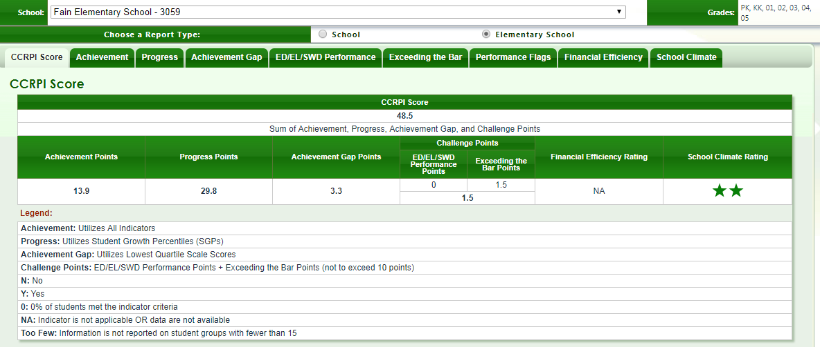
Fain Elementary School 2017 CCRPI Scores

Slide 7
Let’s Take a Deeper Look

Slide 8
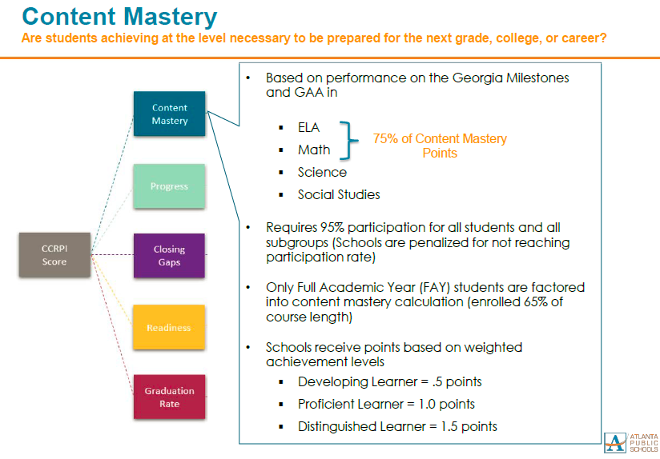
Monitoring Content Mastery…

Slide 9
CCRPI CONTENT MASTERY
Grade | Assess. | Beginning # x 0 0 - 69 | Developing # x .5 70 - 79 | Proficient # x 1 80 - 89 | Distinguished # x 1.5 90 - 100 | Total Total/Total # of students | Total 3rd – 5th
3rd ELA | STAR 1 | 50 x 0 = 0 | 14 x .5 = 7 | 7 x 1 = 7 | 3 x 1.5 = 4.5 | 18.5/74=25% | 29.5/194 = 15%
 | BM1 | 75 x 0 = 0 | 2 x .5 = 1 | 0x 1 = 0 | 0 x 1.5 = 0 | 1/77 = 1.3% | 1.5/206= 0.72%
 | STAR 2
 | BM 2
 | STAR 3
 | GMAS | 75x0=0 | 22x.5=37.5 | 2x1=2 | 0 | 39.5/81=48% | 73/214=34.1
4th ELA | STAR 1 | 57 x 0 = 0 | 6 x .5 = 3 | 2 x 1 = 2 | 1 x 1.5 = 1.5 | 6.5/66 = 9.8% | 29.5/194= 15%
 | BM1 | 70x 0 = 0 | 1 x .5 = .5 | 0 x 1 = 0 | 0 x 1.5 = 0 | .5/71 = 1% | 1.5/206= 0.72%
 | STAR 2
 | BM 2
 | STAR 3
 | GMAS | 76x0=0 | 19x.5=9.5 | 2x1=2 | 3x1.5=4.5 | 16/62=25% | 73/214=34.1
5th ELA | STAR 1 | 47 x 0 = 0 | 5 x .5 = 2.5 | 2x 1 = 2 | 0 x 1.5 = 0 | 4.5/54=8.3 | 29.5/194= 15%
 | BM1 | 58x 0 = 0 | 0x .5 = 0 | 0x 1 = 0 | 0x 1.5 = 0 | 0/58 = 0% | 1.5/206= 0.72%
 | STAR 2
 | BM 2
 | STAR 3
 | GMAS | 72x0=0 | 21x.5=10.5 | 7x1=7 | 0 | 17.5/71=24% | 73/214=34.1

Slide 10
CCRPI CONTENT MASTERY
Grade | Assess. | Beginning # x 0 0 - 69 | Developing # x .5 70 - 79 | Proficient # x 1 80 - 89 | Distinguished # x 1.5 90 - 100 | Total Total/Total # of students | Total 3rd – 5th
3rd math | STAR 1 | 33 x 0 = 0 | 13 x .5 = 6.5 | 17x 1 = 17 | 8x 1.5 = 12 | 35.5/71=50% | 74.5/195= 38.2%
 | BM1 | 87 x 0 = 0 | 0 x .5 = 0 | 0 x 1 = 0 | 0 x 1.5 = 0 | 0/87 = 0% | 4.5/195 = 2%
 | STAR 2
 | BM 2
 | STAR 3
 | GMAS | 73 x 0=0 | 25x.5=12.5 | 2x1=2 | 0x1.5=0 | 14.5/81=17.9% | 53/213=24.88%
4th math | STAR 1 | 46 x 0 = 0 | 14 x .5 = 7 | 7 x 1 = 7 | 10x 1.5 = 15 | 29/67 = 52% | 74.5/195= 38.2%
 | BM1 | 7` x 0 = 0 | 0 x .5 = 1.5 | 0 x 1 = 0 | 0 x 1.5 = 0 | 0/74 = 0% | 4.5/195 = 2%
 | STAR 2
 | BM 2
 | STAR 3
 | GMAS | 69x0=0 | 27x.5=13.5 | 2x1=2 | 2x1.5=3 | 18.5/61=30.32% | 53/213=24.88%
5th math | STAR 1 | 40x 0 = 0 | 14 x .5 = 7 | 3 x 1 = 3 | 0 x 1.5 = 0 | 10/57= 18% | 74.5/195= 38.2%
 | BM1 | 58 x 0 = 0 | 0 x .5 = 0 | 0 x 1 = 0 | 0 x 1.5 = 0 | 0/69 = 0% | 4.5/195 = 2%
 | STAR 2
 | BM 2
 | STAR 3
 | GMAS | 66x0=0 | 28x.5=14 | 6x1=6 | 0x1.5=0 | 20/71=28.16% | 53/213=24.88%

Slide 11
CCRPI CONTENT MASTERY
Grade | Assess. | Beginning # x 0 35% or below | Developing # x .5 36% - 59% | Proficient # x 1 60% - 79% | Distinguished # x 1.5 80% - 100% | Total Total/Total # of students
5th Social Studies | BM1 | 39x0 = 0 | 19 x .5 = 9.5 | 0 x 1 = 0 | 0 x 1.5 = 0 | 9.5/58=16.37%
 | BM2
 | BM3
 | GMAS | 56 x 0 = 0 | 14 x .5 = 7 | 0 x 0 = 0 | 0 x 0 = 0 | 7/70 = 10%
5TH Science | BM1 | 25 x 0 = 0 | 30 x .5 = 15 | 4 x 1 = 4 | 0 x 1.5 = 0 | 19/59=32.2%
 | BM2
 | BM3
 | GMAS | 55 x 0 = 0 | 14 x .5 = 7 | 2 x 1 = 2 | 0 x 0 = 0 | 9/71 = 12.7%

Slide 12
Actions Towards Content Mastery…
Symphony Math
  Students use this online, self-paced personalized, intervention program.
  Students use this program a minimum of three times a week.
LexiaCore 5
  Students use this online, self-paced personalized, intervention program.
  Students use this program a minimum of three times a week.
Reading Interventionist Support
  “ Leveled Learning Intervention” Program
  Addressing the bubble students
  5-7 students (per specialist) 1st - 5th Grades
Rollins Center Support
  Work with teachers to improve reading instruction.
  KDG – 3rd Grades
Reflex Math
  Students use this adaptive and individualized fact fluency intervention program to master addition, subtraction, multiplication, and division facts.
TutorMate
  Online volunteer tutoring program that helps our at-risk first grade students learn to read.
  Data is collected to examine student growth and adjust instructional plans as needed.
Math Interventionist Support
  “Do the Math” Program
  Addressing the beginning/developing students
  5-7 students (per specialist) 1st - 5th Grades
STEM
  PreK – 5th Grades
Monthly book program
Each grade level has an identified STEM focus
Full STEM lab usage on each grade level

Slide 13
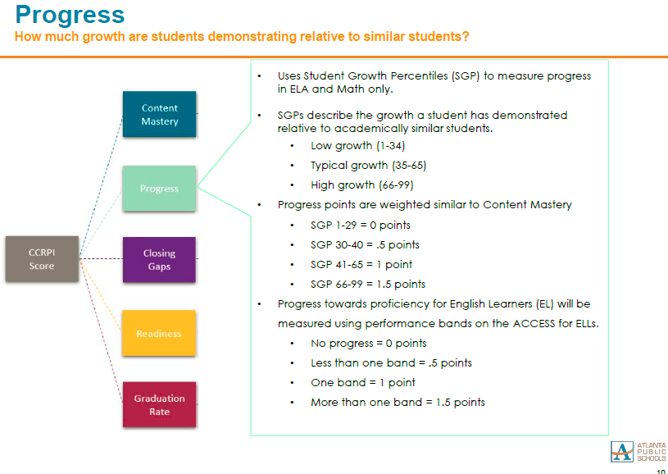
Monitoring Progress…

Slide 14
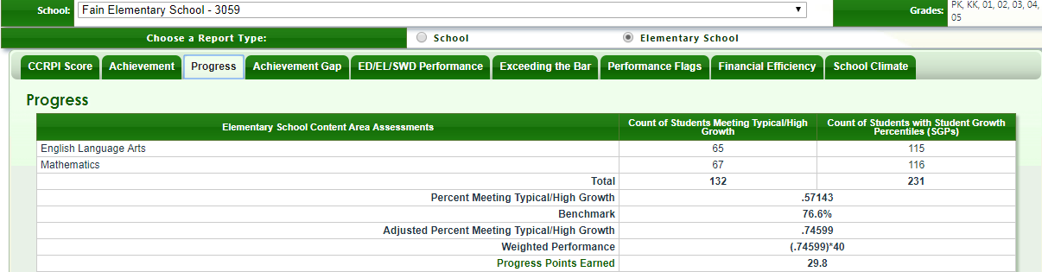
Monitoring Progress…

Slide 15
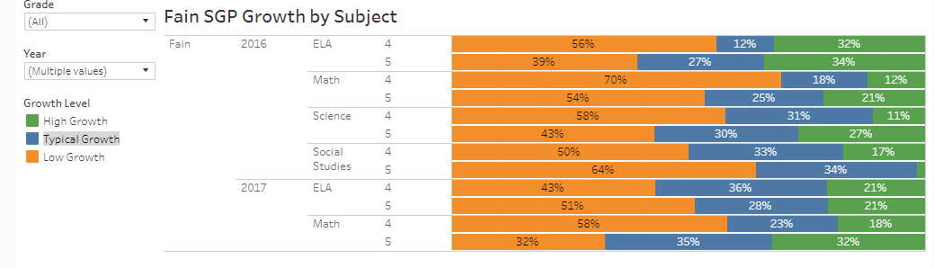

Slide 16
Actions Towards Progress…
Rollins Center Support
  Work with teachers to improve reading instruction.
  KDG – 3rd Grades
LexiaCore 5
  Students use this online, self-paced personalized, intervention program.
  Students use this program a minimum of three times a week.
Reading Interventionist Support
  “ Leveled Learning Intervention” Program
  Addressing the bubble students
  5-7 students (per specialist) 1st - 5th Grades

Slide 17
Actions Towards Progress…
Reflex Math
  Students use this adaptive and individualized fact fluency intervention program to master addition, subtraction, multiplication, and division facts.
TutorMate
  Online volunteer tutoring program that helps our at-risk first grade students learn to read.
  Data is collected to examine student growth and adjust instructional plans as needed.
Math Interventionist Support
  “Do the Math” Program
  Addressing the beginning/developing students
  5-7 students (per specialist) 1st - 5th Grades
Symphony Math
  Students use this online, self-paced personalized, intervention program.
  Students use this program a minimum of three times a week.

Slide 18
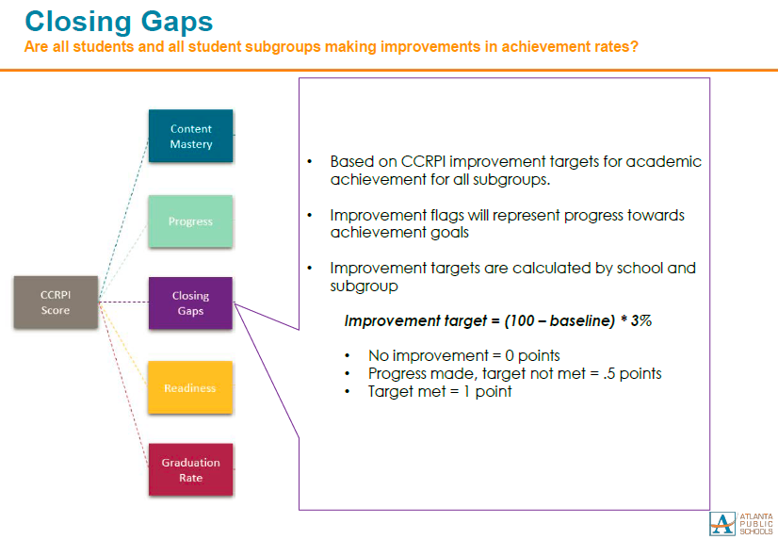
Monitoring Closing Gaps…

Slide 19
Actions Towards Closing Gaps…
Unit Progression Assessments
  Extended Planning Data Meeting
  Target Student/DES/ELL Tracking
Small Group Instruction
  30 Minutes Guided Reading
  30 Minutes Guided Math
  Teacher/Student Think Alouds
Weekly Remediation
  Benchmark Reteach
  Benchmark Enrich
Intervention
  Extended Planning Student Intervention
  Reading and Math Specialists
  Based on Benchmark Results and Teacher Recommendation

Slide 20
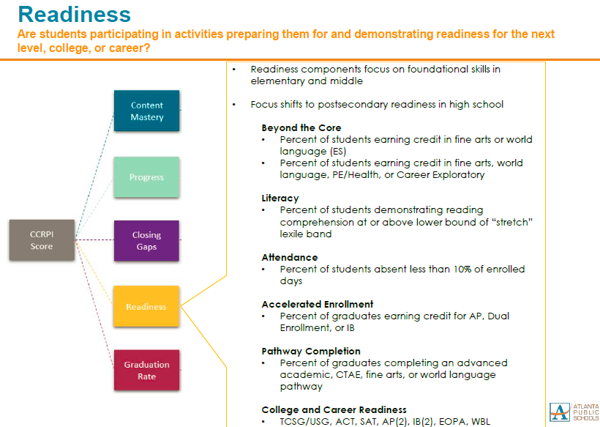
Monitoring Readiness…

Slide 21
Lexile Growth Averages…
Current Lexile Average | Predicted Spring Average | Lexile Growth Points
Grade 3- BR55L | 398 | 298
Grade 4- 25L | 515 | 195
Grade 5- 120L | 596 | 157
Grade 1- BR200L | 382 | 329
Grade 2- BR325L | 382 | 329
Grade K- BR205L
Revised 12-05-17 M. Reid. STAR360

Slide 22
MIDPOINT OF STRETCH LEXILE BANDS
Grade | Assess. | 3rd 420L or below 4th 645L or below 5TH 645 or below | 3rd 422L – 669L 4th 646L – 839L 5th 646L – 919L | 3RD 670L or up 4TH 840L or up 5th 920L or up | Total Total at Midpoint (green)/Total # of students on grade level
3rd | STAR 1 | SPRING GMAS - FALL STAR - 65 | SPRING GMAS - FALL STAR - 7 | SPRING GMAS - FALL STAR - 2 | SPRING GMAS - FALL STAR: 2/65 = <1%
 | STAR 2
 | STAR 3
 | GMAS
4th | STAR 1 | SPRING GMAS - 55 FALL STAR -63 | SPRING GMAS - 12 FALL STAR -1 | SPRING GMAS - 7 FALL STAR -1 | SPRING GMAS: 7/74 = 9% FALL STAR: 1/63 = <1%
 | STAR 2
 | STAR 3
 | GMAS
5th | STAR 1 | SPRING GMAS - 41 FALL STAR - 48 | SPRING GMAS - 22 FALL STAR - 6 | SPRING GMAS - 3 FALL STAR - 0 | SPRING GMAS: 3/66 = 4% FALL STAR: 0/48 = <1%
 | STAR 2
 | STAR 3
 | GMAS
Revised 12-05-17 M. Reid. STAR 360

Slide 23
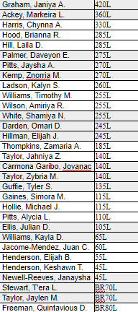
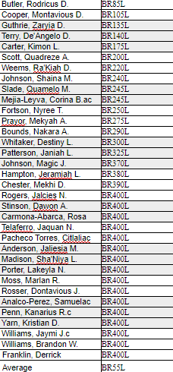

Monitoring Readiness…
3rd Grade
Status |  | Does not Meet | At Risk | Meeting
100% |  | 65 | 7 | 2
 |  |  |  | Millan-Lopez, Emanuel 875L Tanner, Hailey 730L

Slide 24
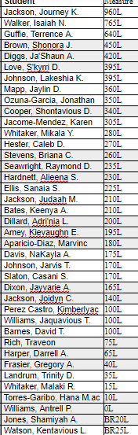
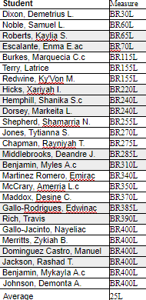
Monitoring Readiness…
4th Grade
Status |  | Does not Meet | At Risk | Meeting
100% |  | 63 | 1 | 1
 |  |  | Walker, Isaiah N. - 765L | Jackson, Journey K. - 960L

Slide 25
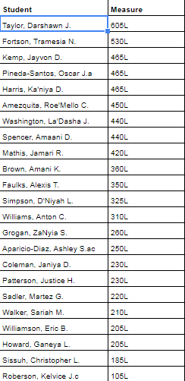
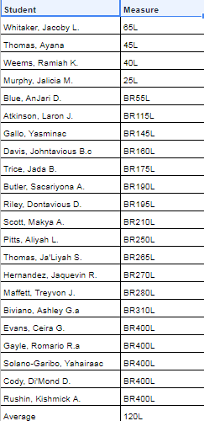
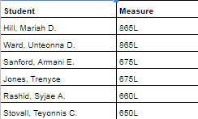
Monitoring Readiness…
5th Grade
Status |  | Does not Meet | At Risk | Meeting
100% |  | 48 | 6 | 0

Slide 26
Actions Towards Readiness…
Student Goal Setting
  Based on Prior Year Scale Score
  Reviewed in January
Attendance Tracking
  Parent Meetings
  Student Meetings
  Home Visits
Daily Small Groups
  30 Minutes Guided Reading
  Intentional Reading Focus - STAR
Reading For the Record Celebration
  Ice Cream Party, brag tag, Six Flags tickets

Slide 27

Next Steps…
Revisit Goals
  Determine Developing, Proficient, Distinguished for ALL Subgroups
Identify Individual Student Growth
  SGP Analysis
Continue Monitoring Instructional Frameworks
December Data Talks
  Teacher, Principal, Assistant Principal, Instructional Coaches
  Discuss each student’s progress and safety-nets for those not making progress according to STAR assessments, SGP, and lexile status.

