Slide 1
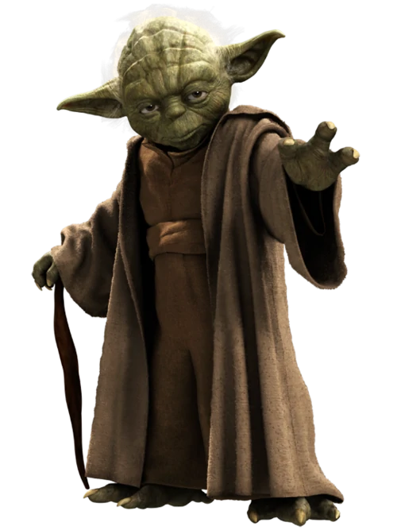

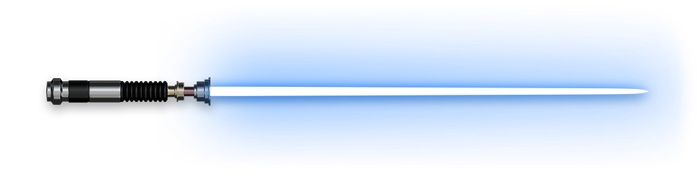
Expectations, Procedures, and Policies
For Mrs. Jared’s Science Students

Slide 2

Classroom Expectations

Slide 3
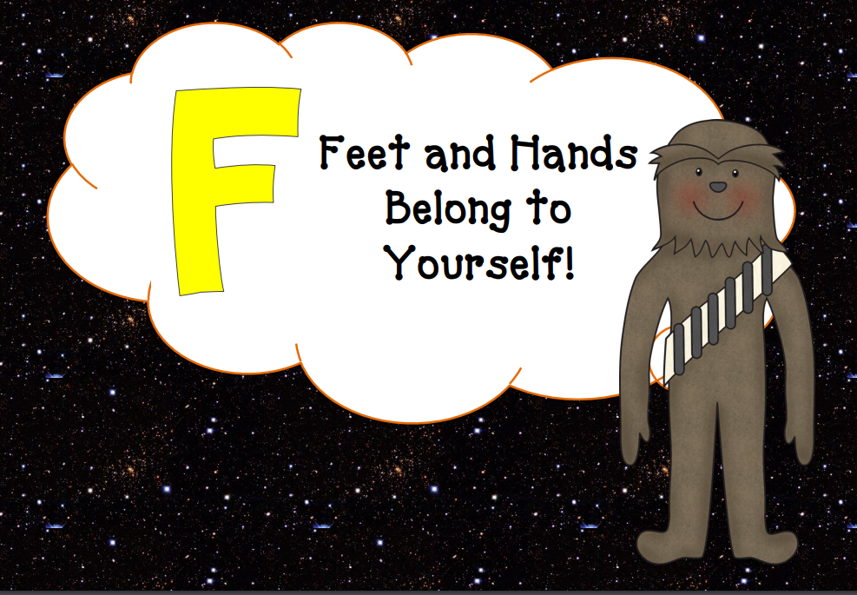

Slide 4
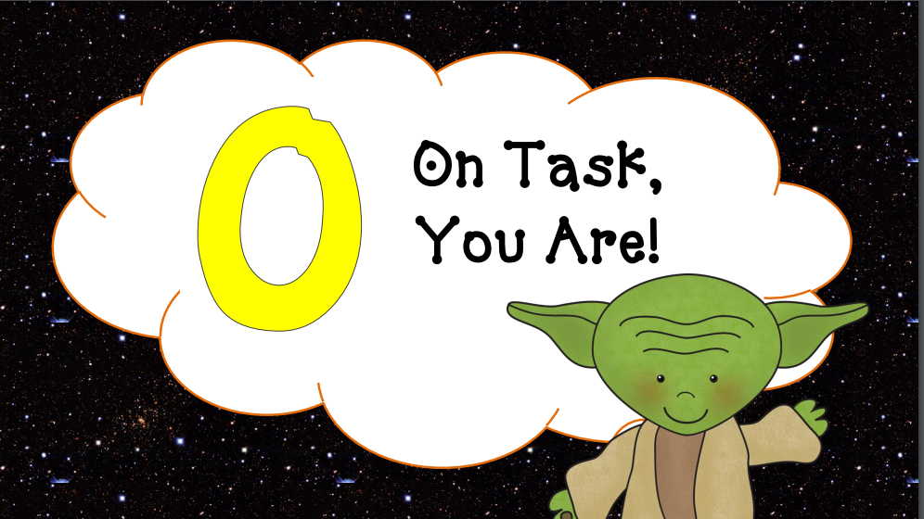

Slide 5


Slide 6
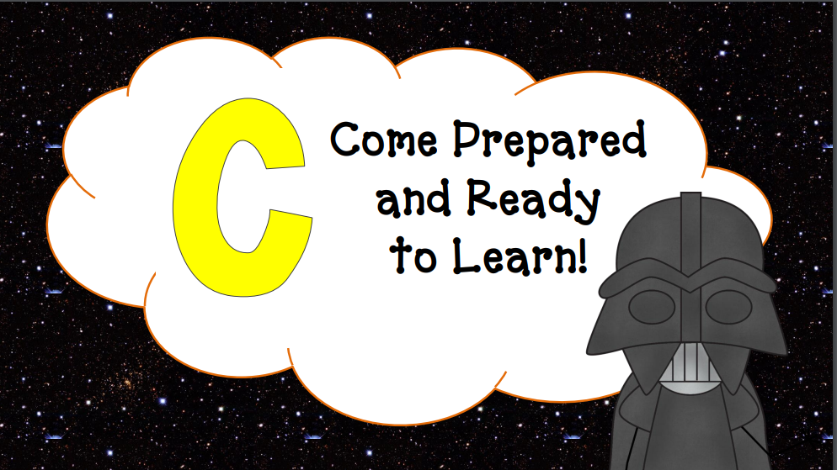

Slide 7
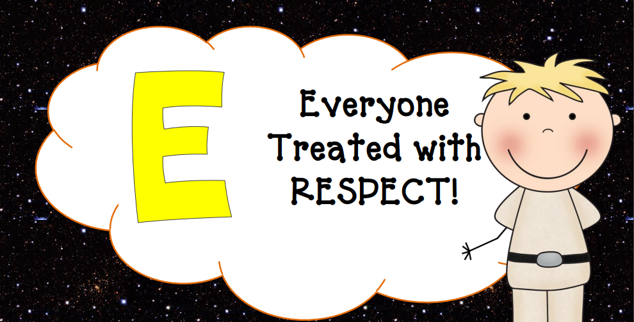

Slide 8

Classroom Rules
  Rule #1: Follow Directions Quickly
  Rule #2: Raise your hand for permission to speak
  Rule #3: Raise your hand for permission to leave your desk
  Rule #4: Make smart choices
  Rule #5: Make your dear teacher happy

Slide 9
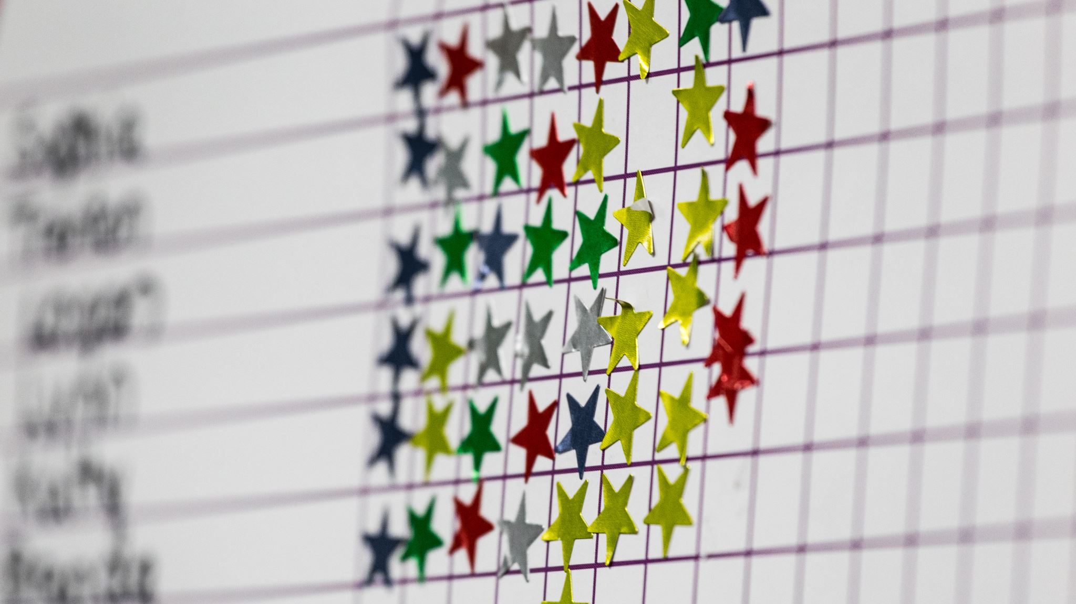
Classroom policies
1. Students may sit where they would like but if that becomes a distraction from learning you will be moved, and I will make a seating chart.
2. Phones will be put in the front of the room in the number pocket you are assigned. If I see or hear a phone that is not in the pocket they will be sent to the office.
3. No food or drink besides bottled water is allowed inside of my classroom. (Unless there is a medical reason for snacks)
4. Gum is NOT allowed during Labs!

Slide 10

Classroom Procedures

Slide 11

Entering the classroom
You must enter class QUIETLY.
Prepared to Learn
You START Class not the Teacher
Moving to your seat and Opening Activity/Bell Ringer
Walk to you seat and read the White Board for instructions – Opening Activity/Bell Ringer
Take out your school supplies and begin working you have 5 minutes for your O.A/Bell Ringer.
If you have a backpack, it should either go on the back of your chair or under the table so no one will trip over them

Slide 12
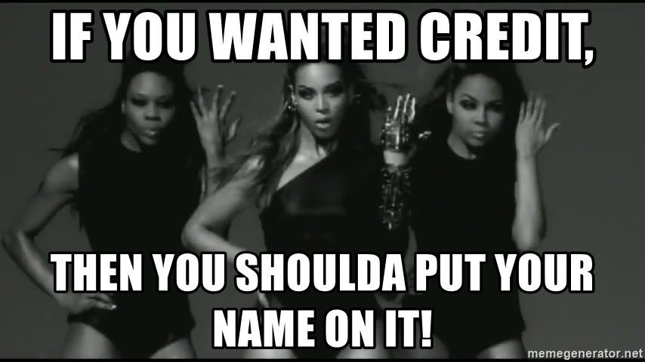
Handing in All Your Work
Put your paper in the tray labeled with your class period in the Student Center.
Make sure your name is on your paper before turning it in. ☺
Make sure you get your make up work if you were absent!!!

Slide 13
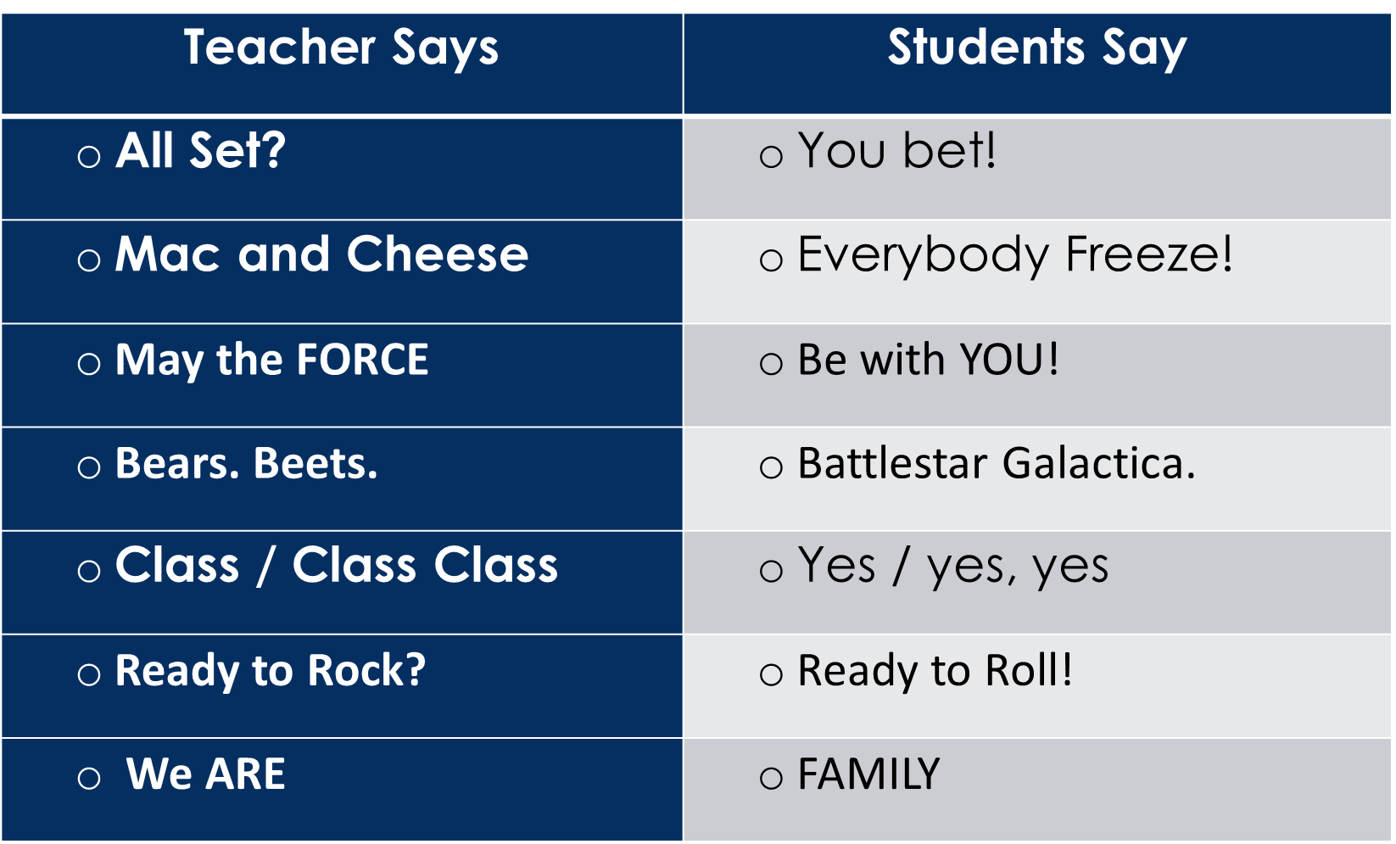

Getting Students attention
Count down from 5 – when I get to 1 students will stop talking a pay attention to the teacher.
Clap it quiet – students will repeat the clap pattern and pay attention to the teacher
Attention Call backs:

Slide 14
Hand Signals
Blow your nose, raise your hand with a piece sign.
Use the Bathroom, hold up your hand with three fingers. Mrs. Jared will then let you know whether you can go to the bathroom at that time.
See the Nurse, If you need to see the nurse hold up 4 fingers and I will come to see you to see what is wrong.
Getting the teacher’s attention – If a student needs to speak with Mrs. Jared, that student should raise their hand but not call out with their voice.

Slide 15

Movement in the classroom
Students must have Mrs. Jared’s permission to get out of their seat at any time throughout the class period. (See Class Rules)
Pencils
Pencils should be sharpened before class begins.
If your pencil is dull and you need to sharpen your pencil during class, raise your pencil in the air. If Mrs. Jared gives you permission to sharpen your pencil, only then may you quietly walk to the pencil sharpener to do so.
If you need a pencil, you may borrow one of mine during SCIENCE CLASS ONLY!

Slide 16

What to do when you finish class work early
If you have successfully completed your class work, check it over. After you have finished your work and checked it, you have three options:
Sit silently and wait for further instructions.
Take out your library (AR) book and read silently.
Finish any work in other classes or work on your i-Ready lessons.

Slide 17


Late Work
Unless you are absent, points will be deducted from work that is late.
Students will write a note to their parents about the missing homework and have it signed.
It must be turned into the teacher the next day with the missing assignment.
Required supplies
Come to class prepared with the proper supplies.
The first item you need to bring is your pencils and spiral notebook.

Slide 18
Student Materials/Class Equipment
Pencils are in the Student Center/For Science class ONLY!
Colored pencils/crayons/markers/glue sticks/scissors are found in the Student Center. Return all borrowed items as soon as you have finished using them.
Notebook paper can be found in the second drawer in the Student Center.
Do not write on the tables in our room.
DO NOT stick gum under the tables. (If I find gun under tables it will be banned)
When equipment is passed out, leave it in the middle of the table until you have been instructed to use it.
You MUST have permission to touch items in this classroom for your safety!!!

Slide 19
Trash
All garbage is to be kept at your desk until the end of class.
At the end of class, take your trash as well as any scraps on the ground near your desk and place them in the trash can.
End of class dismissal
Mrs. Jared, not the sound of the bell, will tell the class when it is time to get ready to leave.
When Mrs. Jared says, “Time to clean up,” that means that all students should silently pack up their belongings and stand up next to their chair.
When Mrs. Jared says, “Have a wonderful day,” then students may leave the classroom or talk with Mrs. Jared if they have questions.

Slide 20


Cheating policy/Visitor policy
Cheating cheats you out of your own education.
Cheating doesn’t help you learn, and we are here to learn.
The minimum punishment for cheating will be a zero on that assignment and a phone call home.
Because we are a class with high goals, we will have more visitors in our classroom than normal.
Do not be distracted by visitors, but instead, show them why we are the most successful science class.

Slide 21



Fire/Earthquake/Tornado/Emergency
For emergency drills and real emergencies, we will remain calm, leave the classroom, and walk to the appropriate place as one group
As we walk together, students will not separate from the class group

Slide 22
Signing Out of Class
To leave class at an unscheduled time, such as going to the nurse, office, or restroom, you must have Mrs. Jared’s permission.
If you have permission, sign out on the sign out sheet.
Classroom Library
You must have permission from Mrs. Jared to go to the library.
It will be a privilege to go to the library.
Make sure the library stays neat and tidy!

Slide 23




Messaging System
5th Grade 6th Grade
Microsoft Teams

Slide 24
Science Class Consequences
  Consequences for choosing to meet or exceed the expectations:
    The joy of learning
    Verbal praise
    Scientist of the Month Award

Slide 25
Consequences for choosing to not meet the expectations:
    Warning! Visual or Verbal – Make Better Choices
    Stop and Think! Stop what you are doing, think what you should be doing and make a right choice! Write on the back of the card what you were doing, sign it and date it. Then bring it to me after class.
    Think About it!
      Reflection writing assignment which is found in the Behavior Folder in the Student Center
    Parent Contact
      Students fill out a parent contact form out of the Behavior Folder found in the Student Center
    Office Visit

Slide 26
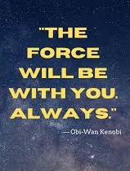

Thank you and Welcome to 6th Grade Science Class

