Slide 1
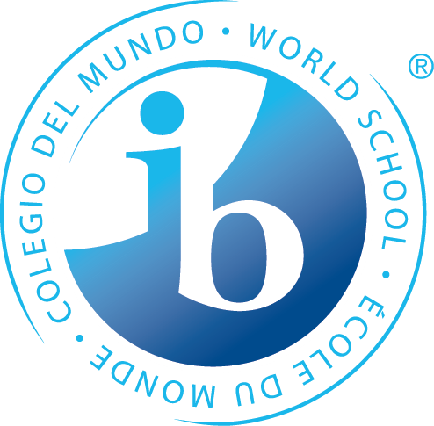
Welcome to Washburn!!!
An IB World School
Graduating Class of 2024!!
Washburn is a destination school of excellence for students from all backgrounds

Slide 2
Washburn Advanced Academic Offerings
International Baccalaureate Program (IB)
Advanced Placement (AP)
Project Lead The Way (PLTW)
CIS – MCTC partnership- Statistics
Post Secondary Enrollment Options (PSEO)

Slide 3
Course Selection Sample- see advanced course chart in folder
Your 9th grade options are listed on the top of the Yellow course chart for you
Moving into 10-12th grade, you will see a jump in advanced offerings especially in 11th and 12th grade

Slide 4
International Baccalaureate
International standard of excellence
2 year (11th and 12th grade) well rounded education program with 6 areas of study, an extended essay, and Theory of Knowledge course
Comprehensive curriculum of college level work
IB scores based on classroom work AND IB external exams
Standard Level (SL) and Higher Level (HL) courses offered
Students can choose to earn the full IB Diploma

Slide 5
What is the International Baccalaureate mission?
The International Baccalaureate Program aims to develop inquiring, knowledgeable and caring young people who help to create a better and more peaceful world through intercultural understanding and respect.

Slide 6
IB Alumni Testimonials
“ The WHS IB program helped me prepare for college by helping me learn how to study and improve time management skills. Overall I think the courses and EE were quite valuable in helping me prepare for college!” – Savannah ‘15
“Having read the amount we read in my IB classes lessened the shock factor for college because you already read so much.”-Mary Margaret ’12
“IB prepared me for college because instead of forcing individuals to only memorize information, it encouraged the consideration of diverse perspectives and the development of new arguments.” –Max ‘17

Slide 7
IB and AP Comparison-
Advanced Placement
National standard of excellence
Consists of independent courses
College level courses
AP score based solely on AP exam
AP exams are multiple choice and short answer or essay
Any student may take an AP exam
Students earn credit in individual courses

Slide 8
Current Reality 2017-2018
IB/AP Passing rates
2016-17: % of IB testing students earning a Credit Eligible Score: 70.0%
2017-18: % of IB testing students earning a Credit Eligible Score: 71.0%
AP Exam passing rate 2018-2019: 60%
AP Geography exam passing rate (scoring 3.4.5) 68%
AP US History exam passing rate (scoring 3,4,5) 64%

Slide 9

Project Lead the Way
Project Lead the Way (PLTW); Universities and colleges throughout Minnesota offer college credit recognition to students who complete PLTW foundational courses and specialty courses from certified high schools. Students must earn a class grade of 85% or higher, taken the college credit exam with a passing grade of at least 70%.

Slide 10
My Two Cents…
Everyone should take at least 1 advanced class before you graduate from Washburn
Take advanced courses you are actively interested in, not one’s that your friends take ☺
Take AVID and other coursework in 9th and 10th grade to help prepare for advanced coursework.
Take courses that will prepare you for whatever you want to do post secondary. Our goal is to provide every one of our students with a challenge!

Slide 11
Questions???
Please feel free to email me at any time with questions:
Aaron.Percy@mpls.k12.mn.us
This PowerPoint is linked under advanced academics on the Washburn webpage. Enjoy the evening! Go Millers!

