Slide 1

Good Morning!
Today: Poetry Slam
Tuesday: Beyond HS Night

Slide 2
Compare and Contrast

Slide 3
Just keep writing, just keep writing…
annotations
timed write (TW)
précis
process paper
For each:
  Define in your own words
  Give one example from class so far this year
Overall: explain how each of these types of writing are similar and how they are different!

Slide 4
Multiple Choice
AP English Language and Composition

Slide 5
Introduction to AP MC

Slide 6
Activate Prior Knowledge
We’ve talked a bit in class about AP MC. With your partners, be ready to share your knowledge about:
  Length of MC section of exam
  Time frame of MC section of exam
  Historical time frame for reading selections
  Content of questions and answers

Slide 7
Practice with Peers!
Neil Postman, excerpt from The End of Education (1995) & Q. 34-41
In groups of 3, complete the following:
Read and annotate the text accompanying the MC practice questions
Preview all the questions before you start answering them. Notice trends and big ideas
As a team, answer the questions! Remember to refer to the text, and to put the question into your own words if necessary!
Be ready to share your answers and defend them to the class ☺

Slide 8
Reflect and Apply
Take out the resource packet titled “AP English Language and Composition: Multiple Choice Questions”
Review the information and examples
Use the resource packet to label each of the questions from your MC peer practice. Write the type of question in the margins
Group debrief – who will lead this tomorrow??

Slide 9
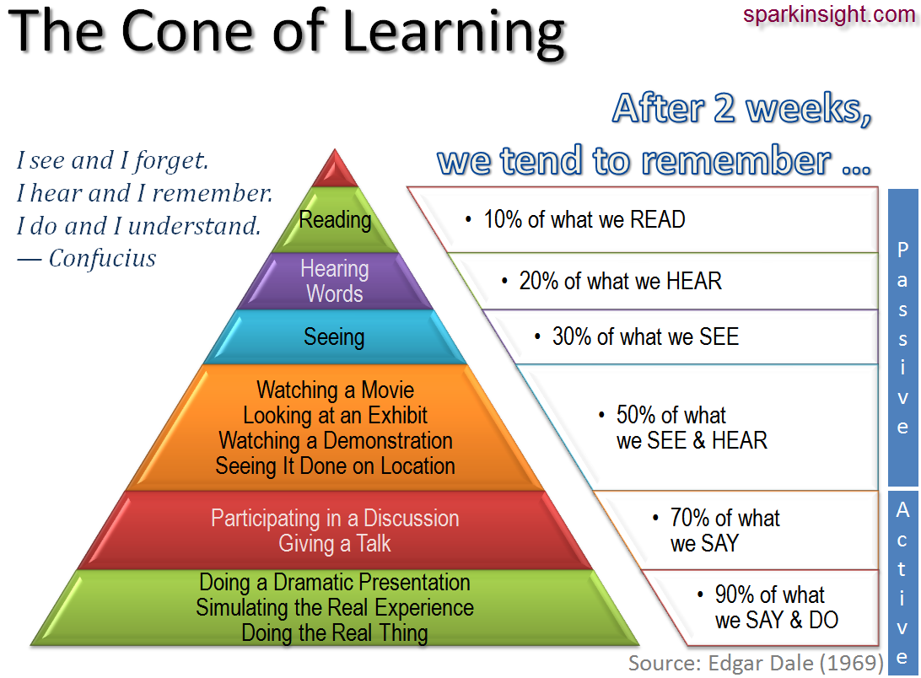
Cone of Learning

Slide 10
Make Your Own AP Questions & Answers
Text: either Jefferson OR Roosevelt
Groups of 2-3 (or individual)
Time frame:
Read & annotate the text – one paper per group
  Rhetorical analysis
  Consider elements of rhetorical précis + rhetorical devices
Create 2-3 AP questions and answers (5 options/1 correct)
Possible types of questions:
  Rhetoric (inc. syntax & diction)
    What effect?
  Meaning and purpose (inc. syntax & diction)
    Why?
  Main idea and thesis
  Organization and structure
  Patterns of development (rhetorical modes)
Use the handout as a resource!

Slide 11
Timeline
Thurs. 10/29
  Writing compare/contrast
  Pass back Unit 2 précis
  Intro AP MC – peer practice
Fri. 10/30
  Peer work – create AP MC questions and answers
Mon. 11/2
  Unit 2 RA TW
Tues. 11/3
  Intro Unit 3
  Field trip to intersection!
  HW: Carnegie & Hardin (Thurs)
Weds. 11/4
  Ball pit lesson!!!
Thurs. 11/5
  Carnegie and Hardin annot. due
  Group work/précis work

