Slide 1

Creative Foods
Continuing with breakfast… here is a great
warm – up recipe to introduce you to.

Slide 2
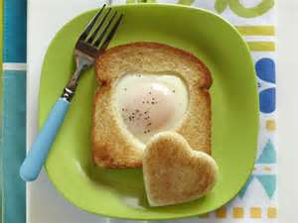
Toad - in - the - Hole

Slide 3

Exam Review
Kitchen Basics Exam:
  Wednesday, February 27, 2013

Slide 4
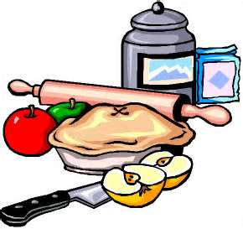
Let’s Review
Kitchen Safety and Sanitation
Types of Kitchen Equipment
Kitchen Work Centers
Recipe Skills
Measuring Ingredients

Slide 5
What is a recipe?
  A recipe is a set of directions for making a food or beverage.

Slide 6
What is included in a recipe?
  List of Ingredients and Amounts: The ingredients are generally listed in the order they are used, which makes it easier for you to follow the recipe and not omit an ingredient. Amounts of the ingredient are also given.
  Number of Servings: The recipe should indicate the number of servings or amount the recipe makes. This is known as the yield.
  Essential Information:
    Oven Temperature
    Cooking Time
    Equipment – pan size and type
  Directions: The directions should be clear and easy to follow. Steps may be numbered so you won’t skip any or lose your place.
  Nutritional Information: This information is not essential, but it can be useful in helping you choose nutritious recipes. Typically nutrition information tells you the following:
    Amount of calories in each serving
    Amount of fat in each serving
    Amount of sodium in each serving

Slide 7
How to use a recipe.
  Read all directions thoroughly before beginning.
  Gather all needed equipment and ingredients.
  Preheat and/or complete other pre-preparation steps.
  Follow directions step by step.

Slide 8
How to adjust a recipe.
  When changing the yield of a recipe, use the measuring equivalents to figure the adjusted amounts of each ingredient before you begin cooking. Write the adjusted amounts on your recipe so you will remember them as you work.
  To adjust recipes you want to use the following formula:
    Want/yield = multiplying factor
  Take the multiplying factor and multiply it by each ingredient amount

Slide 9
Measuring Ingredients
Dry Ingredients: Spoon ingredient into measuring cup until it is overfilled. (When measuring brown sugar, pack it into the measuring cup with the back of the spoon.) Use a straight-edge spatula to level off any excess.
Liquid Ingredients: Set a liquid measuring cup on a flat surface. Bend down so the desired measurement marking is at eye level. Slowly pour the ingredient into the measuring cup until it reaches the mark for the desired amount.
Fat Ingredients: Use a rubber spatula to press fats into a dry measuring cup, making sure to eliminate any air pockets. Overfill the measuring cup. Level it with a straight-edged spatula.

Slide 10

QUESTIONS

