Slide 1
Data Review and Verification Process
Judith S. Harmon
Jennifer Nairne
Assessment, Accountability, and Evaluation Division
Stars Conference
Thursday April 14, 2016

Slide 2
Tests and Reports
Graduation
Quality of Education Survey
School Based Assessment (SBA) Science
School Based Assessment (SBA) Spanish Reading
Access for ELLs
PARCC
NMAPA
DIBELS
End of Course Exams (EoC)
REPORTS
School Grading
District Report Card

Slide 3
Graduation
Reports in SOAP
  Consists of 4 Year Cohort Roster
  Consolidated Outcome Report
Graduation Rates prepared by Accountability in January
Graduation Rates posted on PED website by February

Slide 4
Quality of Education Survey
Mandated by New Mexico State Law – NMSA 22-2C-11D
Parents provide feedback on child’s education
First ten questions required by state and set by PED
Five questions set by District School Boards
but NOT required by the State
Last five questions developed by schools and teachers but NOT required by the State

Slide 5
Quality of Education Survey (QES)
Survey opens early January
E-mails sent to Superintendents about opening
Survey closes end of May
Data review – contact districts missing QES
Data validation form signed by Superintendent
and returned to PED – Accountability
Results become part of the District Report Card

Slide 6
SBA Science & SBA Spanish Reading
2015 SBA/HSGA replaced New Mexico High School Competency Exam (NMHSCE)
Proficiency required for graduation and teacher evaluation
Registration file sent to Measured Progress for SBA Science & Spanish Reading
Student IDs and information provided by STARS

Slide 7
SBA Science & SBA Spanish Reading
Testing begins in March for SBA Science
Testing begins March for SBA Spanish Reading
Data review for SBA Spanish Reading is end of April
Data review for SBA Science is early May
Final data returned to PED end of June

Slide 8
Access for ELL
Access for ELLs English Proficiency Exam
Assess development of English language proficiency K-12
Place student into proficiency levels by ELP standards

Slide 9
Access for ELLs
Develop label file in November
Data review by Accountability - attach student IDs in April
Cleaned and verified data into STARS for federal reporting by September

Slide 10
Partnership for Assessment of Readiness for College and Careers (PARCC)
Replaced SBA Reading and Math as state assessment 14-15
Math and Reading Assessments for grades 3 - 11
Student registration file prepared in November (after 40th day)
Spring PARCC test window in April
Testing ends last week in April

Slide 11
Partnership for Assessment of Readiness for College and Careers (PARCC)
PARCC summative to PED for data review end of May
PARCC summative to vendor for scores
Final PARCC summative file returned to PED by end of June

Slide 12
New Mexico Alternative Performance Assessment (NMAPA)
NMAPA is for students with severe cognitive disabilities
Tests language arts, mathematics, science and social studies
Testing end of April to early May (two weeks)
NMAPA data arrives to PED June 30

Slide 13
Dynamic Indicators of Basic Early Literacy Skills (DIBELS)
DIBELS is a reading test for K-3 grades
Purpose to identify students at risk for reading difficulties
Three assessment windows: beginning, middle, end of year
Benchmarks: Well Below, Below, Benchmark
DIBELS data to PED at end of May

Slide 14
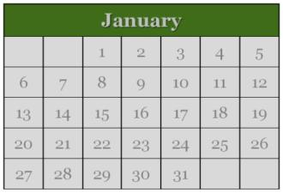
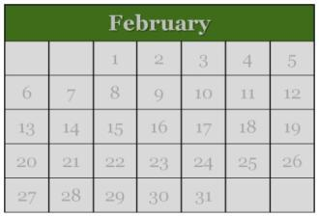
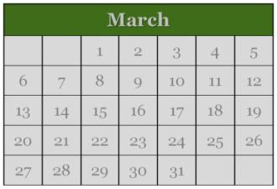
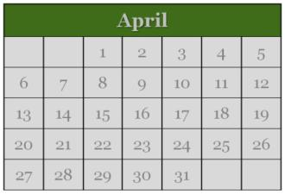
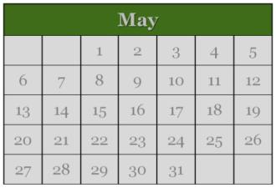
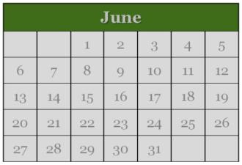
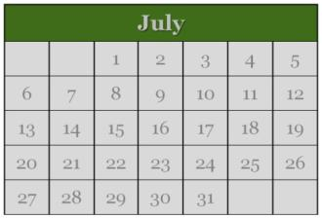
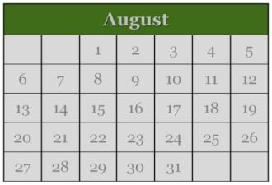
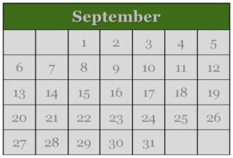
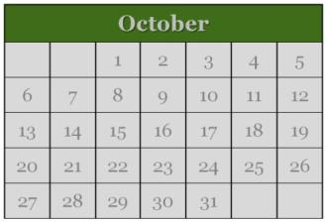
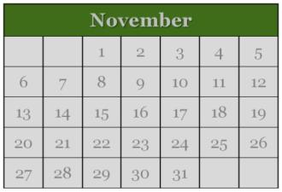
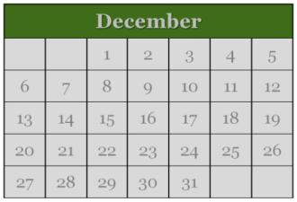
Year at a Glance
Assessments, Graduation, School Grading
Graduation
Access for ELLs
SBA
PARCC
QE Survey
CCR 1
CCR 2
EOCs
NMAPA
A-F School Grading
EOCs
NMAPA
Biodata Review
Cohort Reassignment
SBA
Retakes
LEA Report Card

Slide 15

End-of-Course Assessments
EoCs

Slide 16
EoCs
Intended as final exams
Core and elective subjects
ES, MS, HS
63 developed by PED
Course Assessment Linkage document details how assessments are linked to NMTeach

Slide 17
EoCs: Purpose
EoCs serve three purposes:
  Final exam for student assessment
  Alternative Demonstration of Competency
    High school only
    ADC Manual on AAE website
  Educator Effectiveness System (EES)
    EoCs currently used for grades 4 through 12

Slide 18
EoCs: Score Submission
EoC Data Submission Requirements
Blackboard | Paper
Districts/Charters score tests within Blackboard | Districts/Charters score tests and enter all raw scores into STARS
PED pushes scores into STARS at regular intervals | Raw scores are submitted using the STARS “Assessment Fact” template
Districts/Charters review data in STARS | Districts/Charters review data in STARS

Slide 19
EoCs: Data Review
EoC scores may be submitted to STARS at any time.
Districts/Charters are strongly encouraged to submit EoC scores before the next STARS snapshot.
All EoC tests must be submitted within 10 days of final day of school.

Slide 20
EoCs: Data Review
Districts/Charters must complete a review of all EoC data in STARS.
Two reports in “End-of-Course Exams” STARS Folder to validate EoC exams.
  End of Course Exam Assessment Fact Validation Report (Summary)
  End of Course Exam Validation with Summary Countsv2 (Detail)

Slide 21
EoCs: Important Dates
May 27th is the last day of testing on Blackboard.
Current EoC data review for 2014-2015 school year through April 30th.
EoC data review for 2015-2016 will be conducted through EOY snapshot.

Slide 22
Reports
School Grading | Cohort Data Review
PARCC SBA Spanish Reading SBA Science, DIBELS Career and College Readiness (CCR) Attendance Opportunity to Learn Survey Bonus Points | Graduation Q1Q3 Report Fall Retakes

Slide 23
Reports
District Report Card | Teacher Evaluation
PARCC SBA Spanish Reading SBA Science, DIBELS Budget School Boards CCR QES National Assessment of Education Progress (NAEP) | School Grading data End of Course Exams NM Teach

