Slide 1
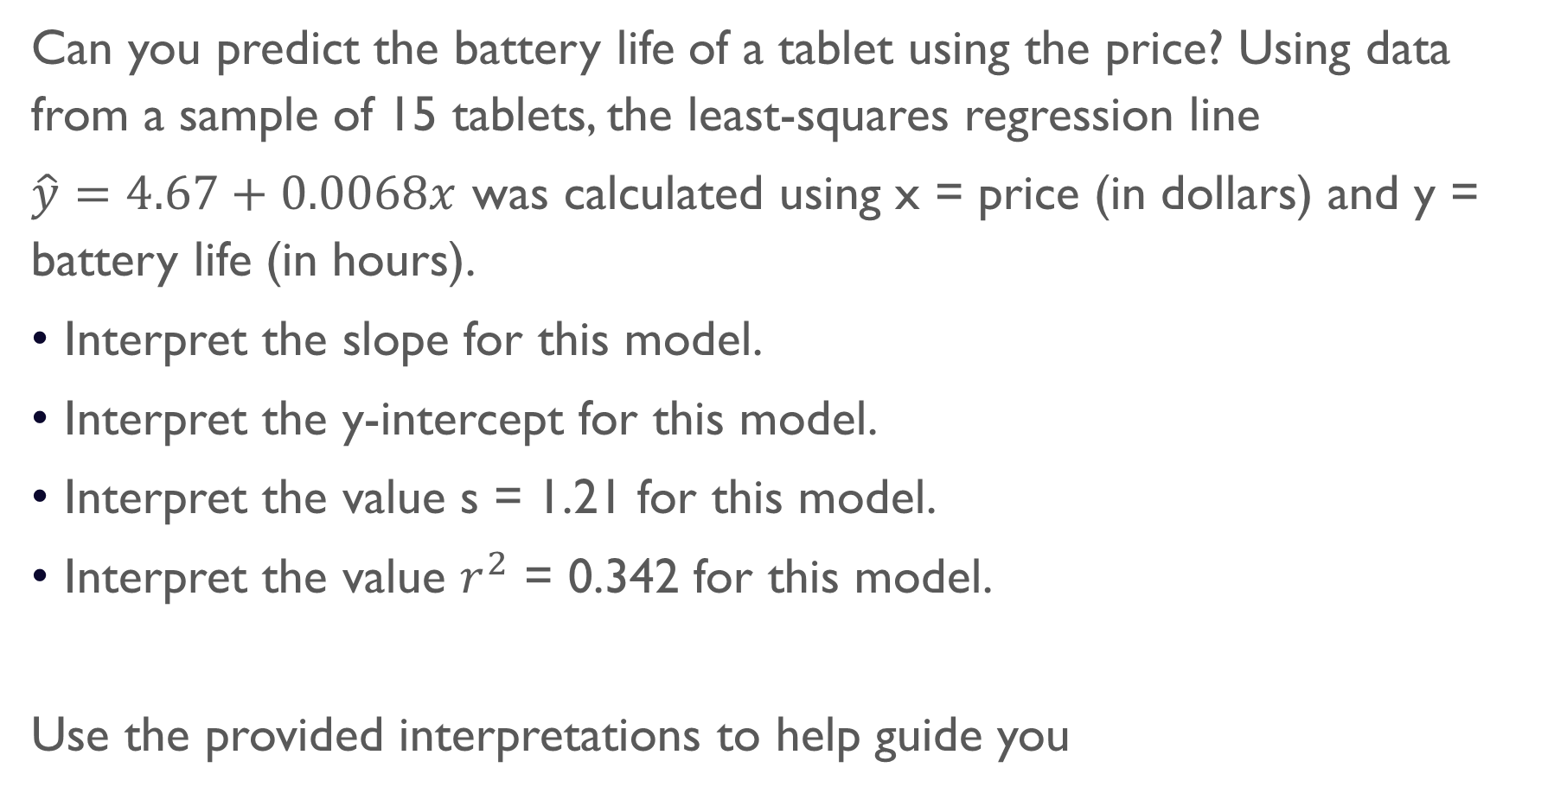
Do Now
Can you predict the battery life of a tablet using the price? Using data from a sample of 15 tablets, the least-squares regression line
$\hat{y}=4.67+0.0068x$ was calculated using x = price (in dollars) and y = battery life (in hours).
Interpret the slope for this model.
Interpret the y-intercept for this model.
Interpret the value s = 1.21 for this model.
Interpret the value $r^{2}$ = 0.342 for this model.
Use the provided interpretations to help guide you

Slide 2
Slope
With each additional dollar, the predicted battery life increases by .0068

Slide 3
Y-intercept
When the price = 0, the predicted battery life is 4.67 hours

Slide 4
Standard deviation of residuals
The actual battery life is typically about 1.21 hours away from the number predicted by LSRL

Slide 5
Coefficient of determination
About 34.2% of the variability in battery life is accounted for the by LSRL.

Slide 6
Chapter 2 Test Review

Slide 7
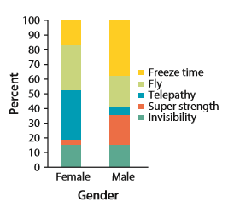
Question 1
The following segmented bar chart shows the relationship between gender and superpower preference for a sample of 200 children ages 9–17 from the U.K. Is there an association between gender and superpower preference?

Slide 8
Question 2
Identify the explanatory and response variable
The amount of time studying for a statistics exam and the grade on the exam.

Slide 9
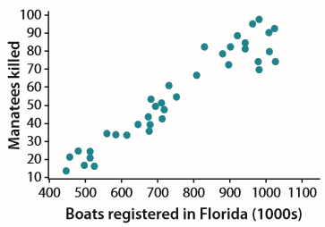
Question 3
Describe the following scatterplot

Slide 10

Question 4
Sarah’s parents are concerned that she seems short for her age. Their doctor has the following record of Sarah’s height:
Make a scatterplot of these data. Show me on our calculator. I will not give you hints on how to do it.

Slide 11
Question 5
Sarah’s parents are concerned that she seems short for her age. Their doctor has the following record of Sarah’s height:
Use your calculator to find the equation of the least squares regression line to predict height from age.
Again, I will not help you with the calculator functions.

Slide 12
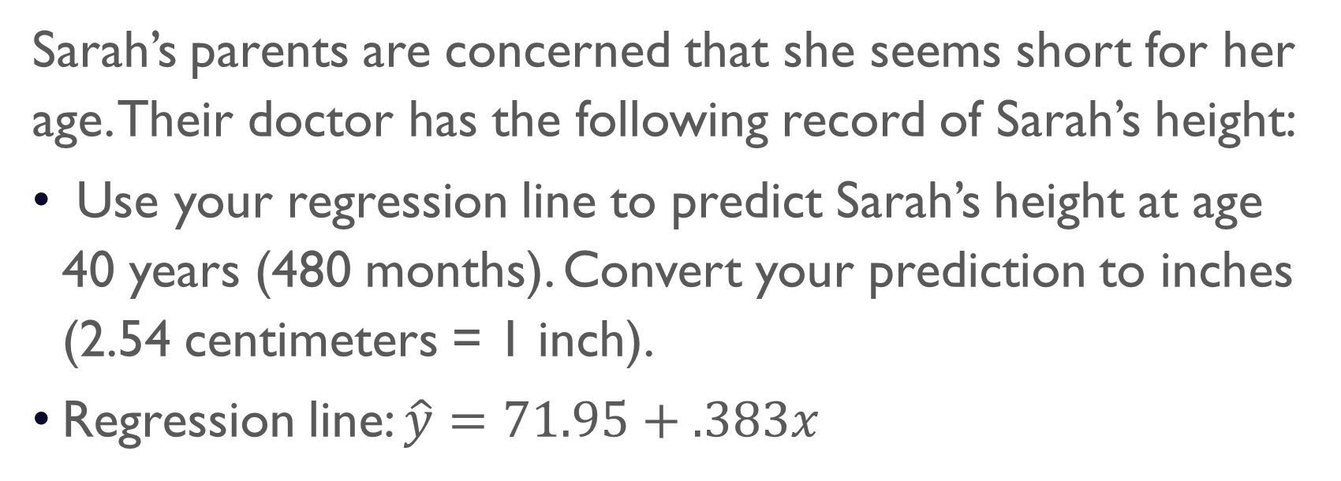
Question 6
Sarah’s parents are concerned that she seems short for her age. Their doctor has the following record of Sarah’s height:
Use your regression line to predict Sarah’s height at age 40 years (480 months). Convert your prediction to inches (2.54 centimeters = 1 inch).
Regression line: $\hat{y}=71.95+.383x$

Slide 13
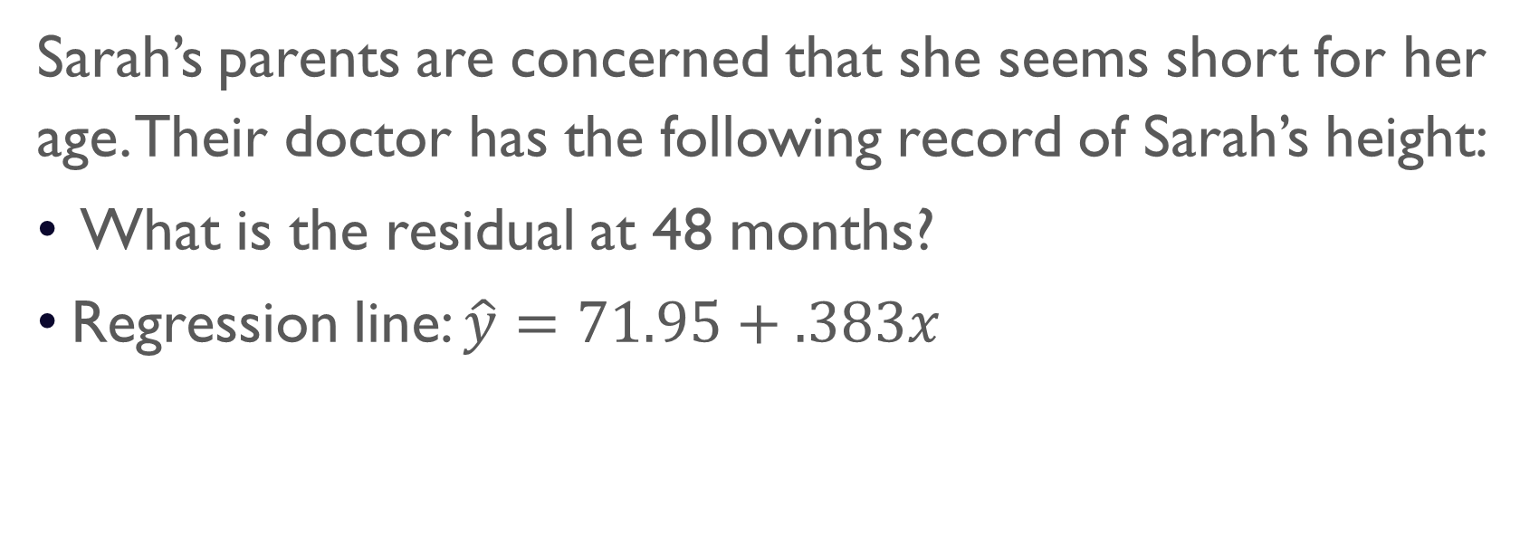
Question 7
Sarah’s parents are concerned that she seems short for her age. Their doctor has the following record of Sarah’s height:
What is the residual at 48 months?
Regression line: $\hat{y}=71.95+.383x$

Slide 14
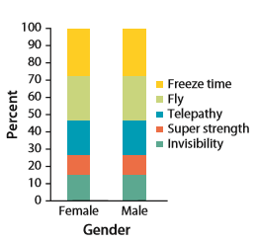
Question 8
The following segmented bar chart shows the relationship between gender and superpower preference for a sample of 200 children ages 9–17 from the U.K. Is there an association between gender and superpower preference?

Slide 15
Question 9
Metabolic rate, the rate at which the body consumes energy, is important in studies of weight gain, dieting, and exercise. We have data on the lean body mass and resting metabolic rate for 12 women who are subjects in a study of dieting. Lean body mass, given in kilograms, is a person’s weight leaving out all fat. Metabolic rate is measured in calories burned per 24 hours. The scatterplot shows the relationship between metabolic rate and lean body mass. The correlation is r = 0.88.
What would happen to the correlation if metabolic rate was plotted on the horizontal axis and lean body mass was plotted on the vertical axis?

Slide 16
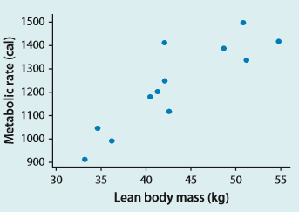
Question 9 cont…
What would happen to the correlation if metabolic rate was plotted on the horizontal axis and lean body mass was plotted on the vertical axis?

Slide 17
Question 10
What would happen to the correlation if lean body mass was measured in pounds instead of kilograms?

Slide 18
Question 11
Howard claims that the correlation between metabolic rate and lean body mass is r = 0.88 cal/kg. Is this correct?

Slide 19
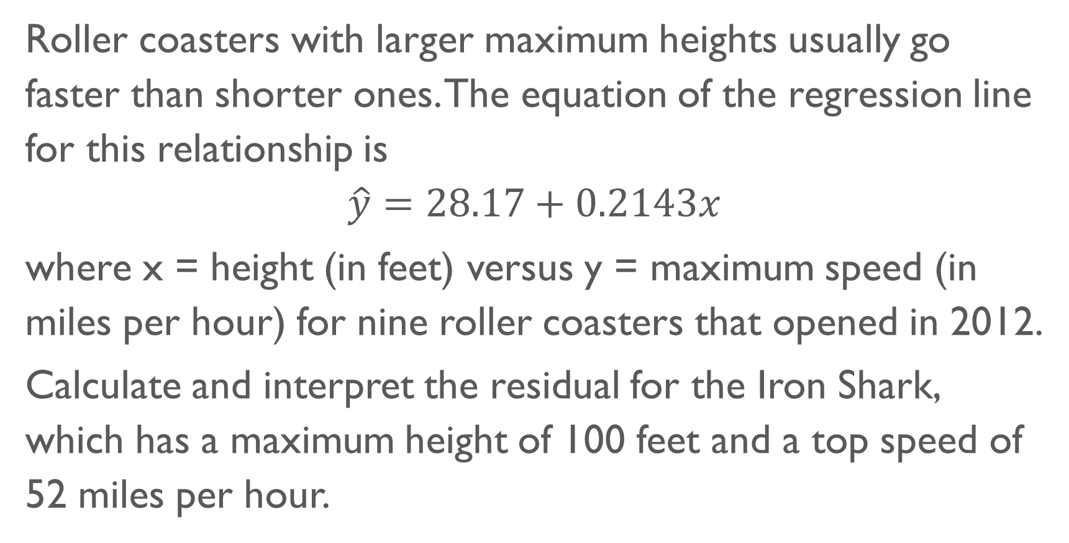
Question 12
Roller coasters with larger maximum heights usually go faster than shorter ones. The equation of the regression line for this relationship is
$$\hat{y}=28.17+0.2143x$$
where x = height (in feet) versus y = maximum speed (in miles per hour) for nine roller coasters that opened in 2012.
Calculate and interpret the residual for the Iron Shark, which has a maximum height of 100 feet and a top speed of 52 miles per hour.

Slide 20
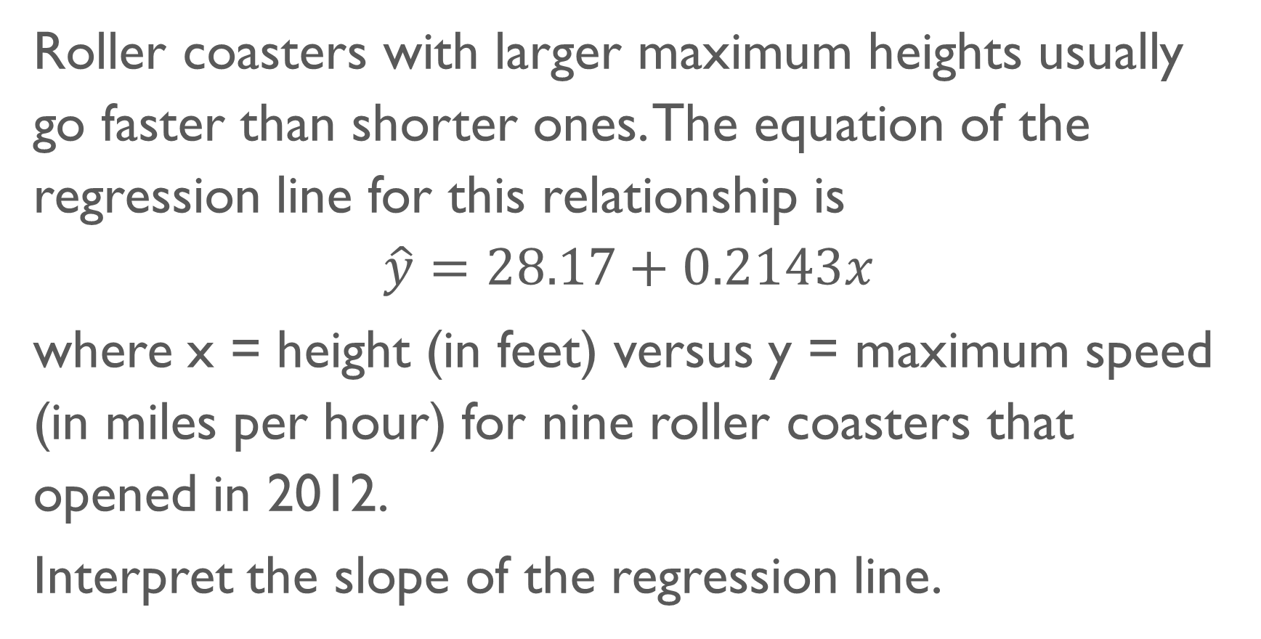
Question 13
Roller coasters with larger maximum heights usually go faster than shorter ones. The equation of the regression line for this relationship is
$$\hat{y}=28.17+0.2143x$$
where x = height (in feet) versus y = maximum speed (in miles per hour) for nine roller coasters that opened in 2012.
Interpret the slope of the regression line.

Slide 21
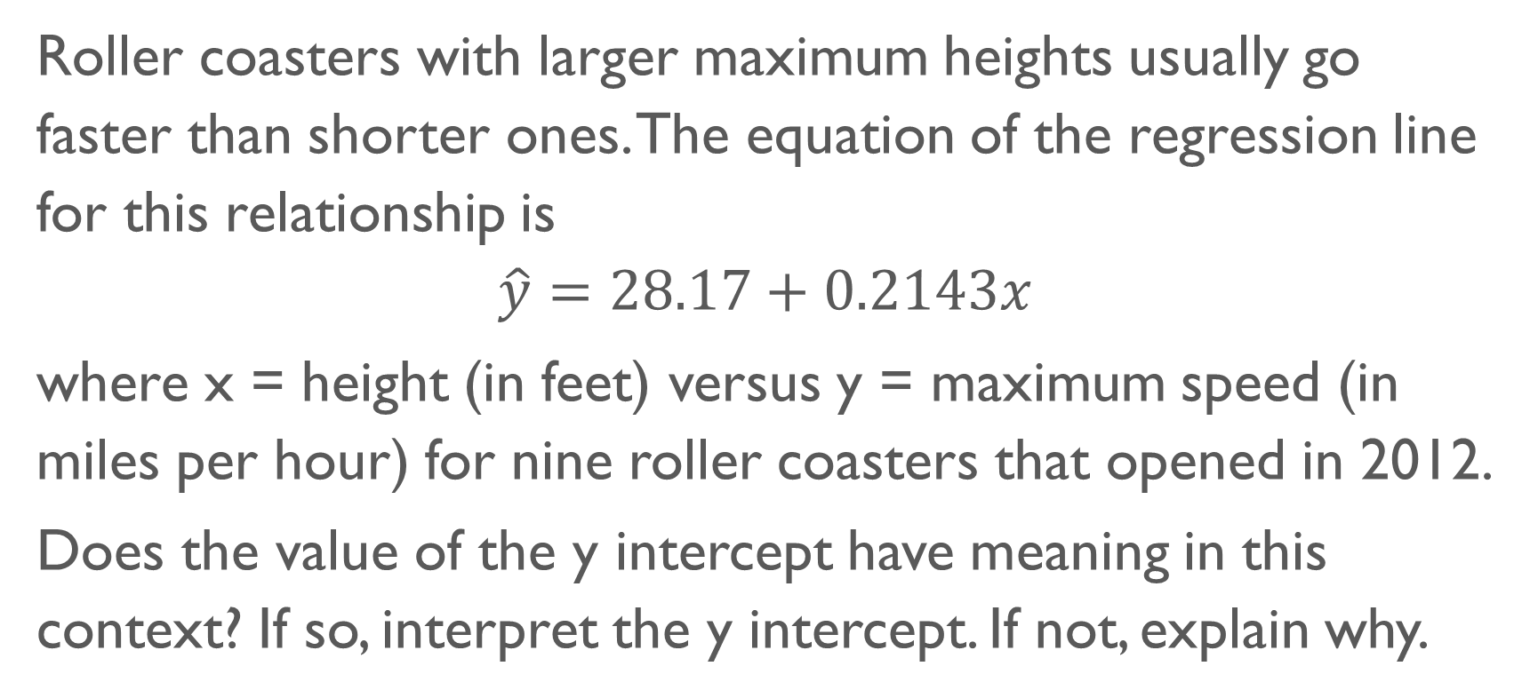
Question 14
Roller coasters with larger maximum heights usually go faster than shorter ones. The equation of the regression line for this relationship is
$$\hat{y}=28.17+0.2143x$$
where x = height (in feet) versus y = maximum speed (in miles per hour) for nine roller coasters that opened in 2012.
Does the value of the y intercept have meaning in this context? If so, interpret the y intercept. If not, explain why.

Slide 22
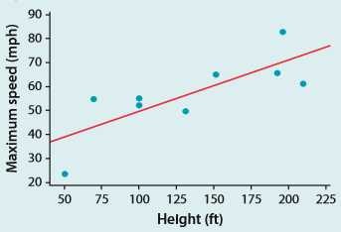
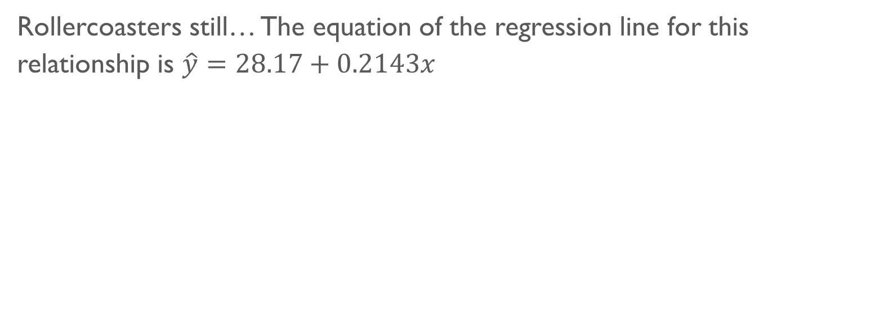
Question 15
Rollercoasters still… The equation of the regression line for this relationship is $\hat{y}=28.17+0.2143x$
What would happen to the slope if the point for the slowest and shortest roller coaster was removed?

Slide 23
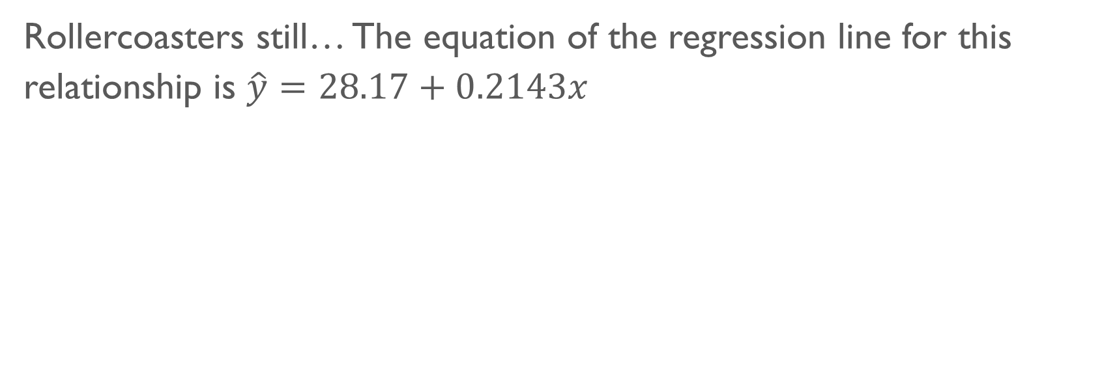
Question 16
Rollercoasters still… The equation of the regression line for this relationship is $\hat{y}=28.17+0.2143x$
What would happen to the y-intercept if the point for the slowest and shortest roller coaster was removed?

Slide 24

Question 17
Calculate the correlation.

Slide 25
Question 18
What happens to the correlation if a point (20, 19.88) was added?
r = 0.816

Slide 26
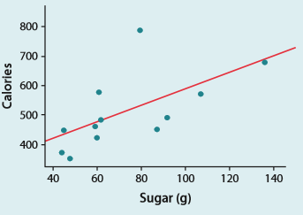
Question 19
Data were collected on a sample of 12 brands of movie candy. The scatterplot shows the relationship between x = amount of sugar (in grams) and y = number of calories, along with the least-squares regression line. The standard deviation of the residuals for this model is s = 105.5. Interpret this value.

Slide 27
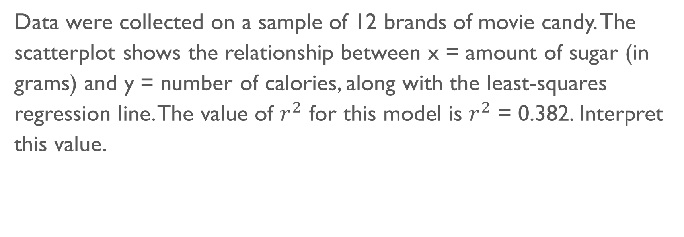
Question 20
Data were collected on a sample of 12 brands of movie candy. The scatterplot shows the relationship between x = amount of sugar (in grams) and y = number of calories, along with the least-squares regression line. The value of $r^{2}$ for this model is $r^{2}$ = 0.382. Interpret this value.

Slide 28
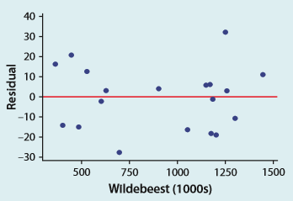
Question 21
Long-term records from the Serengeti National Park in Tanzania show interesting ecological relationships. When wildebeest are more abundant, they graze the grass more heavily, so there are fewer fires. Researchers collected data on one part of this cycle and computed a least-squares regression line relating y = the percent of the grass area burned to x = wildebeest abundance (in thousands of animals) in the same year. Here is a residual plot for this model.
Use the residual plot to determine whether the regression model is appropriate.

Slide 29
Question 21 cont.
Here is a residual plot for this model.
Use the residual plot to determine whether the regression model is appropriate.

Slide 30
Question 22
Long-term records from the Serengeti National Park in Tanzania show interesting ecological relationships. When wildebeest are more abundant, they graze the grass more heavily, so there are fewer fires. Researchers collected data on one part of this cycle and computed a least-squares regression line relating y = the percent of the grass area burned to x = wildebeest abundance (in thousands of animals) in the same year. Here is a residual plot for this model.
Interpret the value s = 15.99 for this model.

Slide 31
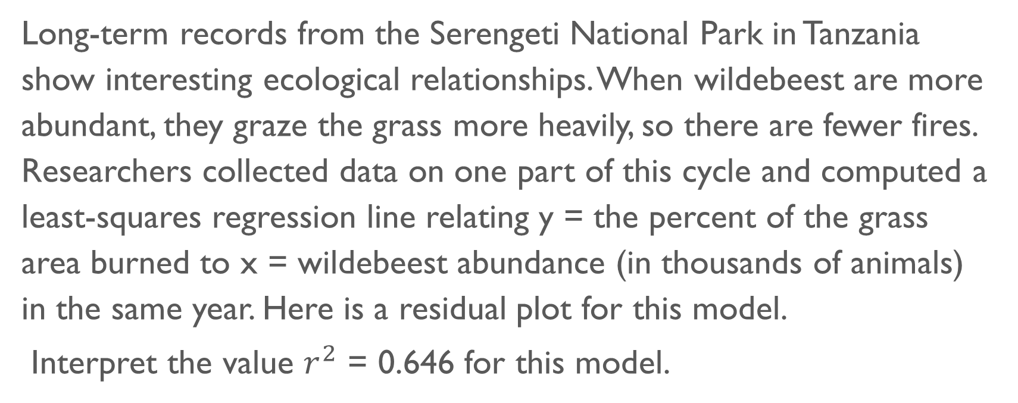
Question 23
Long-term records from the Serengeti National Park in Tanzania show interesting ecological relationships. When wildebeest are more abundant, they graze the grass more heavily, so there are fewer fires. Researchers collected data on one part of this cycle and computed a least-squares regression line relating y = the percent of the grass area burned to x = wildebeest abundance (in thousands of animals) in the same year. Here is a residual plot for this model.
Interpret the value $r^{2}$ = 0.646 for this model.

Slide 32

Question 24
A student opened a bag of M&M’S® Chocolate Candies, dumped them out, and ate all the ones with the “M” on top. When he finished, he put the remaining 30 M&M’S back in the bag and repeated the same process over and over until all the M&M’S were gone. Here are data on the number of M&M’S remaining at the end of each of the first 6 courses.
Calculate an exponential model for these data using course as the explanatory variable.

Slide 33
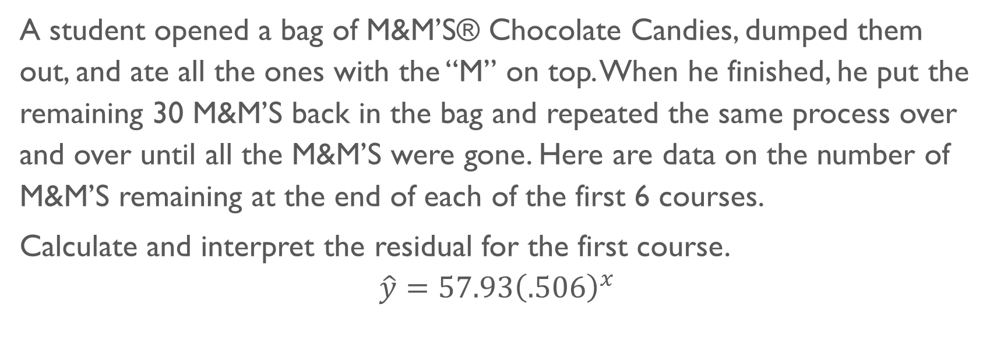
Question 25
A student opened a bag of M&M’S® Chocolate Candies, dumped them out, and ate all the ones with the “M” on top. When he finished, he put the remaining 30 M&M’S back in the bag and repeated the same process over and over until all the M&M’S were gone. Here are data on the number of M&M’S remaining at the end of each of the first 6 courses.
Calculate and interpret the residual for the first course.
$$\hat{y}=57.93{\left(.506\right)}^{x}$$

Slide 34
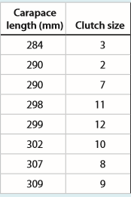
Question 26
A team of researchers measured the carapace (shell) length and clutch size (number of eggs) for female gopher tortoises in Okeeheelee County Park, Florida. Here are the data for 16 tortoises.
Calculate a quadratic model for these data using carapace length as the explanatory variable.

Slide 35
Question 27
A team of researchers measured the carapace (shell) length and clutch size (number of eggs) for female gopher tortoises in Okeeheelee County Park, Florida. Here are the data for 16 tortoises.
Calculate and interpret the residual for the tortoise with carapace length 298 millimeters.
$$\hat{y}=−.028x^{2}+16.74x −2515.29$$

