Slide 1
AP Exam Registration
2020
Timberline High School

Slide 2
What you will learn today about AP registration for 2020
When does Registration open?
Does signing up on College Board mean that an exam will automatically be ordered for me?
How much does each exam cost?
What is the time-frame to pay the regular exam fee?
How much is an exam if I order it late?
What is the time-frame to order a late exam?
What is the last date you can order an exam (includes the late-fee)?
Will you get a refund if you cancel past the last order-by date?

Slide 3
2020 Exam Fees
$98 per exam
Free/Reduced Lunch Students: No fee – check with Mrs. Olson to confirm status
Financial Assistance is Available: For students who do not qualify for Free/Reduced lunch and need assistance, see Mrs. Olson
$40 non-refundable late fee – this applies to ALL students, including students with financial need
$40 cancellation fee - this also applies to ALL students, including students with financial need

Slide 4
AP Exam Ordering & Payments
Exams will NOT be ordered unless full payment is made.
PAYMENTS: Full payment of $98 is due at the time of registration using a credit card or debit card through Timberline’s payment system @:
https://wa-norththurston.intouchreceipting.com/
**The $2 convenience fee will be waived for AP exams**
All exam orders will be placed through College Board! Class join codes can be obtained through your AP teacher
The link to the College Board will be on our website @: https://apstudents.collegeboard.org/register-for-ap-exams

Slide 5
Important Dates & Fee Information
October 1st: Online registration opens
October 1st - November 15th: ORDER YOUR EXAM!! $98/exam
November 16th - March 13th: $138/exam. During this time College Board charges a $40 LATE FEE per exam ($98/exam + $40 late fee/exam)
  **Please note, late fee will be automatically added to the fines list
March 13th @ 8:59 PM: ordering is closed
May 4th – May 15th: Take your exams

Slide 6
Cancellation Fees
Per College Board Policy:
  If you cancel an exam between November 16th - March 13th, a $40 fee will be charged. This is an increase from last year
  After March 13th, there will be NO REFUNDS

Slide 7
AP Rules, Procedures, Policies
All AP policies are non-negotiable & are established/enforced by the College Board
Common Questions/Concerns:
        Exam Dates/Times are set nationwide & cannot be changed
        Absolutely no electronics allowed in testing site (except approved calculators for math/science)
            Leave cell phones behind
        No food or water allowed in testing site
        Teachers cannot be present at site during exam day
        Arrive early & plan to stay until end of test – no late arrivals/early dismissals on test day

Slide 8
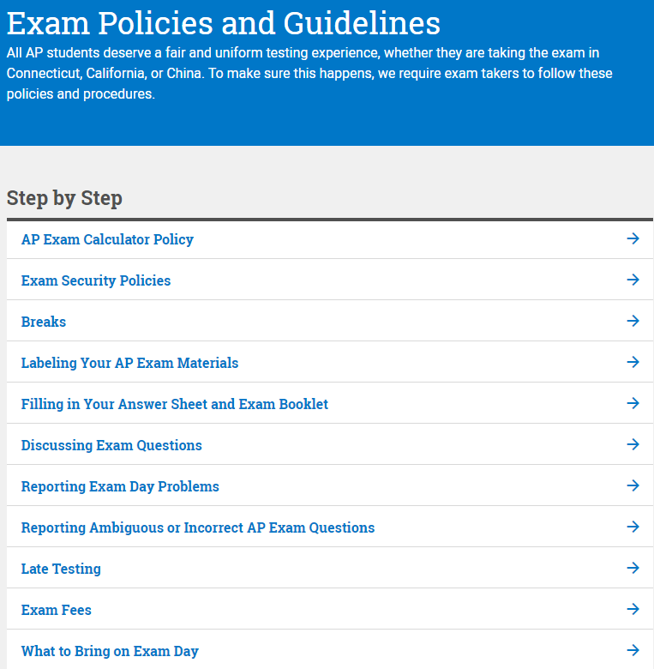
AP Guidelines
Please take the time to read through these guidelines. This is a good resource on what to expect the day of the exam
https://apstudents.collegeboard.org/exam-policies-guidelines

Slide 9
What do you know?
When does Registration open? October 1st
Does signing up on College Board mean that an exam will automatically be ordered for me? NO!! You must also pay the fee online through our payment portal
How much does each exam cost? $98
What is the time-frame to pay the regular exam fee? 10/1 – 11/15
How much is an exam if I order it late? $138 ($98/exam + $40 late fee/exam)
What is the time-frame to order a late exam? 11/15/19 – 3/13/20
What is the last date you can order an exam (includes the late-fee)?
March 13th, 2020
Will you get a refund if you cancel past the last order-by date? No

Slide 10
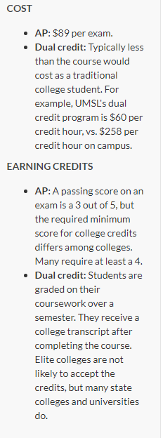
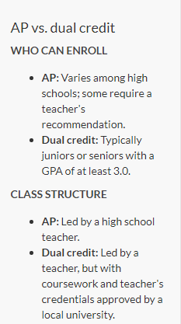
CiHS 0r AP
There are benefits to either of these options
https://www.stltoday.com/news/local/metro/ap-courses-vs-dual-credit-what-s-best-for-high/article_32de45f2-37e8-572c-a01a-aa7726797e62.html

Slide 11
Questions?
Contact April Olson @
360-412-4867 or aolson@nthurston.k12.wa.us

