Slide 1
Registration 2019-20
Parent Registration Information
GHS Counseling Center

Slide 2
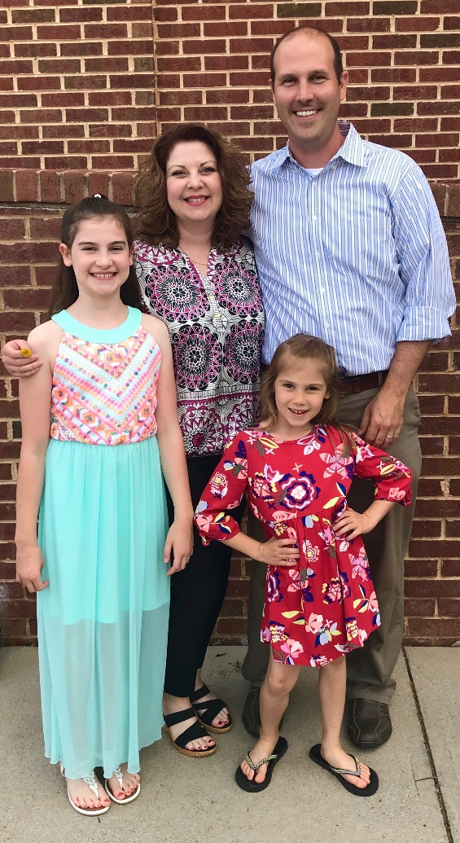
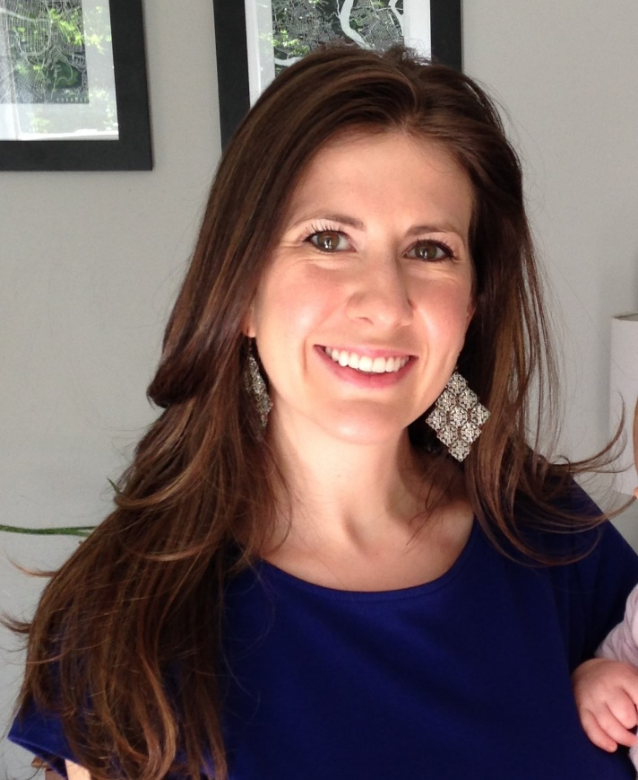
Counselors
Gwyn Noell, Coordinator
Last Names A – L (10-12)
Last Names A – K (8 & 9)
Kelley McCall, Counselor
Last Names M – Z (10-12)
Last Names L – Z (8 & 9)

Slide 3
Overview
Registration Process
Diploma Types & Graduation Requirements
RCPS Online
AP and DE
Out-of-building electives
Questions

Slide 4
Registration Process
Students fill out Registration Form during registration presentation in class
Students will enter Course Requests in Synergy in class with Counselors
Counselors review Course Request individually with each student based on:
  Teacher Recommendations
  IEP Accommodations (if applicable)
  College and career goals
  Student’s progress toward graduation
Student Request Verification (SRV) given to students via homeroom (English 8 for 8th grade students)
  MUST be signed by parent/guardian and returned to school by deadline
  Changes can be indicated on the SRV, signed, and returned (may require additional forms)

Slide 5
Teacher Recommendations
Teachers in core classes (English, Science, Math, Social Studies) and World Languages (if applicable) make recommendations for the next level of class that the student should take based on many factors.
The goal of teacher recommendations is for the student to be placed in the most appropriate course to ensure their success next year.
During the registration process, we (Counselors) rely heavily on the teacher recommendation when working with students.
Students are provided a copy of their recommendations to take home to discuss with their parents and are given a copy to use during registration.

Slide 6
Diploma Types
Course | Advanced Studies | Standard
English | 4 | 4
Math | 4 | 3
Science | 4 | 3
Social Studies | 4 | 3
Health/PE (CPR/AED - 9th) | 2 | 2
World Language | 3 or 4 | -
Econ & Personal Finance | 1 | 1
Online Course Req | 1 (included in Econ course) | 1 (included in Econ course)
Fine Arts/CTE | 1 | 2 (can be World Lang.)
Industry Credential | - | 1
Electives | 2 or 3 | 4 (2 must be sequential)
TOTAL | 26 | 22

Slide 7
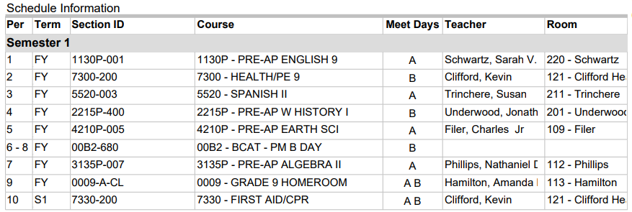
Sample Schedule
A Day
1A – English
3A – Language/Elective
5A – Science
7A - Math
B Day
2B – Health/PE
4B – Social Studies
6B – Elective
8B - Elective
*This is an example of a schedule. Your child’s schedule will be based on their request and scheduling.

Slide 8
RCPS Online
1 FREE RCPS Online course (except AP Psychology)
Additional courses - $400 each
  AP Psychology is Supplemental Only and is $400.00
Must take a Study Hall with RCPS Online course
1 credit course is taken in a semester, with the exception of DE Government, DE English 11, and DE English 12
Make sure it is a good fit!
  Requires motivation, ability to work independently, good communication, internet & computer access outside of school, and ability to ask for help when needed.

Slide 9
RCPS Online Courses
English 10
PreAP English 10
AP English 11
DE English 11
CB English 11
CB English 12
AP English 12
DE English 12
US/VA History
AP US History
US/VA Government
DE US/VA Government
AP US Government & Politics
Geometry
Algebra 2
Precalculus
DE Precalculus
Earth Science
Pre-AP Earth Science
Ecology
Economics & Personal Fin.
DE Economics & Personal Fin.
AP Psychology (supplemental only - $400)

Slide 10
AP vs. DE
AP – Advanced Placement
  College credit earned based on score (1-5) on AP exam in May (check with college admissions office/website)
  AP exam cost: $94 (set by College Board annually)
  Nationally recognized by colleges and universities (check with college you are interested in for score requirements and credits earned)
DE – Dual Enrollment (application materials due by March 16)
  Must apply to VWCC and meet course prerequisites (VPT/PSAT/SAT/ACT score)
  College credit earned by passing class – can only transfer C or above
  Transferrable to any Public College/University in VA, as well as many other private and out-of-state schools (check with college admissions office/website)
  Current cost: $53/VWCC credit hour (RCPS will announce price in spring/summer)
Some courses taught simultaneously as AP/DE
  Students only earn DE credit if enrolled as DE, but both can take AP exam
  If Dual Enrollment is no longer taught, we will transition students to equivalent AP course
Courses are designed to have college-level rigor
Weighted GPA (5.0 on a 4.0 scale)
For more info, please visit website: https://www.rcps.us/Domain/160

Slide 11
AP and DE Courses at GHS
Advanced Placement:
  AP World History
  AP US History*
  AP US Government & Politics*
  AP English 11 (Language)*
  AP English 12 (Literature)*
  AP Calculus AB
  AP Calculus BC
  AP Statistics
  AP Latin
  AP French
  AP Spanish
  AP Studio Art
  AP Biology (2 blocks)
  AP Chemistry (2 blocks)
  AP Physics (2 blocks)
  AP Psychology (RCPS Online ONLY)*
Dual Enrollment:
  DE English 11*
  DE English 12*
  DE US/VA Gov (RCPS Online Only)*
  DE US/VA History
  DE Precalculus*
  DE Calculus AB
  DE Calculus BC
  DE Chemistry
  DE Architectural Drawing/DE Engineering Drawing
* Course is offered through RCPS Online

Slide 12
Program Options
Out-of-building electives/programs:
BCAT - Applications due January 18 (online app) for 9-11 graders (GMS has different deadline)
  Classes are 2 blocks (A1, B1, or B2) and 2 credits
  Must provide own transportation to BCAT (7:30) or GHS (6:50) if A1 or B1
Roanoke Valley Governor’s School for Science & Technology
  For advanced students enrolled in Geometry as 8th graders
  Must attend one of the information meetings
    January 3, January 10, January 17 (other dates upon request)
    All meetings are at RVGS campus at 6:30pm (Patrick Henry HS)
    Attendance required in order to apply
Virginia Western Regional Academy for Advanced Technology - Applications due in March
  Mechatronics, Engineering, Pre-Health Programs
  Meet daily at VWCC 8:00-10:30 (4 classes at GHS)
  Rising 11th graders
  Must provide own transportation
  Pay full tuition to VWCC (not DE price)
  Apply through VWCC website: https://www.virginiawestern.edu/academy/index.php

Slide 13
BCAT
Auto Service
Building Trades
Computer Info Tech
Cosmetology
Criminal Justice
Culinary Arts
Early Childhood Education
EMT (must be 16)
Game Design & Programming
Intro to Nursing Careers
Masonry
Motorsports
Networking
Robotics/Mechatronics
Teaching Internship
Welding
Specialty Centers:
  Mass Communication
  Engineering
  Performing Arts
  Visual Arts & Museum Studies
Apply Online by Jan 18!
BCAT courses require an application unless students are continuing in a BCAT Program.
Application is ONLINE this year! Click here: https://www.rcps.us/domain/1394

