Slide 1
New Teacher Orientation
August 27, 2020
Caroline Onyesonwu
Supervisor
Bilingual/ESL/World World Languages

Slide 2
AGENDA
Opening Activity: My Multicultural Self
Languages in Orange School District
Student Placement
Can-Do-Descriptors for English Language Learners
Comprehensible Input – Video
List of Supports for ELLs
Accommodations in the Content Area Classrooms
Survey – Sheltered English Instruction (SIOP)/Co-Teaching

Slide 3
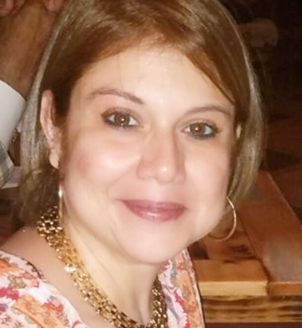
Activity: My Multicultural Self
Directions:
Think of yourself or a favorite person
Write down the names of groups you identify with (e.g. teacher, mother)
Share your answers – volunteers
Discuss a time when you were proud to be a member of a group - volunteer
Discuss a time when it was painful to be a member of a particular circle - volunteer

Slide 4
Languages in Orange School District
https://docs.google.com/spreadsheets/d/1--k1FmlKVRvRUSv913-5oHi19RpTCTNP/edit#gid=878309114
https://docs.google.com/spreadsheets/d/1--k1FmlKVRvRUSv913-5oHi19RpTCTNP/edit#gid=1090585609

Slide 5

Student Placement
Intake form/placement test/ACCESS test determine English Language Proficiency (ELP) of the students:
  ELP Level 1: Entering
  ELP Level 2: Emerging
  ELP Level 3: Developing
  ELP Level 4: Expanding
  ELP Level 5: Bridging
  ELP Level 6: Reaching

Slide 6
English Language Development Standards
Standard 1 – Social and Instructional Language
English language learners communicate for social and instructional purposes within the school setting.
Standard 2 – Language of Language Arts
English language learners communicate information, ideas and concepts necessary for academic success in the content area of language arts.
Standard 3 – Language of Mathematics
English language learners communicate information, ideas and concepts necessary for academic success in the content area of mathematics.
Standard 4 – Language of Science
English language learners communicate information, ideas and concepts necessary for academic success in the content area of science.
Standard 5 – Language of Social Studies
English language learners communicate information, ideas and concepts necessary for academic success in the content area of social studies.

Slide 7
WIDA CAN-DO DESCRIPTORS
Grade Pre-K: https://wida.wisc.edu/sites/default/files/resource/CanDo-Descriptors-Early-Years.pdf
Grade K: https://wida.wisc.edu/sites/default/files/resource/CanDo-KeyUses-Kindergarten.pdf
Grade 1: https://wida.wisc.edu/sites/default/files/resource/CanDo-KeyUses-Gr-1.pdf
Grades 2-3: https://wida.wisc.edu/sites/default/files/resource/CanDo-KeyUses-Gr-2-3.pdf
Grades 4-5: https://wida.wisc.edu/sites/default/files/resource/CanDo-KeyUses-Gr-4-5.pdf
Grades 6-8: https://wida.wisc.edu/sites/default/files/resource/CanDo-KeyUses-Gr-6-8.pdf
Grades 9-12: https://wida.wisc.edu/sites/default/files/resource/CanDo-KeyUses-Gr-9-12.pdf
Can do name charts: https://wida.wisc.edu/sites/default/files/resource/CanDo-Descriptors-Student-Name-Charts.pdf

Slide 8
Factors Affecting Second Language Acquisition
Age
Socioeconomic status
Classroom culture
Cognitive development in home language
Family support
Whether environment provides adequate L2 input
Literacy level
Stage in acculturation
Whether school environment provides language use opportunities
Reason for coming to the U.S.
Attitudes toward second culture
Literacy in home language
Maintenance of home language
Motivation
Expectations of child
Sense of identity in the classroom
How host culture views student's culture
Proficiency in the home language
Facility with English and ability to help child
Role models in the community
Date of arrival in the U.S.
Personality
Whether student has enough opportunities to use English
Teacher's expectations
Preferred learning

Slide 9
Clarifying the Roles of the Content and ESL Teachers
Content: content objectives - same for all students; content assessments; language objectives - differentiated
ESL Teacher: language objectives; language assessments – differentiated
Points of Collaboration: ELD Standards, language of the content areas; language objectives; differentiation strategies for ELLs; common formative assessments (rubrics, portfolios)

Slide 10
Collaborating with the ESL Teacher
Lesson plans
Whole Group
Small Groups
Resources for students
Adaptations/Modifications
Assessments/Grades

Slide 11
Collaborating with the ESL Teacher
Whole Group Opening
Teacher-Directed Instruction: teacher presents new material
ESL Teacher-Directed Instruction: ESL teacher presents new material
Student-Directed Activity Students work on activities related to new materials presented
Teacher-Directed Instruction: teacher presents new material
Student-Directed Activity:Technology Center
ESL Teacher-Directed Instruction:ESL teacher presents materials
Student-directed Instruction: students work in groups on previously taught materials
Whole Class: Application Activity Closure

Slide 12
Co-Teaching Approaches
One teaching-one observing
One teaching-one circulating (both teachers take turns leading lessons)
Team Teaching (both teachers share the lead)
Station Teaching (both teachers supervise centers or stations)
Parallel teaching/split class
Small group pull out

Slide 13
Comprehensible Input – Video
https://www.youtube.com/watch?v=2jRhzyIKymg
Rhode Island Teachers of ELLs Projects (RITELL)
http://www.ritell.org/Language-and-Country-Projects

Slide 14
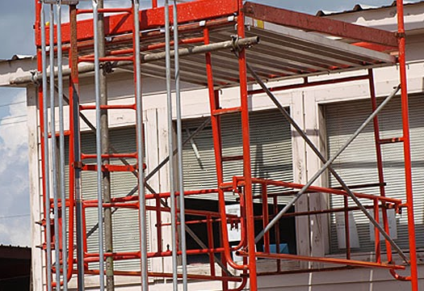
List of Supports for ELLs
https://docs.google.com/document/d/16Tt1XBgg4VPz0-s6MVgrp9fAPZQu6QoiEUpviebghHI/edit
This Photo by Unknown author is licensed under CC BY.

Slide 15
Accommodations in the Content Area Classrooms
Accommodations for ELLs in the content areas of:
Testing Accommodations & Modifications
Mathematics
Social Studies
Reading
Science
Writing
https://docs.google.com/document/d/1IGbnysxbBFAjazTJw6_fIjgmZzQk7RDdWFuPkPg6s9o/edit
Classroom & assignments
Testing accommodations
Testing Modifications
https://docs.google.com/document/d/1IGbnysxbBFAjazTJw6_fIjgmZzQk7RDdWFuPkPg6s9o/edit

Slide 16
Resources
https://www.teachingchannel.org/blog/2018/03/02/engaging-newcomers-enlace
ELLs in their own words: https://docs.google.com/document/d/1XYOWV2z-oleYhGBL_3G9DLN1Hvp7xdy3eF36cweOW-I/edit?usp=sharing
https://docs.google.com/document/d/1e0HGPV_2fBTpuw0-wZO1sfePClMZF1vB34qyQxXjlxg/edit?usp=sharing
https://docs.google.com/document/d/193fzyc9Qxzj-jMxZPbIuqgI0q8keGBEcGPJVh7CEUqA/edit?usp=sharing

Slide 17
Survey – Sheltered English Instruction (SIOP)/Co-teaching
This survey will help us properly schedule Professional Development for teachers in:
Sheltered English Instruction (SEI or SIOP).
Co-Teaching
https://docs.google.com/forms/d/1PM1P0IspoCRNgadaM7XSA98BGbOsYO3jwcZBbNshD0E/edit
.

Slide 18

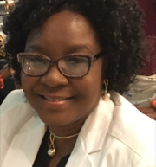
Q & A
CONTACT INFORMATION
Caroline A. Onyesonwu
973-677-4000 ext. 6099
Onyesoca@orange.k12.nj.us

