Slide 1

Welcome
Please make sure your audio works.
Introduce yourself by typing your name and school in the chat box.
Program Presentation
Your microphone will be muted for the presentation.
Q&A
Please enter your questions for the Q&A into the chat box.

Slide 2
Presented by
_______________
An Evening with
Chris Crutcher:
The Truth in Fiction
Chris Crutcher
Author &
Former Child and Family Specialist
1998 NCTE Intellectual Freedom Award
2000 ALA Margaret Edwards Award
Sigma Tau Delta Honorary Member

Slide 3
Writing Triggers
Running Loose, 1983, written out of anger
True story of racially bigoted coach
The happening that led to the text
The emotional truths of the characters involved
USA Today list of top-ten banned books that year
Since then, all my books have been challenged or banned

Slide 4
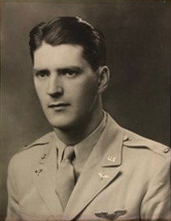
First Amendment Rights
Going to “battle” about censorship
Fighting for our right to write and read ideas
Line between defenders of the First Amendment and religious/political conservatives

Slide 5
The Fight Itself
“Responsible” adults needing to control what children under 18 see/read
“Other side” holds to conviction that control can’t and shouldn’t be done
    Kids’ brains developing
    Responsibility for thinking resides within individual

Slide 6
Writers and Readers
Strategies of the writer writing truths in fiction
Readers finding own truths in reading

Slide 7

First Person Narrator
Intimacy between narrator and reader
Harper Lee’s crafting of the intimacy of Scout

Slide 8
Emotional Truths
Whale Talk
Readers encountering emotional truths
Further Examples

Slide 9

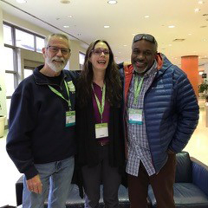
Laurie Halse Anderson

Slide 10
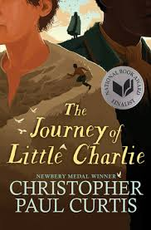
Christopher Paul Curtis

Slide 11
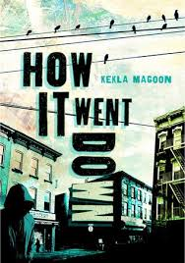
Kekla Magoon
How It Went Down

Slide 12
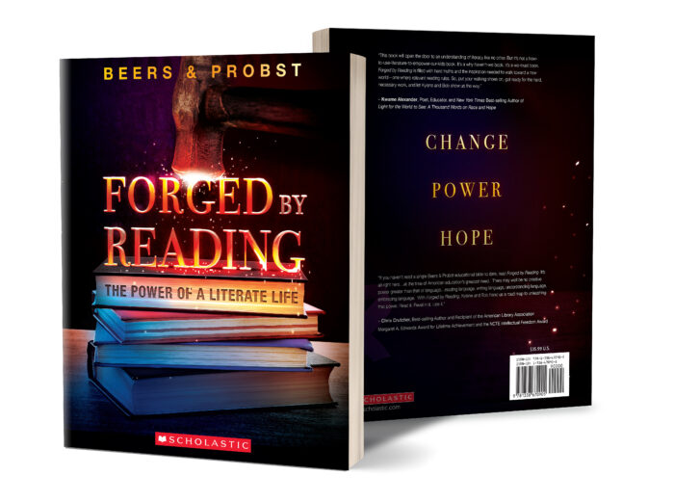
Kylene Beers & Bob Probst
Forged by Reading: The Power of a Literate Life

Slide 13
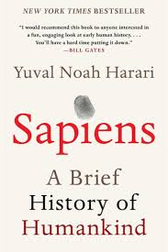
Yuval Noah Hrari
“Fictions” more important than “fire,” setting Homo Sapiens on our way
Telling our fictions, the best, detailed, exact truths may save us

Slide 14
NCTE Resources
Intellectual Freedom Center
https://ncte.org/resources/ncte-intellectual-freedom-center/
Position Statement on Independent Reading
https://ncte.org/statement/independent-reading/
Position Statement on Students’ Right to Read
https://ncte.org/statement/righttoreadguideline/
Guidelines for Dealing with Censorship of Instructional Materials
https://ncte.org/statement/censorshipofnonprint/
NCTE Position Statement Regarding Rating or “Red-Flagging” Books
https://ncte.org/statement/rating-books/

Slide 15
Resources –Titles
Crutcher, Chris
---. Running Loose. 1983.
---. The Crazy Horse Electric Game. 1990
---. Chinese Handcuffs. 1989
---. Athletic Shorts: Six Short Stories. 1991
---. Staying Fat for Sarah Byrnes. 1993
---. Ironman. 1995.
---. Whale Talk. 2001.
---. King of the Mild Frontier: An Ill-Advised
Autobiography. 2003
---. The Sledding Hill. 2005.
---. Period 8. 2013
---. Losers Bracket. 2018
Other Authors
Anderson,Laurie Halse. Speak. Macmillian Children’s Publishing Group.1999.
Beers, Kylene and Bob Probst. Forged by Reading: The Power of a Literate Life. Scholastic. 2020.
Curtis, Christopher Paul. The Journey of Little Charlie. Scholastic Press. 2018.
Harari, Yuval Noah. Sapiens: A Brief History of Humankind. McClelland and Stuart. 2014
Magoon, Kekla. How it Went Down. Macmillan. 2014.

Slide 16
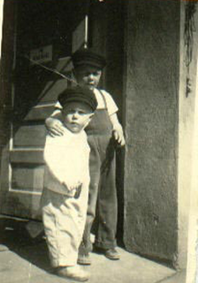
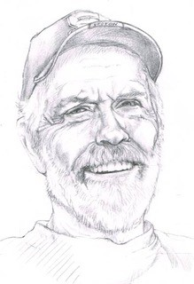
Contact Chris Crutcher
Email: stotan717@gmail.com

