Slide 1
DHS English Department
Karen Baynes - Grade 12
Mark Brown - Grade 12 and Journalism
Denise Burnham - Grade 10
Nancy Chadwick - Grade 9
Mary Ciccarelli - Grades 10 and 12
Meaghan Davey - Grades 9 and 10
Pamela Manley - Grade 10
Amy Marino - Grade 11
Kendall McWilliam - Grades 11 and 12
Meghan Peterson - Grades 10 and 11
Rebecca Sargent - Grade 9
Corinne Woodworth - Grades 10 and 11

Slide 2
Levels
At 9th and 10th grades: college preparatory and honors
At 11th grade: college preparatory, honors, and advanced placement (English language and composition)
At 12th grade: college preparatory, honors, and advanced placement (English literature and composition)

Slide 3
Elective Class
Journalism
For students in grades 10, 11, and 12

Slide 4
9th Grade Core Texts
Short Stories: Points of View
Drama: Romeo and Juliet
Non-Fiction: Night
Novel: Oliver Twist/A Christmas Carol/Wuthering Heights/Far From the Madding Crowd

Slide 5
10th Grade Core Texts
Short Stories: Various contemporary, multi-cultural stories
Drama: Othello
Non-Fiction: American diaries
Novel: The Count of Monte Cristo/Jane Eyre/Great Expectations/Return of the Native

Slide 6
11th Grade Core Texts
Short Stories: Selections from Coming of Age in America
Drama: Death of a Salesman
Non-Fiction: Walden
Novel: The Scarlet Letter/The Adventures of Huckleberry Finn

Slide 7
12th Grade Core Texts
Short Stories: Selections from The Art of the Story
Drama: Hamlet
Non-Fiction: Enrique’s Journey
Novel: Pride and Prejudice/Dr. Jekyll and Mr. Hyde

Slide 8
Essential Questions
9th Grade: What creates conflict, and how is it resolved?
10th Grade: What are our individual rights and responsibilities?
11th Grade: What is the American Dream?
12th Grade: What is our place in the world?

Slide 9
Writing
Students are assigned at least four pieces of multi-paragraph writing per term.
Common Core Standards emphasize the following types of writing for students at each grade:
* Narrative
* Informative
* Persuasive
Emphasis is also placed on research-based writing.

Slide 10
The Research Paper
9th Grade: Narrative
10th Grade: Informative
11th Grade: Persuasive
12th Grade: Literary Analysis

Slide 11
Vocabulary
Student: stu·dent
noun
1. a person formally engaged in learning, especially one enrolled in a school or college; pupil: a student at Duxbury High School.
2. any person who studies, investigates, or examines thoughtfully: a student of human nature.

Slide 12
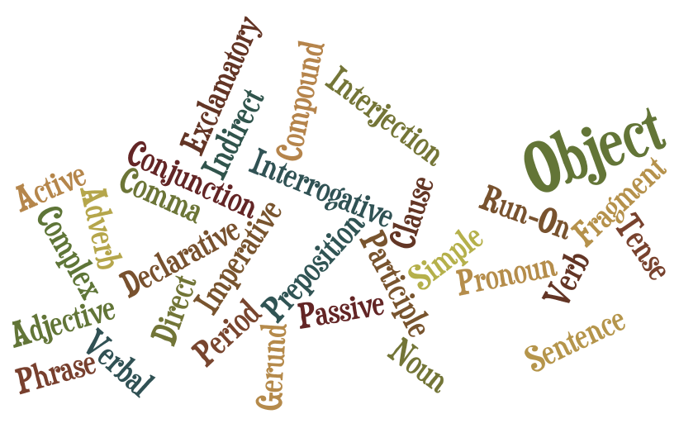
Grammar

Slide 13
Learning Expectations
English Department Responsibilities:
*Reading
*Writing
*Communication
*Personal, Social, Civic Responsibility

