Slide 1
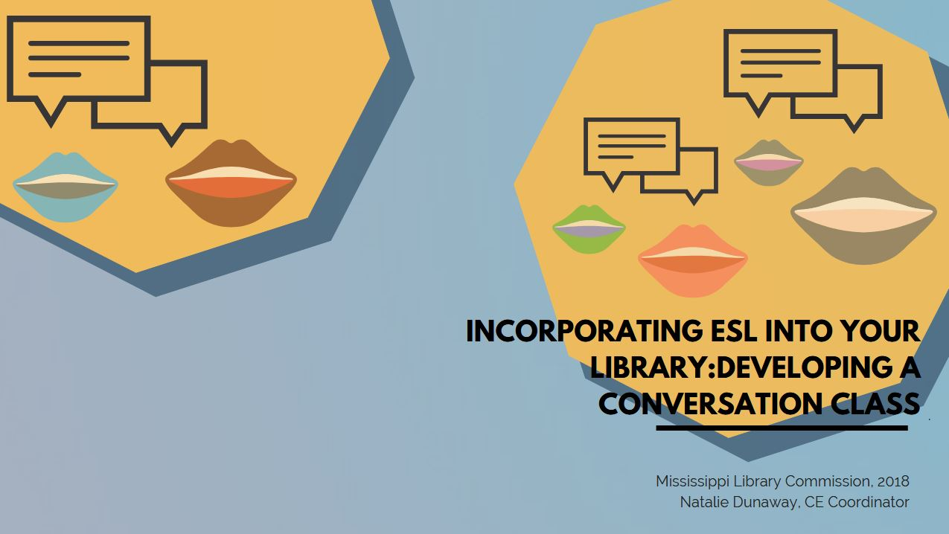

Slide 2

What we’ll talk about
Conversation classes
  What are they
  Building a class
  Advertising
  Class ideas/activities
  Things to keep in mind
Building resources
  Cultivating what you already have
This Photo by Unknown Author is licensed under CC BY-NC-ND

Slide 3
Conversation Classes 101
What constitutes as a convo class?
  For this presentation, I’m going to use “conversation class” as an umbrella term to refer to any interactive, ESL course or social hour that is not set up in the way of a traditional style class, but functions with the base goal of improving speaking and listening skills
  Conversation classes are typically student-directed. Facilitation/scaffolding is still present. The amount of direction provided will also depend on the speaking/listening level of the attendees
What are some things to keep in mind?
  Content is flexible.
  Know what you want to do and find out as much as you can about the community/communities you’re trying to reach out to. Do demographic research and find out what your communities need.
  If you have a class of beginners with only a basic grasp of English, your conversation class will require more instruction and review. This does not mean that you necessarily need to incorporate formal assessment (quizzes, tests, presentation, etc), but you may need to be prepared to teach vocabulary, grammar points, etc.

Slide 4

Conversation Classes 101
How do I build a class?
  Think about the resources you have/can gain access to
  What kind of prep are you willing/can you do?
  Think about the patrons you’re trying to reach
  Think about what you want patrons to take away
    Skills
    Socialization
    Information

Slide 5
Conversation Classes 101
Conversation class vs. traditional style class
  If your library is new to working with non-native English-speaking populations, I recommend starting with a conversation class instead of a formal traditional style class, or anything requiring registration
How do I get people through the door?
  The communities you’re trying to reach will determine how you advertise
  Call, call, call!
    Outside partnerships
  Post! Use social media
  Get to know your immigrant communities

Slide 6
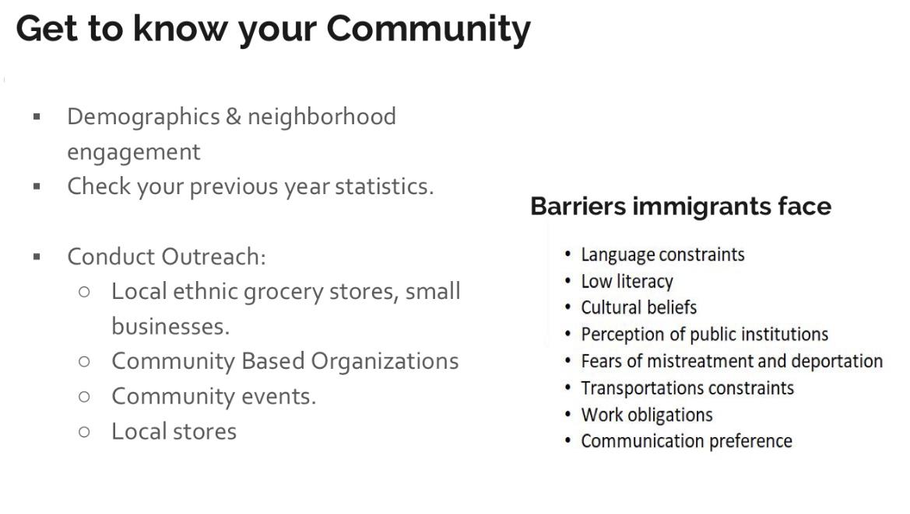
We Welcome You to Welcome Everyone - Handout Resources
Overview of Key Data Sources
Migration Policy Institute: Immigrant Data Matters https://www.migrationpolicy.org/research/immigration-data-matters
Public Policy Institute of California
http://www.ppic.org/publication/immigrants-in-california/
Demographic Information
Data USA https://datausa.io/
Statistical Atlas https://statisticalatlas.com/
Census American Fact Finder https://factfinder.census.gov/
USC Center for the Study of Immigrant Integration: https://dornsife.usc.edu/csii
Local Government websites: City, Department of Education
Legal Resources and Information
USCIS U.S. Citizenship and Immigration Services - https://www.uscis.gov/
Immigration Law Help - www.immigrationlawhelp.org
AILA American Immigration Lawyers Association - http://www.aila.org/
United We Dream - https://unitedwedream.org/
BAJI Black Alliance for Just Immigration - http://baji.org/
NILC National Immigration Law Center - www.nilc.org
ILRC Immigrant Legal Resource Center - www.ilrc.org
Email subscriptions / Listservs
USCIS Alerts - https://www.uscis.gov/news/alerts
Immigration Advocates Network - https://www.immigrationadvocates.org/
Federal Register - https://www.federalregister.gov/
Welcoming Communities
Project Welcome - https://publish.illinois.edu/projectwelcome/
Welcoming America - https://www.welcomingamerica.org/
Black Immigrants in Libraries- https://blackimmigrantsinlibraries.com/
Policy Landscape
Migration Policy Institute - https://www.migrationpolicy.org/
Asian Americans Advancing Justice - https://www.advancingjustice-aajc.org/
National Association for Latino Elected Officials - http://www.naleo.org/
Professional Organizations
Asian/Pacific American Librarians Association - http://www.apalaweb.org
Chinese American Librarians Association - http://www.cala-web.org
REFORMA - The National Association to Promote Library and Information Services to Latinos and the Spanish Speaking - http://www.reforma.org
Ethnic & Multicultural Information Exchange Round Table - www.ala.org/emiert/
Conferences
Joint Conference of Librarians of Color http://www.jclcinc.org/
National Immigrant Integration Conference - https://niic2018.org/
https://americanlibrariesmagazine.org/blogs/the-scoop/serving-immigrants-refugees-public-libraries/
Handout from Eva Raison, Brooklyn Public Library

Slide 7
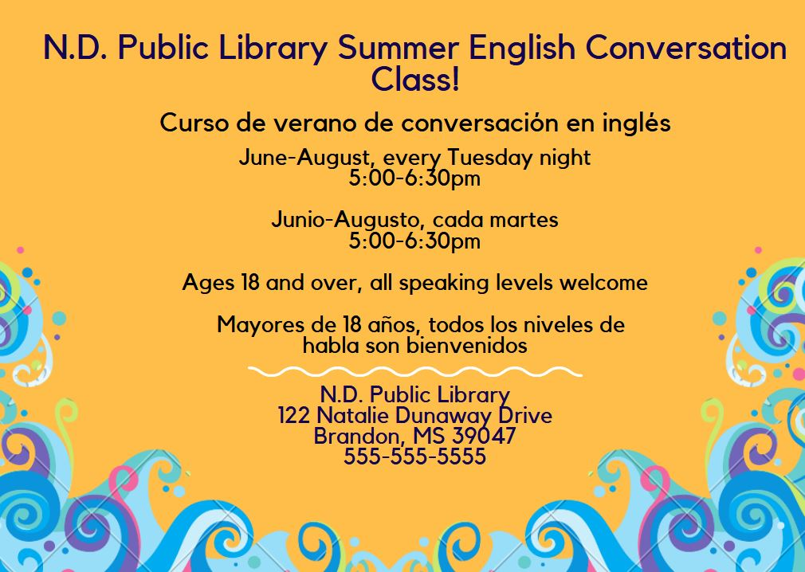
Conversation Classes 101

Slide 8
Conversation Classes 101
Possible solutions:
For your first couple of conversation classes, you may want to make sure you have enough resources for 10 more than you expect.
Avoid an activity which requires a strict number of tools/resources to participate-like a cooking class
Be sure to have a couple volunteers on hand, in case you have more patrons, and need help scaffolding
Registration
Pros:
You’ll be a gauge the number of participants you’ll have
It’s easier to keep track of who’s who-build a relationship
Solidify details- people are clear
Cons:
How will people save a seat? At the library? Over the phone? On the internet?
People may be intimidated by needing to register- keep personal details minimal

Slide 9
Conversation Classes 101
Conversation class ideas. How do I get people to talk?
  For the first lesson or so, you may find yourself initiating conversation
  Warm-up’s/introductions- *Name badges*- first name only
  Find out why people are there- This will help you sculpt future conversation topics
  Talk a little bit about yourself and your library, and the community
  Have a couple games as an ice breaker (my favorite is Jenga- each time someone pulls a wooden piece, they must ask a question to someone else).
        **Note: Games aren’t only restricted to serving as ice breakers. Let them become an integral part of your class
        Read the room: If your conversation class is lively and people are engaged and self-directing easily, let them keep going. Keep the snacks flowing, and let your attendees keep chatting- unless it has been specifically in demand and is crucial, save the activity for next time.

Slide 10
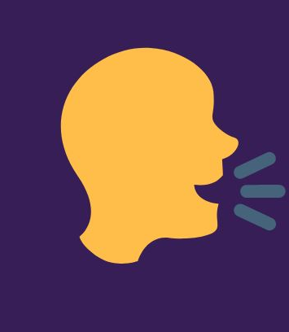
Conversation Classes 101
Conversation class ideas. How do I get people to talk?
  The implementation of essential words/phrases- crucial in times of communication breakdown.
    Hello
    How are you?
    My name is…
    I’m from…
    I don’t understand…
    What does this mean?
    What is this?
    Please speak slowly.

Slide 11
Conversation Classes 101
Conversation class ideas. What does a plan look like?
Conversation Class lesson plan: 1
Goal: To practice expressing opinions
Key terms/Possible challenges: Expressing “I think/I don’t think”, adjectives
Activities: Discussing recent event, movie, etc
Conversation Class lesson plan: 2
Goal: To practice life-skills/cooking
Key terms/Possible challenges: Cooking vocabulary/Listening skills
Activities: Learning kitchen/cooking terminology/vocab; attendees bring their own food/snacks and share/describe recipes
Conversation Class lesson plan: 3
Goal: To practice applying for jobs (reading/writing job application)
Key terms/Possible challenges: Reading job applications/terms
Activities: Teaching key terms
Filling out a mock-application (demonstrate, then have students work on one together)
Conversation Class lesson plan: 4
Goal: To practice saying likes and dislikes
Key terms/Possible challenges: Relevant vocabulary
Activities: Pair work-asking each other “do you like?”, learning how to answer in negative

Slide 12
Conversation Classes 101
Condensed ACTFL (American Council on the Teaching of Foreign Languages) guidelines (for speaking)
  Novice
    Low- No real functional ability, given time and cues, they may be able to exchange basic information (name, greetings, etc)
    High- can manage a few formulative questions, can communicate regarding basic tasks, a few objects, immediate needs
  Intermediate
    Low- ordering food, self and family, daily activities, uncomplicated, straightforward communication.
    High- Converse with ease and confidence when dealing with routine tasks and social situations, they can handle talking on a basic level about things like work, interests, etc.
  Advanced
    Low- Can speak in several communicative scenarios, can talk about current events, public interest, politics, and can navigate tenses, time frames, and can be understood by native speakers
    High-well developed ability to speak with ease, can use communicative strategies like paraphrasing, illustration, and can correct errors.

Slide 13
Conversation Classes 101
Things to keep in mind:
  If you have a large class, try to split students into smaller groups, especially if the program is relatively new. This can help keep anxiety levels about speaking low.
    Also, keep in mind sounds and sound level. It may be harder for participants to listen effectively if the classroom is loud, or there are multiple people speaking to the whole group at once.
    Don’t try and force anyone to talk. While this seems obvious, and of course we want to encourage all attendees to participate, remember that all of us, English Language Learners, native speakers, immigrants, U.S. citizens, all of us have different life experiences. You may have a conversation class attendee who just wants to come and check out the library, or see what services you have, or see if the convo class is something they’d be interested in consistently participating in. And that’s enough. That’s fine.
    You’ve met the goal of getting someone into your library and showing them that they have a place there.

Slide 14
Conversation Classes 101
Things to keep in mind:
  It is very likely that you will have attendees who have varying skill sets
    If you have a conversation class that is intended for patrons with at least intermediate speaking skills, you could have not only intermediate level speakers, but also advanced level speakers.
    You may have a group who have advanced speech skills, but beginner reading skills. Or vice versa.
Conversation classes are not the place to stress about grammatical correctness.
  If the overall meaning is understandable, I encourage gentle corrections if it doesn’t require too much time/attention. Ideally, let student’s help each other.
  Teach vocabulary

Slide 15
Conversation Classes 101
http://www.bbc.co.uk/learningenglish/

Slide 16
Conversation Classes 101
Building up resources in your library
  Take a good look around at what you have
    Do you have any grammar books? Do you have any dictionaries?
    What about some graphic novels?
    Compile a list of online resources that your ELL’s may find useful
    Remember, you can also include citizenship and legal resources here.
  Compile resources and see if you can make an ESL or foreign language learning corner.

Slide 17
Conversation Classes 101
Natalie Dunaway
  Continuing Education Coordinator, Mississippi Library Commission
  601-432-4057
  ndunaway@mlc.lib.ms.us
  Sources :
  https://www.actfl.org/publications/guidelines-and-manuals/actfl-proficiency-guidelines-2012/english/speaking
  https://americanlibrariesmagazine.org/blogs/the-scoop/serving-immigrants-refugees-public-libraries/

