Slide 1
Absolute English Monarchs

Slide 2
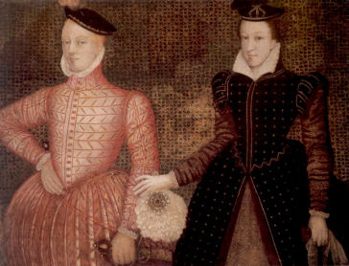
Mary Queen of Scots and Henry Stuart
Parents of James I
Mary was involved in a plot to kill her husband, he did die after a gunpowder explosion blew up his quarters.

Slide 3
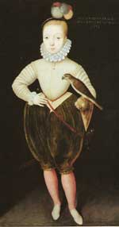
James I
He was raised by his mother’s enemies and taught that his mother killed his father.
He was a nervous and confused child.

Slide 4
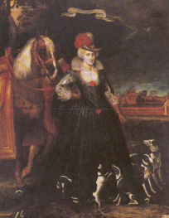
James I
Despite his homosexual tendencies, James I fathered 6 children, with 3 not reaching adulthood, however, with his wife Anne.

Slide 5
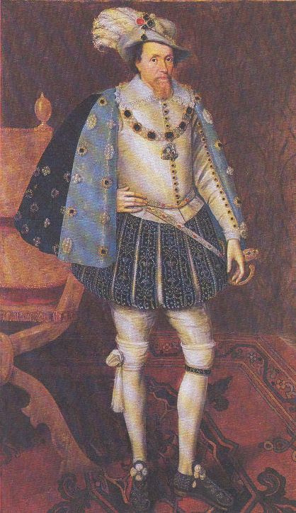
James I
Took over with Elizabeth’s death.
Known for his slobbering as well as his vulgar language and crude jokes.

Slide 6
The Rule of James I
Persecuted the Catholics
Frequently clashed w/ Parliament over money issues
Dissolved Parliament
Was responsible for the creation of the King James Bible- used in many Protestant churches today.
Died at age 59 of possibly a stroke or kidney failure

Slide 7
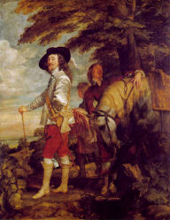
Charles in Charge
After a sickly
childhood, he grew
up to be
5’ 4” tall.
Stubborn and strong-willed.

Slide 8
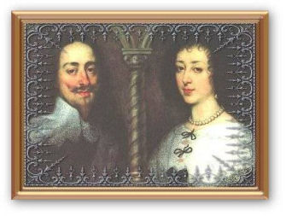
Charles: Personal Life
Wished to form an alliance with Spain and married Henrietta Maria. He was 25, she was 14. On their first meeting, she saw him and burst into tears!

Slide 9
Reign of Charles I
Imprisoned foes w/o trials
Needing funds, he called Parliament
Agreed to the Petition of Right
Dissolved Parliament
Arrested Parliamentary members, sparking the English Civil War

Slide 10
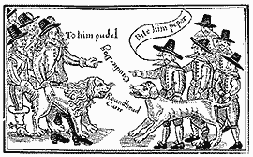
Cavaliers Vs. Roundheads
Cavaliers- supporters of Charles
Roundheads- supporter of Parliament
Cromwell- military leader of Parliament

Slide 11
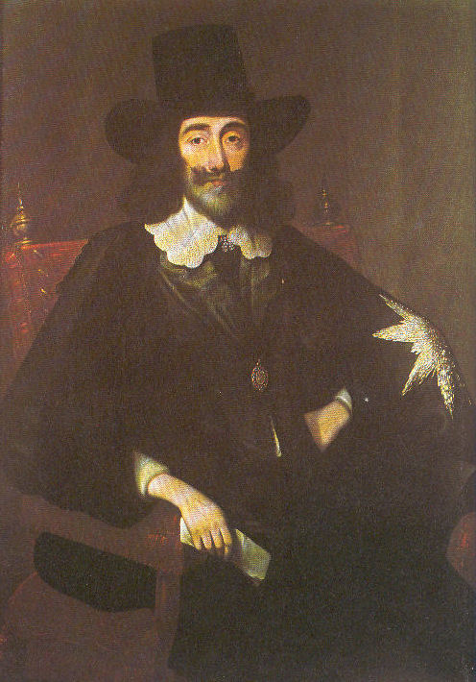
The End of Charles
Charles is defeated by Cromwell and his roundheads.
Charles is put on trial, convicted, and beheaded.

Slide 12
Gunpowder Review Questions
Where was James I from?
Why did the gunpowder plot come about?
How was the plot to unfold?
How did the Parliament and James find out about the plot?
Describe what occurred to Guy Fawkes.
Why is there still a Guy Fawkes Day celebrated today in England?

Slide 13
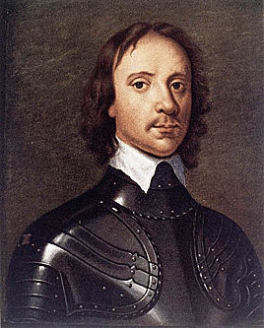
11 Years Without a King
Oliver Cromwell was named Lord Protector of England.

Slide 14
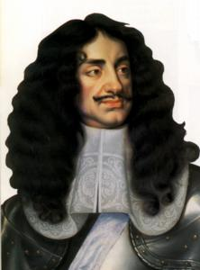
Charles II is put on the throne.
Known as the Restoration.
Famous for his many mistresses.

Slide 15
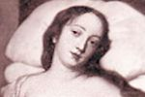
Nell Gwynne
Most famous of Charles’ mistresses.
Bore him 2 sons.
Attempts made on her life.

Slide 16
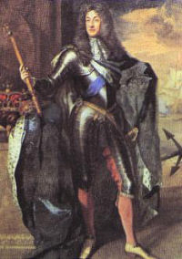
James II
After, Charles II, his younger brother James II would take the throne.
He was 51 years old.

Slide 17
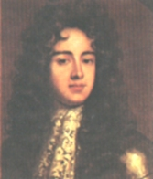
Ambition knows no bound
James II’s rule was questioned by Charles II’s eldest son, James Duke of Monmouth, who had dreams of becoming king himself.

Slide 18
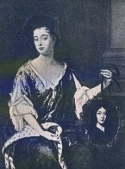
Background
James Duke of Monmouth planned a rebellion to overthrow James II.
James II did not believe his brother Charles II even had this boy as the mistress “died of a disease indicative of her profession.”
James II had James Duke of Monmouth executed for high treason.

Slide 19
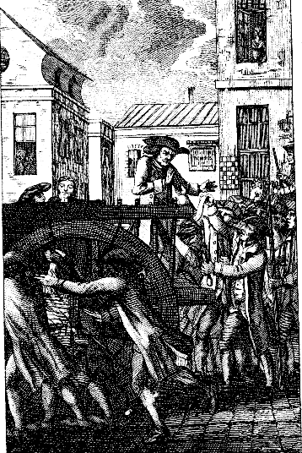
The Execution
His execution was botched by the executioner Jack Ketch. He needs to five whacks with the ax to behead him.
After failing numerous times to completely sever the head from the body, he used a knife to finish the job.

Slide 20
James II’s Rule
James II feared that even though he tolerated Protestants, they would eventually turn on him.
James II abdicates the throne to his daughter Mary who was married to his nephew William of Orange.
James II flees to France where he lives at Versailles for the rest of his life.

Slide 21
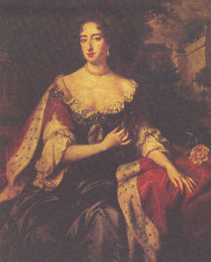
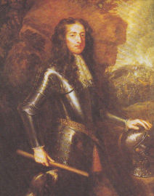
William and Mary
Take the throne without any bloodshed
This is known as the Glorious Revolution

