Slide 2
Ch.4.3
Influences on American Beliefs on government
LT: Explain the influences on American beliefs about
government.

Slide 3
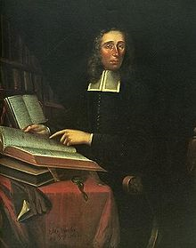
In 1688, minister Increase Mather sailed from Massachusetts to England with a complaint. The colonist believed that the new royal governor had trampled their rights as English subjects. Eventually, Mather came home with a new charter that restored
colonists’ rights.
“For all English liberties are restored to them: No Persons shall have a Penny of their Estates taken from them; nor any Laws imposed on them, without their own Consent by Representatives chosen by themselves.”
- Increase Mather, 1688
English rights guaranteed by the Magna Carta and later documents are the basis for rights Americans enjoy today.

Slide 4
How it affected American belief about government?
Event or document
What it is or did?
Magna Carta
1215
protected against unfair treatment or punishment
That rulers or leaders are bound by the law
the model for American legislatures; gave people a voice in government
English Parliament
A representative law making body
A transition of power forced by Parliament
no ruler should have more power than the legislature
Glorious Revolution
1688

Slide 5
What it is or did?
How it affected American belief about government?
Event or document
That ruler can’t suspend or make laws without Parliament’s consent . . . garanteed rights
English
Bill of Rights
1689
there are clear limits on a ruler’s power
Colonial Assemblies
Elected legislators that made certain laws for the colonists
People take part in ruling themselves by voting for representatives
Town Hall Meetings
Allowed people to discuss, vote and pass laws concerning local issues
That people have the right to govern themselves

Slide 6
Read, “English Economic Policies” p. 94-95 and complete the
Cause & Effect diagram below:
Cause
Effect
to build wealth & power by controlling colonial trade
Colonists resented English restrictions & began smuggling goods
Navigation Acts
1650s
Mercantile system – build up supplies of gold & silver by exporting more than importing; colonies supply raw materials & serve a market for exports

Slide 7
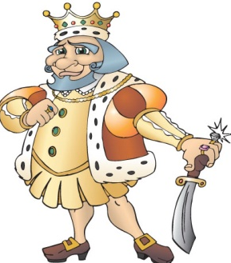
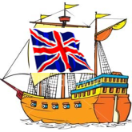
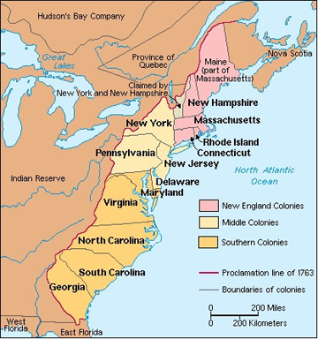
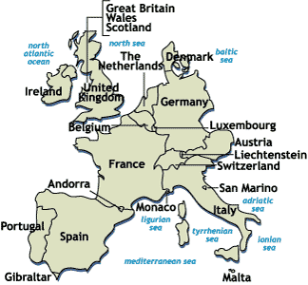



Navigation Acts (1651)
I’m bloody filthy rich!
furniture
lumber
tools
iron
textiles
cotton

Slide 8
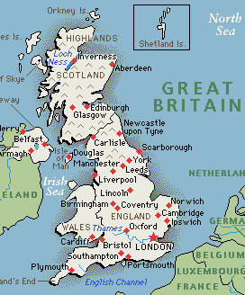
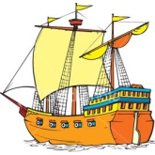
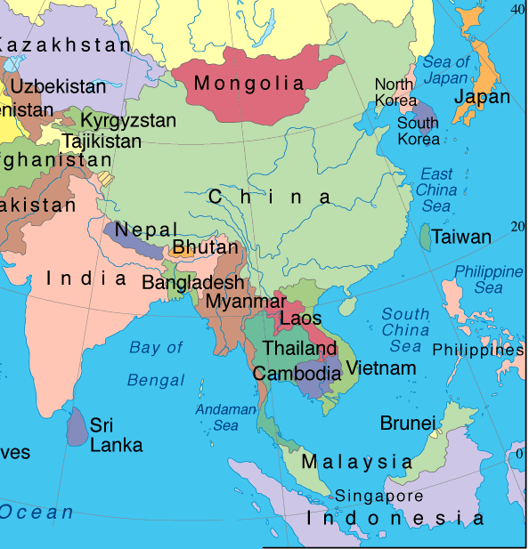
2) All products going to the colonies had to first go through England where the products were taxed.
spices
tea
tea
spices

Slide 9
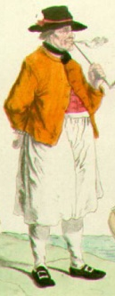


Navigation Acts (1660's)
I’m bloody filthy rich!
furniture
Ik ben het eens!
lumber
tools
Il serait moins coûteux pour le commerce direct avec l'Amérique!
iron
textiles
cotton
¿Por qué debo pagar a los británicos tan altos precios?

Slide 10
Effects of the Navigation Acts
• There was an increase in smuggling in the colonies.

Slide 11
Read, “English Economic Policies” p. 94-95 and complete the
Cause & Effect diagram below:
Cause
Effect
to build wealth & power by controlling colonial trade
Colonists resented English restrictions & began smuggling goods
Navigation Acts
1650s
Mercantile system – build up supplies of gold & silver by exporting more than importing; colonies supply raw materials & serve a market for exports

