Slide 1
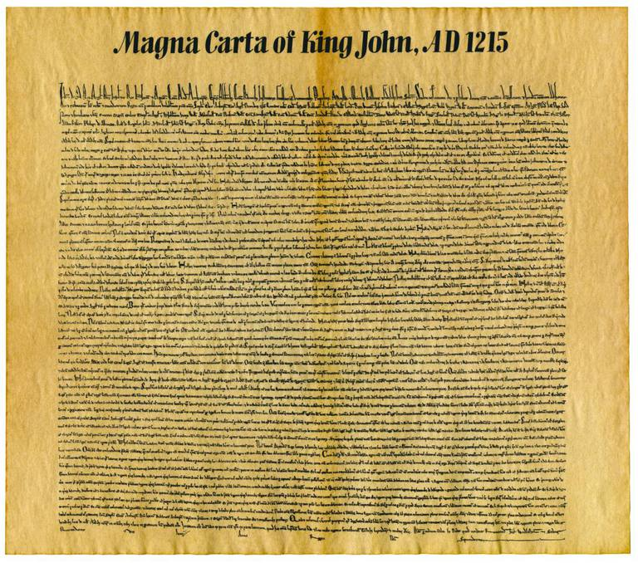
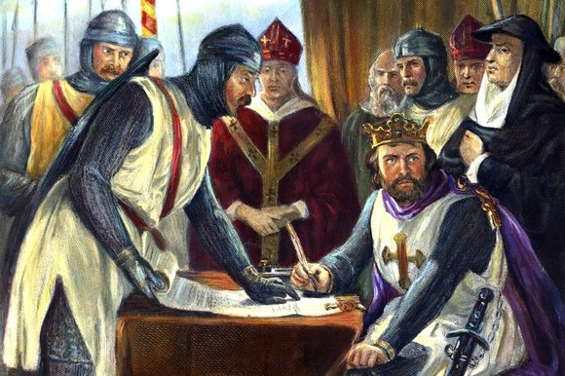
The Magna Carta
The Great Charter

Slide 2
The Magna Carta: Skills Practice
In article 1, who is granted the rights described elsewhere in the Magna Carta?
  Only the King and his heirs.
  Only the general council.
  All freemen and their heirs.
  Only the nobles assembled at the signing.
  C. All freemen and their heirs – this is important b/c the Magna Carta sets the precedent that FREE PEOPLE should have certain basic rights.

Slide 3
2. Approval by the general council was not required for any tax that would…
  Fund the building of roadways.
  Pay for schools.
  Support the general council.
  Ransom the king.
D. Ransom the king – article 12 says that “ no [tax] except for ransoming…”

Slide 4
3a) What do Articles 14 and 40 suggest about royal abuse of power during this period of English history?
First try to figure out what the Article is about…
Article 14 is about the king having restrictions on holding a council (a meeting). It says that the nobles need to be told the day of the meeting and what the meeting is about – 40 days prior.
This suggests what (what’s the inference)?
That the king was in the habit of calling meetings but not giving the nobles enough time to arrive or telling them what it was about.

Slide 5
What about Article 40? What is it about?
Article 40 is about selling justice and rights.
What does this mean?
The inference: The king was selling justice and special favors. (remember $$ = power) In this case if you commit a crime but can pay the judge (the king) enough money you get no punishment!

Slide 6
3b) Who was NOT included in the general council according to article 14? What can you infer from this?
The King?
Inference: The council limited the king’s power.
No common people?
Inference: Common people did not have the rights laid out by the Magna Carta – at least not yet but in time they will b/c it says in article 1 “all the freemen of our kingdom, for us and for our heirs forever”

