Slide 1
Endocrine System part 4

Slide 2
The Major Endocrine Organs
Hypothalamus
Pituitary gland
Pineal gland
Thyroid gland
Parathyroid glands
Thymus
Adrenal glands
Pancreas
Gonads (testes and ovaries)

Slide 3
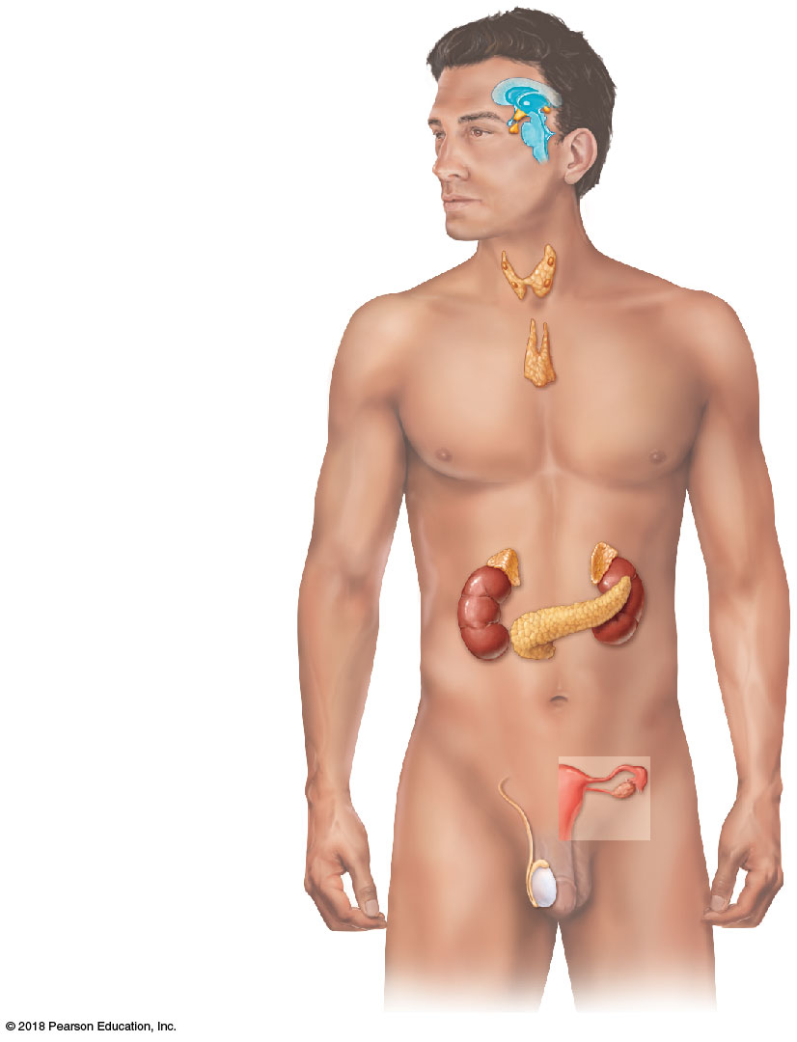
Figure 9.3 Location of the major endocrine organs of the body.
Pineal gland
Hypothalamus
Pituitary gland
Thyroid gland
Parathyroid glands
Thymus
Adrenal glands
Pancreas
Ovary (female)
Testis (male)

Slide 4
The Major Endocrine Organs
Some glands have purely endocrine functions
  Anterior pituitary, thyroid, adrenals, parathyroids
Endocrine glands are ductless glands
Hormones are released directly into blood or lymph
Other glands are mixed glands, with both endocrine and exocrine functions (pancreas, gonads)

Slide 5
Pituitary Gland and Hypothalamus
Pituitary gland
  Pea-sized gland that hangs by a stalk from the hypothalamus in the brain
  Protected by the sella turcica of the sphenoid bone
  Has two functional lobes
    Anterior pituitary—glandular tissue
    Posterior pituitary—nervous tissue
  Often called the “master endocrine gland”

Slide 6
Pituitary Gland and Hypothalamus
Hypothalamus produces releasing hormones and inhibiting hormones
  These hormones are released into portal circulation, which connects hypothalamus to anterior pituitary
Hypothalamus also makes two hormones: oxytocin and antidiuretic hormone
  Carried to posterior pituitary via neurosecretory cells for storage

Slide 7
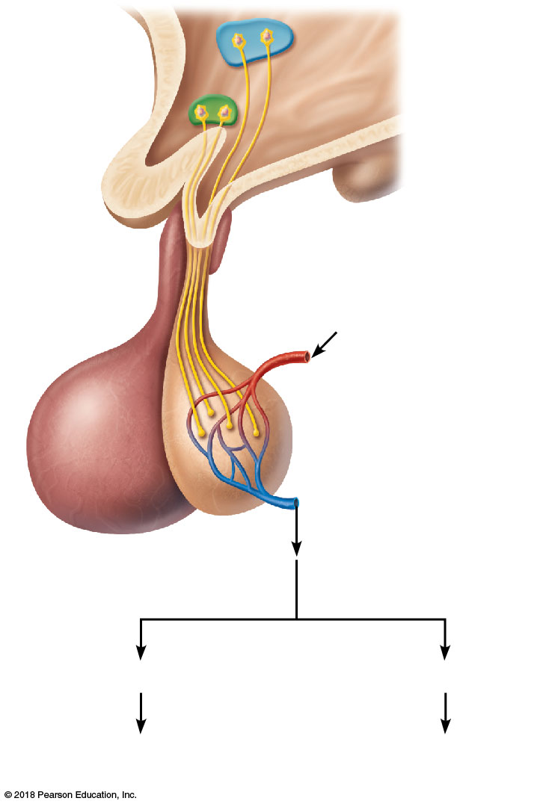
Figure 9.4 Hormones released by the posterior pituitary and their target organs.
Hypothalamic neurosecretory cells
Optic chiasma
Hypothalamus
Axon
terminals
Arterial blood supply
Posterior lobe
Capillary bed
Venous drainage
Anterior lobe
of the pituitary
ADH
Oxytocin
Kidney tubules
Mammary glands Uterine muscles

Slide 8
Pituitary Gland and Hypothalamus
Posterior pituitary
  Does not make the hormones it releases
  Stores hormones made by the hypothalamus
Two hormones released
  Oxytocin
  Antidiuretic hormone (ADH)

Slide 9
Pituitary Gland and Hypothalamus
Posterior pituitary (continued)
  Oxytocin
    Stimulates contractions of the uterus during labor, sexual relations, and breastfeeding
    Causes milk ejection (let-down reflex) in a breastfeeding woman

Slide 10
Pituitary Gland and Hypothalamus
Posterior pituitary (continued)
  Antidiuretic hormone (ADH)
    Inhibits urine production (diuresis) by promoting water reabsorption by the kidneys
    Urine volume decreases, blood pressure increases
    In large amounts, causes constriction of arterioles, leading to increased blood pressure (the reason why ADH is known as vasopressin)
    Alcohol inhibits ADH secretion

Slide 11
Figure 9.4 Hormones released by the posterior pituitary and their target organs.
Hypothalamic neurosecretory cells
Optic chiasma
Hypothalamus
Axon
terminals
Arterial blood supply
Posterior lobe
Capillary bed
Venous drainage
Anterior lobe
of the pituitary
ADH
Oxytocin
Kidney tubules
Mammary glands Uterine muscles

Slide 12
Pituitary Gland and Hypothalamus
Six anterior pituitary hormones
  Two hormones affect nonendocrine targets
    Growth hormone
    Prolactin
  Four are tropic hormones
    Follicle-stimulating hormone
    Luteinizing hormone
    Thyrotropic hormone
    Adrenocorticotropic hormone

Slide 13
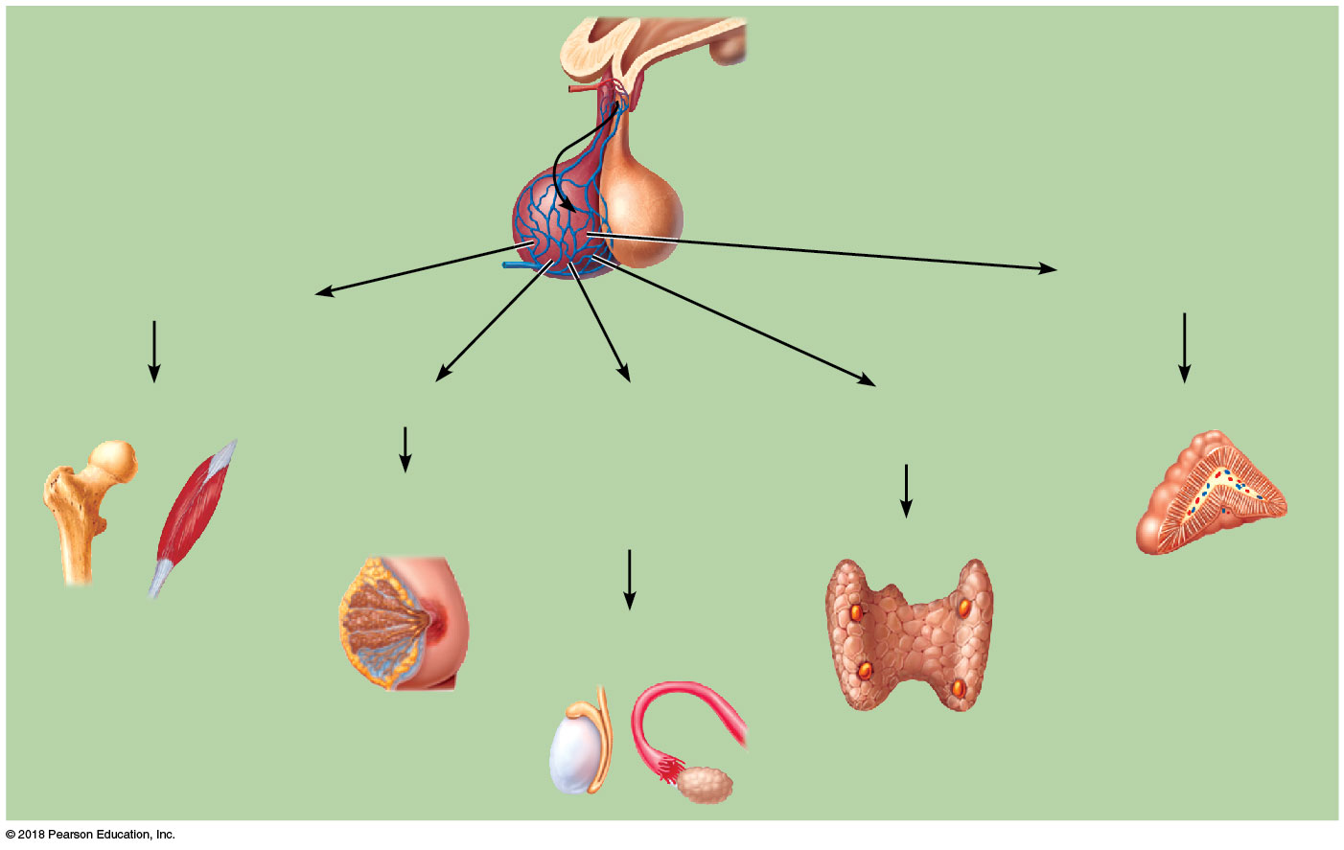
Figure 9.5 Hormones of the anterior pituitary and their major target organs.
Releasing hormones secreted into portal circulation
Hypothalamus
Anterior pituitary
Posterior pituitary
Hypophyseal
portal system
Adrenocorticotropic
hormone (ACTH)
Growth hormone (GH)
Bones and muscles
Prolactin (PRL)
Follicle-stimulating hormone (FSH)
and luteinizing
hormone (LH)
Thyrotropic
hormone (TH)
Adrenal cortex
Mammary glands
Thyroid
Testes or ovaries

Slide 14
Pituitary Gland and Hypothalamus
All anterior pituitary hormones:
  Are proteins (or peptides)
  Act through second-messenger systems
  Are regulated by hormonal stimuli
  Are regulated mostly by negative feedback

Slide 15
Pituitary Gland and Hypothalamus
Growth hormone (GH)
  General metabolic hormone
  Major effects are directed to growth of skeletal muscles and long bones
  Plays a role in determining final body size
  Causes amino acids to be built into proteins
  Causes fats to be broken down for a source of energy

Slide 16
Pituitary Gland and Hypothalamus
Prolactin (PRL)
  Stimulates and maintains milk production following childbirth
  Function in males is unknown

Slide 17
Pituitary Gland and Hypothalamus
Gonadotropic hormones
  Regulate hormonal activity of the gonads
    Follicle-stimulating hormone (FSH)
      Stimulates follicle development in ovaries
      Stimulates sperm development in testes
    Luteinizing hormone (LH)
      Triggers ovulation of an egg in females
      Stimulates testosterone production in males

Slide 18
Pituitary Gland and Hypothalamus
Thyrotropic hormone (TH), also called thyroid-stimulating hormone (TSH)
  Influences growth and activity of the thyroid gland
Adrenocorticotropic hormone (ACTH)
  Regulates endocrine activity of the adrenal cortex

