Slide 1
The economy in the valley will need to grow if students want to come back and work with their specialized degrees. We need to develop more to create more opportunities.
Frank Murphy
Thursday: According to the quote above, which of the following would Frank Murphy most likely agree with?
The creation of a public university within the valley
The addition of a McDonald’s in the valley
The creation of a public park in the valley
A new highway in the valley

Slide 2
Intro to Economics
Unit 9
Unit 9 Essential Question: In what ways do your choices impact the economy of the United States? How much of an impact do you have? Support your argument with at least 3 sources.

Slide 3
Unit 9.1 Essential Question: How does where you live affect your economic freedoms?
Microeconomics
Macroeconomics
Scarcity
Goods
Services
Trade-Offs
Opportunity costs
Traditional Economy
Command Economy
Communism
Market Economy
Capitalism
Mixed Economy
Labor
Capital

Slide 4
What is economics?
The study of choices in a world full of unlimited wants and limited resources.
Microeconomics: study of choices made by individuals and individual businesses
Macroeconomics: study of choices made by entire industries and countries
How can you impact both?

Slide 5
What is the key to economics?
Scarcity: having more wants (goods and services) than you have resources
Ex.
You can’t buy a new car without enough money.
You can’t get everything done because there’s not enough time.
Can you think of any more examples?

Slide 6
What are goods and services?
Goods Services things you can hold things you pay someone to do

Slide 7
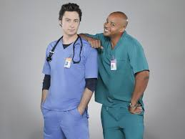
Good or service?

Slide 8
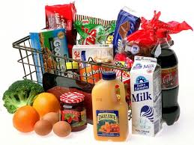
Good or service?

Slide 9
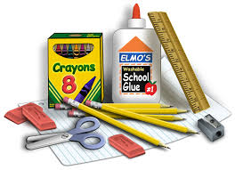
Good or service?

Slide 10
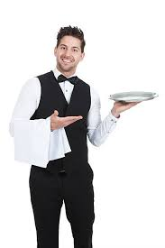
Good or service?

Slide 11
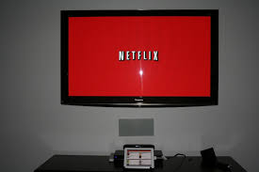
Good or service?

Slide 12
How do you choose what you want?
Trade-offs: choose one thing over another
Opportunity costs: the value of what you gave up
Ex. Choosing Pitt CC over ECU
Can you think of your own example?

Slide 13
What are the 4 major economic questions?
What should be produced?
How should it be produced?
How much should be produced?
For whom should it be produced?
Who answers these questions?

Slide 14
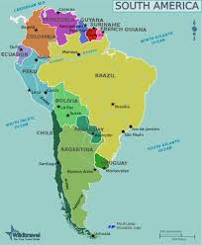
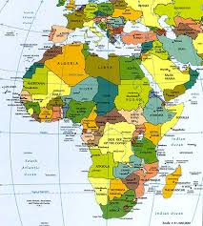
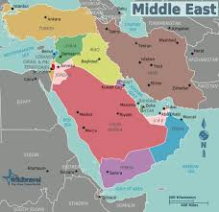
What are the 4 major types of economies?
Traditional: decisions based on traditional bartering systems
  Custom, beliefs, religion
  Little to no tech
  “The way it’s always been”
Where are traditional economies?

Slide 15
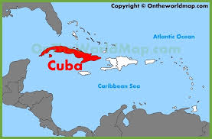
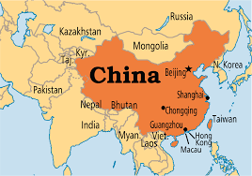
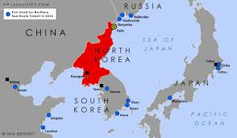
What are the 4 major types of economies?
Command: decisions made by government
  Communism: No private property, gov’t owns everything
Advantages:
Low prices
Financial support for education
Basic needs like housing, medical provided by gov’t
Disadvantages:
No competition
Little choice of goods
Quality of goods is poor
Little individual freedom of choice

Slide 16
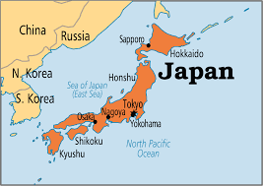
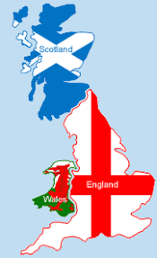
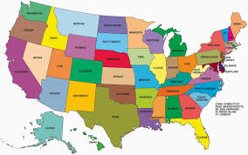
What are the 4 major types of economies?
Market: decisions made by individuals
  Based on supply and demand
  Capitalism: Profit = biggest motivation
Advantages:
More choices
Better quality
Abundant supply
Private property
Individual freedoms
Disadvantages:
Unequal distribution of wealth

Slide 17
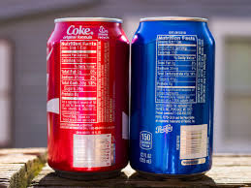
What are the 4 major types of economies?
Mixed: decisions made by individuals and government
  Most countries have some kind of mixed economy
  In the US - required labels on food, minimum wage, FDA, etc

Slide 18
What are the 4 factors of production?
Land - natural factors
Labor - human work factor
Capital - $ and tech factor
Entrepreneurship - leadership factor
Which is more important, the land, the worker, the computer, or the boss?

Slide 19
Essential Question: How does where you live affect your economic freedoms?
Exit Ticket: Unit 9.1 Exit Ticket Turn in Box
Create a postcard to a friend in the United States from the perspective of someone living in another country that does not have a mixed market economy. In the post-card, compare and contrast your two ​economies and living styles.
Take this Sporcle Quiz on World Maps!

Slide 20
Friday’s Bellringer: Sporcle Quiz on World Maps!

Slide 21
Unit 9.2 Essential Question: How can you increase productivity?
Productive
Specialization
Division of Labor
Technology
Education
Sole Proprietorship
Partnership
Corporation

Slide 22
What is productivity?
Making the most of what we have.
How productive have you been today?

Slide 23
How can we increase productivity?
Specialization
  Focusing on one small task
How will this help increase productivity?

Slide 24
How can we increase productivity?
Division of Labor
  Dividing tasks among people
How will this help increase productivity? Do you have any experience with this?

Slide 25
How can we increase productivity?
Technology
  Applying knowledge to a task
    Computers, scissors, wheels, radio
How will this help increase productivity?

Slide 26
How can we increase productivity?
Education
  Training, educating people to be more effective
How will this help increase productivity?

Slide 27

What are the types of businesses?
Sole Proprietorship / Entrepreneurship
  One Owner
Advantages:
Pride
Keep all of profit
Quick decision making process
Flexibility
Tax Breaks
Disadvantages:
Financially Responsible
Unlimited Liability
Hard to Raise funds
Hard to get qualified employees

Slide 28
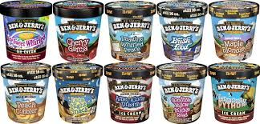
What are the types of businesses?
Partnership
  Two or more owners
Advantages:
Raise more money
Tax Breaks
Bring in special talents
Disadvantages:
Complex decision making
Unlimited Liability
Fully responsible for finances

Slide 29

What are the types of businesses?
Corporation
  Many individuals own stock in a company and it is treated as its own entity
Advantages:
Easy to raise money
Professionals run business (board)
Ownership can be easily transferred
Limited Liability
  Corp. responsible for debts
Disadvantages:
Expensive
Complex
Owners have little say
More gov’t regulation
Double Taxed
  Corp. pays income taxes
  Owners pay income taxes

Slide 30
How can a business become a corporation?
Get permission via gov’t via charter
Stockholders invest money to gain ownership
Stockholders elect board of directors to run corporation
Why would a company want to become a corporation?

Slide 31
Essential Question: How can you increase productivity?
Exit Ticket: Unit 9.2 Exit Ticket Turn in Box
In partnerships, begin a concept of an idea of your own business. By the end of the period at least have in mind a good or a service that you would like to offer. Your business MUST be entirely school appropriate. If it's something you can't talk about in class - your business can't have anything to do with it. (guns, drugs, tobacco, alcohol etc.) KEEP IT G-RATED!
Small Business Plan Worksheet

Slide 32
Monday:
Create a list of your top 5 most used businesses.
  For each business, tell me why you use them.
  Tell me one alternative for that business that you choose to use less often than them.
  Finally, why do you choose to use those businesses more than others?
    What makes them more successful?

Slide 33
Unit 9.3 Essential Question: ​Why is competition a good thing?
Consumer sovereignty
Pure competition
Free enterprise
Profit motives / incentives
Non-Profits
Monopolistic Competition
Oligopoly
Monopoly
Merger
Conglomerate

Slide 34
Key terms to know:
Consumer Sovereignty: consumer decides what is produced (customer is always right)
Pure Competition: no one person / group controls the market on a product and there are no barriers to enter the market
Free enterprise: individuals answer all 4 economic questions and allow for free trade; capitalism
Profit motive / incentives: individuals willing to give up a factor of production for a personal gain

Slide 35
What are the types of competition?
Non-profits:
  Organizations not interested in making a profit
  Want to benefit society rather than make money
What are some examples of non-profits?

Slide 36
What are the types of competition?
Monopolistic: (aka pure / market)
  Many companies compete with similar products and no one has total control
    Little price difference between products
    Few barriers to entry and exit
    Producers have a degree of control over price
What are some examples of monopolistic industries?

Slide 37
What are the types of competition?
Oligopoly:
  Few companies compete with very similar products
  One company can greatly impact the market
What are some examples of oligopolies?

Slide 38
What are the types of competition?
Monopoly
  One company controls everything in that market
  Illegal in USA, unless government operated
What monopolies still exist?

Slide 39
How do corporations become monopolies?
Merger: buying up all similar companies
Conglomerate: corporation buys up other companies that provide its capital goods - corporations are usually large, multinational and multi-industry
Why would you want to become a monopoly?

Slide 40
Essential Question: Why is competition a good thing?
Exit Ticket: Unit 9.2 Exit Ticket Turn in Box
In partnerships, create your own business. Your business MUST be entirely school appropriate. If it's something you can't talk about in class - your business can't have anything to do with it. (guns, drugs, tobacco, alcohol etc.) KEEP IT G-RATED!
Small Business Plan Worksheet

Slide 41
Remediation Schedule
7:45…...……………………………….…………………………………..Enter the Bldg.
8:15…………………………….………………………….Start of Instructional Day Bell
8:20………………………….……………………………………....................Tardy Bell
8:25-9:50……….……..………………………………………………................1st Period
9:50-9:55……………………...………………Change Class/ Report Remediation Area
9:55-10:35…………………………..…………………………………………Remediation
10:35-10:40……………………………...…………………………………….Change Class
10:40-12:05………………………………….……………………………………2nd Period
12:05-12:10…………………………………...……………………………….Change Class
12:10-2:00…………………………………....…………………………………….3rd Period
A Lunch……………………………………………………………12:10-12:35
B Lunch…………………………………………………………….12:35-1:00
C Lunch…………………………………………………………..….1:00-1:35
D Lunch……………………………………………………………...1:35-2:00
2:00-2:05……………………………………………………..…………………Change Class
2:05-3:30 …………………………………………………...………………………4th Period

Slide 42
Tuesday: Which of these is an example of capital?
6 acres of land
24 employees
5 computers
Washington D.C.

Slide 43
Unit 9.4 Essential Question: Why are supply and demand important for business owners?
Demand
Demand Curve
Law of Demand
Substitution
Taste / Preference
Income
Complement
Elasticity
Elastic
Inelastic
Supply
Supply Curve
Law of supply
Production costs

Slide 44
Prezi - Slides 90-117
https://prezi.com/p4vlbru-eis4/unit-9-economics/?auth_key=567a5ba94810ffced9a3fd0000bcfc29db095116

Slide 45
Essential Question: Why are supply and demand important for business owners?
Exit Ticket: Unit 9.4 Exit Ticket Turn in Box
​Create your own examples of STIC and PET using the fake business that you created.

Slide 46
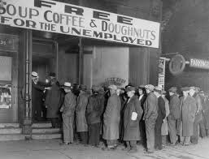
Wednesday: What has happened to the demand of businesses in this area?
It goes up
It goes down
It stays the same
It becomes demand

Slide 47
Unit 9.5 Essential Question: Explain the relationship between supply and demand.
Equilibrium
Surplus
Shortage
Price floor
Price ceiling
Employment
Unemployment rate
Rural
Urban

Slide 48
Prezi - Slides 119-135
https://prezi.com/p4vlbru-eis4/unit-9-economics/?auth_key=567a5ba94810ffced9a3fd0000bcfc29db095116

Slide 49
What does it mean to be employed?
Part time employment - works less than 35 hrs per week
Full time employment - works 35+ hours a week, usually receiving benefits
Unemployment rate - % of ppl without a job that are actively looking for one
Which states have the highest employment rates? Highest unemployment rates?

Slide 50
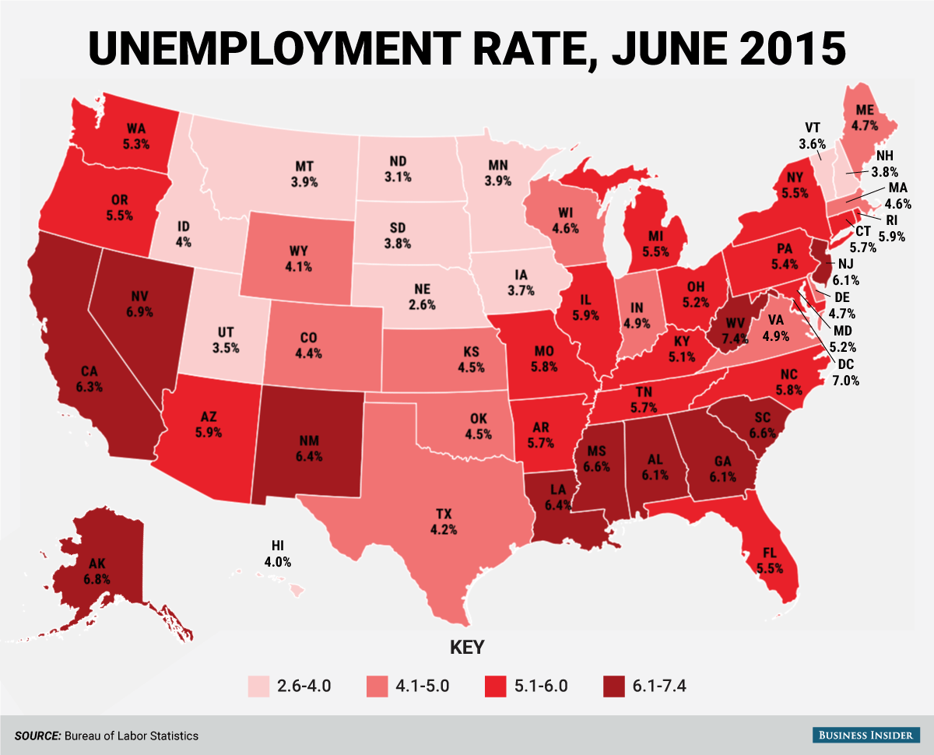

Slide 51
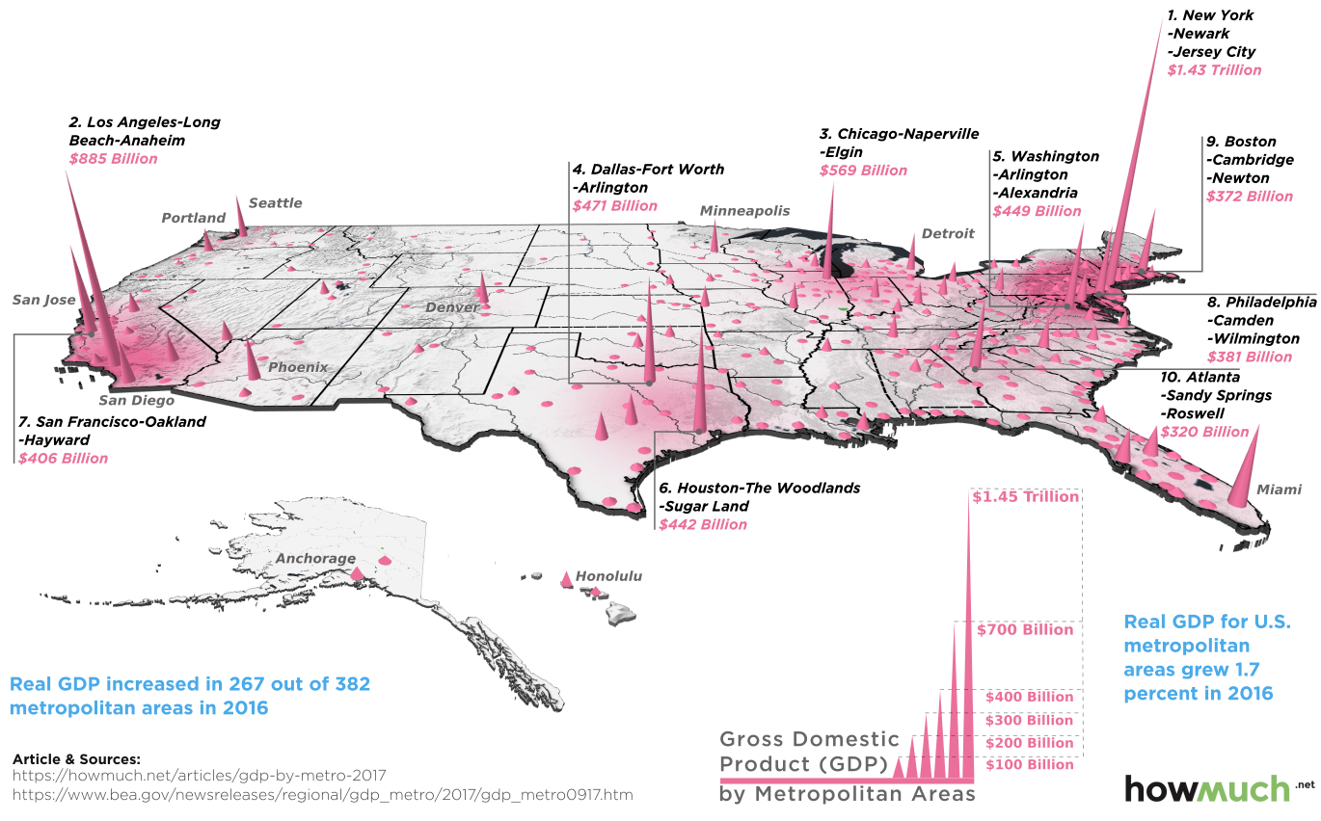
How does where you live impact our economy?
Urban: major cities with large populations
Rural: low populated areas outside cities

Slide 52
Essential Question: Explain the relationship between supply and demand.
Exit Ticket: Unit 9 Review Turn in Box
​Complete the Unit 9 Review

Slide 53
Jenny owns an event planning business. For the upcoming year, she has 2 options. She can either take on 6 average clients, or one major Hollywood star. Planning for the average clients will require her usual amount of work, the planning process will be routine, and she will make enough money to fulfill her budget. If she decides to take on the Hollywood star’s event, she will not have enough time to have any other clients and may not make enough to cover her expenses. However, planning the Hollywood star’s event could be the “big break” she’s been looking to get to make her business famous.
Thursday: According to the passage above, what is Jenny’s trade-off?
a. She chooses to plan the Hollywood star’s event over the average clients’ events
b. She loses out on guaranteed income to balance her budget
c. She misses out on the sense of security and structure she’s use to
d. All of the above

