Slide 1
The study of production, distribution and consumption of goods and services.
Economics

Slide 2
Learning Targets for Economics
LT1: I can explain the process of how goods are distributed in the US
LT2: I can explain how productivity is increased.
LT3: I can analyze how nations of the world are depend on each other.
LT4: I can explain the characteristics of the different economic systems.
LT5: I can explain how supply and demand affects the price of goods and services.
LT6: I can explain production process using the production equation.
LT7: I can describe productive resources.
LT8: I can explain how scarcity leads people to make decisions based on wants and needs.

Slide 3
Supply and Demand
Supply: The total amount of a good or services that is available to consumers.
Demand: A consumers desire and willingness to pay a price for a specific good or service.

Slide 4

Hula Hoops

Slide 5
Hula Hoop Video
In your notes, explain what happened in the hula hoop video to the cost of hula hoops. Be sure to include why you think this happened.

Slide 6
Hula hoop scenario
At first the store owner had _____ hula hoops.
  Anytime you have more supply (hula hoops) that what the consumer wants, this is called a surplus.
In the end of the video, he had ______ hula hoops.
  Anytime you do not have enough supply (hula hoops) to fill what the consumer wants, this is called a shortage or scarcity.

Slide 7
Think…
Think back to your earlier experiences either in middle school or elementary school.
Explain a time when you had to deal with the issue of supply and demand. This could be any time that there were too many (surplus) or not enough (shortage) of something in your life.

Slide 8
Silly Bandz!

Slide 9
Silly Bandz
What problems did stores experience as the demand for the ‘Silly Bandz’ grew?
What problems do you think the owner of Silly Bandz might be facing now that the demand for Silly Bandz has declined?

Slide 10
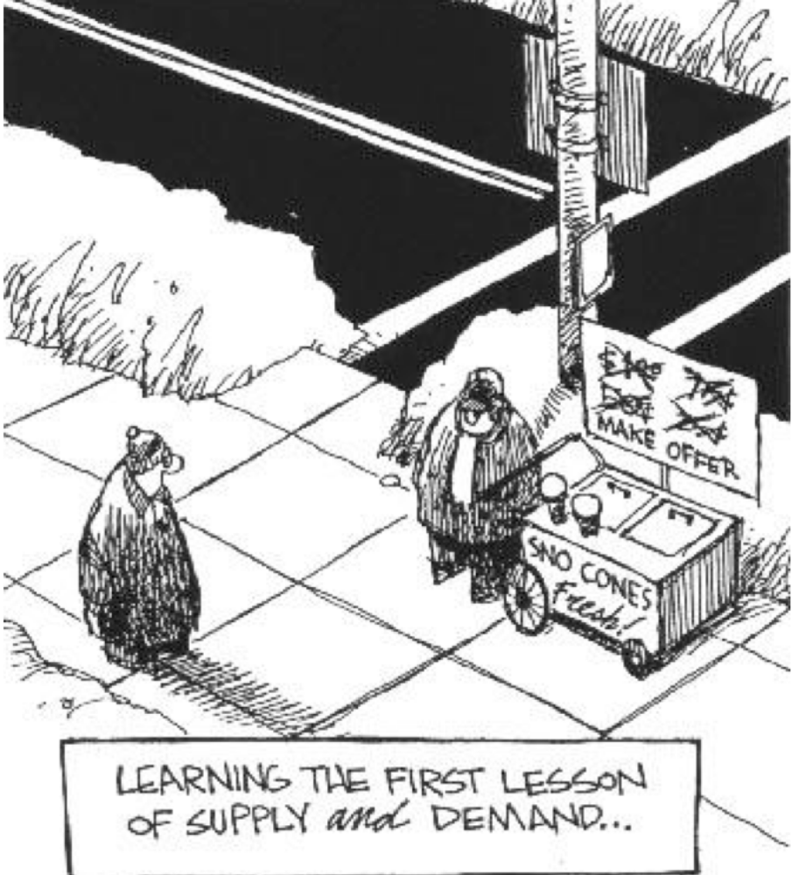
How does this cartoon illustrate the concept of supply and demand?

Slide 11
Assessment
1.) Supply goes up and demand goes down, what will happen to the price?
2.) Supply goes down and demand goes up, what will happen to the price?
3.) Supply and demand are equal, what will happen to the price?
4.) Who or what sets the price of good and services?
5.) Describe how supply affects the price of goods or services. Give an example.
6.) Describe how demand affects the price of goods or services. Give an example.

Slide 12
1.) Supply goes up and demand goes down, what will happen to the price?
A. When the supply of a good goes up and the demand for the product goes down, the price is lowered. This is because there becomes a surplus of the product and in order to make any money at all, the supplier must sell the product at a cost the consumer is willing to pay for the product which is no longer in demand.

Slide 13
2.) Supply goes down and demand goes up, what will happen to the price?
A. As the supply of a product goes down and the demand goes up, the cost of the product will increase. This is because there is a shortage of the product. Because the demand is so high, consumers are willing to pay more for a product in order just to obtain it.

Slide 14
3.) Supply and demand are equal, what will happen to the price?
If the supply and demand are equal, the price of a good or product will remain the same or constant.

Slide 15
4.) Who or what sets the price of good and services?
The price of a good or service is set by the consumer. While the supplier may set a base price based on the cost of manufacturing, it is ultimately the consumer who determines what the value of the good is worth based on their demand.

Slide 16
5.)Describe how supply affects the price of goods or services.
Supply affects the price of goods and services because it can create shortages and surpluses. A shortage is when there isn’t enough supply to meet the demand of the consumer. Therefore, customers are willing to pay more in order just to have the product. Example: When a new gaming system is released, there is often not enough supply in the store to meet the number of customers who wish to buy it. They may then pay hundreds more for the system on eBay. In the same regards, there can be a surplus. This means that too much of an item has been made and not enough customers want to buy it. Example: When a new edition iPhone is released, the older editions will become cheaper to purchase because people want the new version. Therefore, a surplus is created and Apple must sell the older models for cheaper in order to sell them at all.

Slide 17
6.) Describe how demand affects the price of goods or services.
Demand affects the price of goods and services because when a customer really wants a certain good or service, they are willing to pay more in order to get something that other people have a hard time obtaining. On the other hand, If the demand for something isn’t very high, meaning no one wants it, people are less likely to pay very much for something that isn’t popular.

