Slide 1
Personal Finance
Chapter 1: Personal Financial Planning
Section 1.1: Decisions and Goals in Personal Finance

Slide 2
Making Personal Financial Decisions
Personal financial planning means spending, saving, and investing your money to have a life you want while maintaining financial security.
Goals are simply things you want to accomplish.
Planning your finances will help you reach your goals.
You will have more money and be financially secure if you plan your finances.
You will have less of a chance of going into debt.
My Spending Profile score from page six is

Slide 3
The Financial Planning Process
Step 1: Determine your current financial situation
Make a list of monthly savings, income, expenses, and debts.
Estimate your expenses by keeping a record of everything you spend money on in a month.

Slide 4
The Financial Planning Process
Step 2: Develop your financial goals
Values are what beliefs and principles you consider important, correct, and desirable.
You must be able to distinguish between your wants and needs.
Make specific goals
Make a list of your wants and needs.

Slide 5
The Financial Planning Process
Step 3:Identify alternative courses of action
Expand the current situation - increase amount of money to save each month
Change the current situation – invest in stocks instead of putting money in a savings account
Start something new – start paying off a debt
Continue the same course of action – don’t change anything

Slide 6
The Financial Planning Process
Step 4: Evaluate your alternatives
Consider all consequences and risks of each decision you make.
Keep up-to-date on current economic and social conditions.
Opportunity cost, a trade-off, is what you give up when you make one choice instead of another – go to college or have a full-time job.

Slide 7
The Financial Planning Process
Step 4 Continued: Evaluate your alternatives
Inflation risk- things will cost more in the future
Interest rate risk- interest rates are constantly going up and down
Income risk- you may lose your job
Personal risk- things that can happen to you on a daily basis
Liquidity risk- Liquidity means you can quickly and easily convert financial resources into cash without a loss in value

Slide 8
The Financial Planning Process
Step 5: Create and use your financial plan of action
A plan of action is a list of ways to achieve your financial goals.

Slide 9
The Financial Planning Process
Step 6: Review and revise your plan
Your financial planning doesn’t end once you start to follow your plan.
Your finances and needs change over time.
You should reevaluate and revise your plan every year.

Slide 10
Developing Personal Financial Goals
Types of Financial Goals
One factor that influences your planning is the time frame you want to reach your goals.
Another factor is the financial need that inspires your goals.
Short-term goals- reach in < 1 year
Intermediate goals- reach in 2-5 years
Long-term goals- reach in >5 years

Slide 11
Developing Personal Financial Goals
Types of Financial Goals Continued
A service, like a haircut, is a task that a person or machine performs for you.
A good, like a car, is a physical object that is produced and can be weighed and measured.
Consumable goods- purchases made often and are used up quickly, like food and toiletries.
Durable goods- items that are expensive and not made often, like a car or house.
Intangible goods- items that you cannot touch and are usually important to your happiness and well-being, like relationships and an education.

Slide 12
Developing Personal Financial Goals
Guidelines for Setting Goals
Financial goals should be realistic.
Financial goals should be specific.
Financial goals should have a clear time frame.
Financial goals should help you decide what type of action to take.

Slide 13
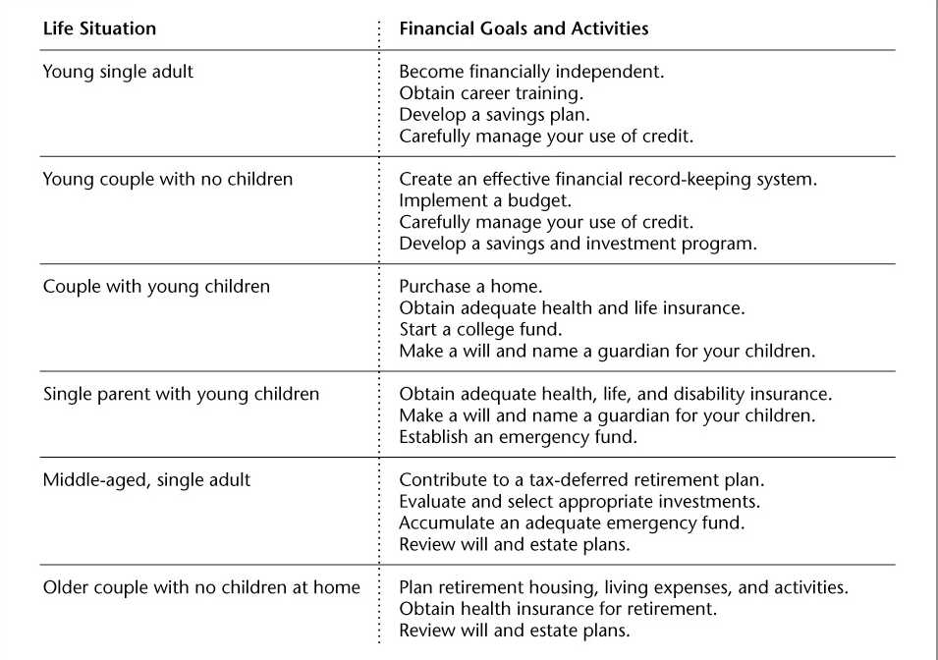
Financial Goals and Activities for Various Life Situations

Slide 14
Influences on Personal Financial Planning
Life Situations and Personal Values
You will experience many changes when entering and going through adulthood.
Your personal values will change, which will influence your financial decisions.
What are some life goals you may have in ten years that you don’t have today?

Slide 15
Influences on Personal Financial Planning
Economic Factors
Economics is the study of the decisions that go into making, distributing, and using goods and services.
The economy is the ways people make, distribute, and use their goods and services.
Supply is the amount of goods and services available for sale.
Demand is the amount of goods and services people are willing to buy.

Slide 16
Influences on Personal Financial Planning
Economic Factors Continued
The Federal Reserve System (Fed) is the central banking organization of the U.S.
Inflation is the rise in the level of prices for goods and services.
A consumer is a person who purchases and uses goods or services.
Interest is the price that is paid for the use of another’s money.
An increase in savings and investments will increase the amount of money others can borrow, causing interest rates to go down. Less saving and investing and times of inflation cause interest rates to rise.

Slide 17
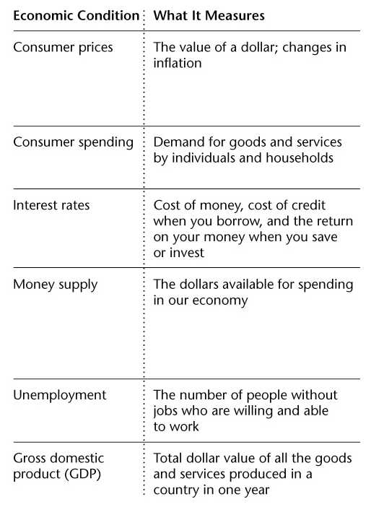
Economic Conditions and Financial Planning

Slide 18
Check Your Understanding
  Name the six steps used to create a financial plan.
  What is the relationship between the timing of your goals and the type of good or service that you seek?
  Describe two economic factors that affect financial decisions. How might these factors influence your financial planning?

Slide 19
Thinking Critically
Why is it important to distinguish between your needs and your wants?

