Slide 1
Taxpayer Impact of Creation of a New High School and K-12 District in Hellgate Elementary.
Jim Standaert
Aug 1, 2014
443-0620 - jestandaert@yahoo.com
  Dr. James Standaert is the retired Senior Fiscal Analyst for the State of Montana. Dr. Standaert has a BS degree from Gonzaga University in English and a PhD from Washington State University in Agricultural Economics. He has served as an assistant professor at the North Carolina State University, Montana State University, and as an adjunct professor at Carroll College.
T

Slide 2
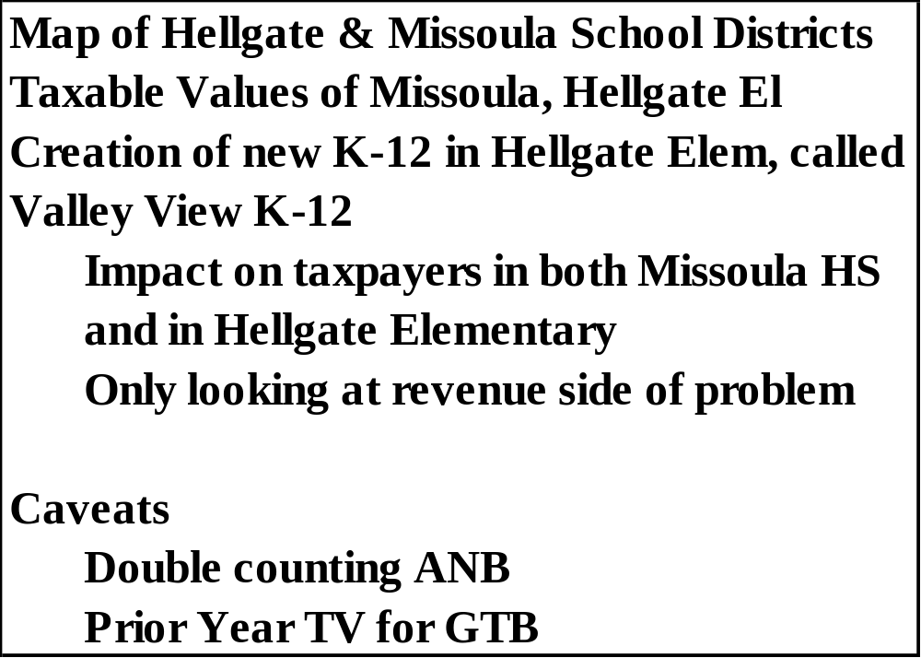
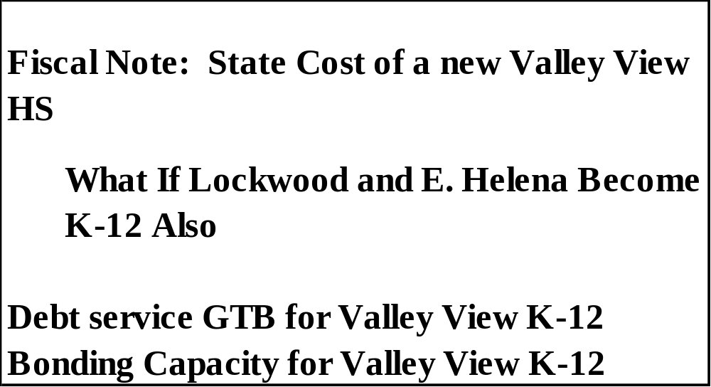
Outline

Slide 3
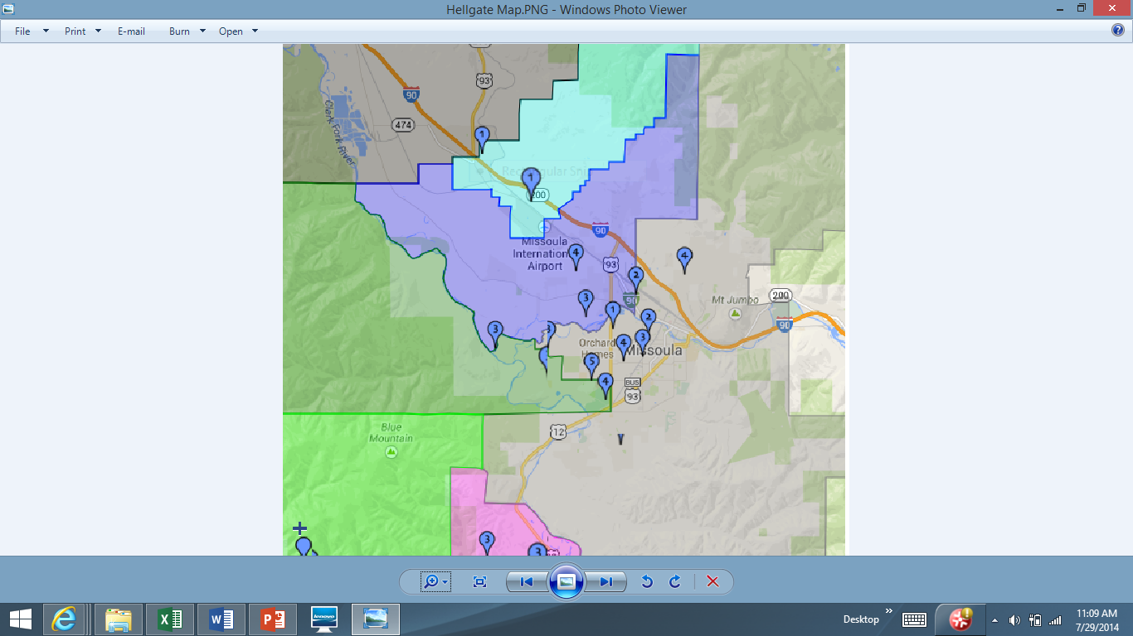
Very Rough Map of Current Helena HS and E. Helena Elementary

Slide 4
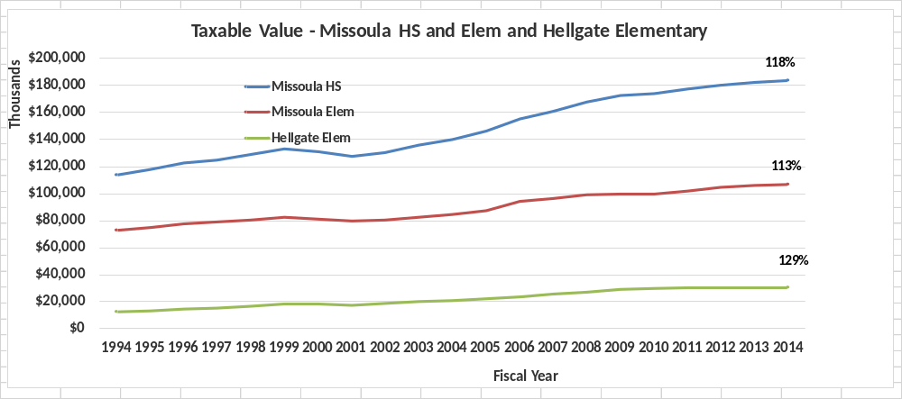
Taxable Value Missoula HS, Missoula Elem & Hellgate Elem 1994 - 2014

Slide 5
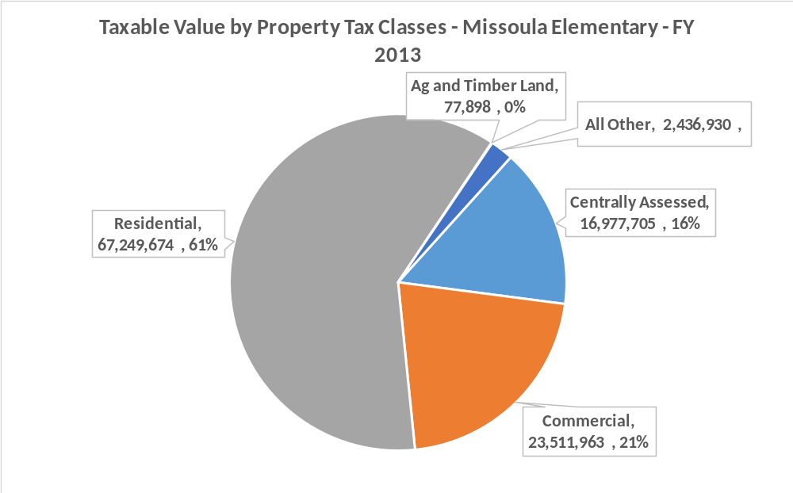

Slide 6
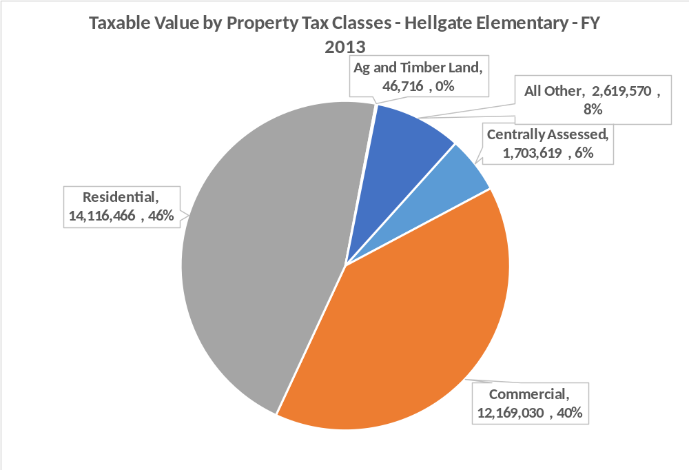

Slide 7
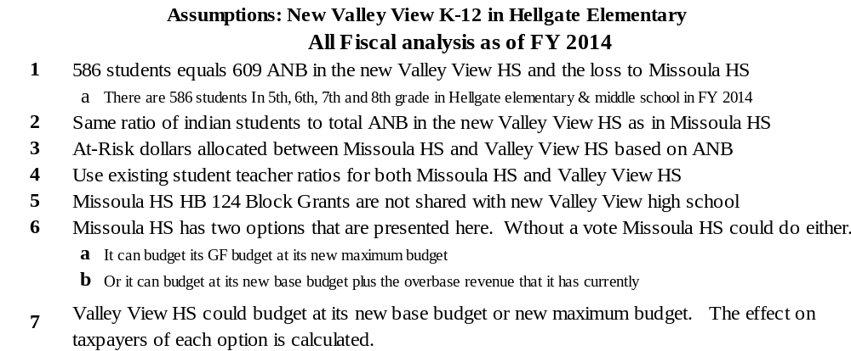
Assumptions

Slide 8
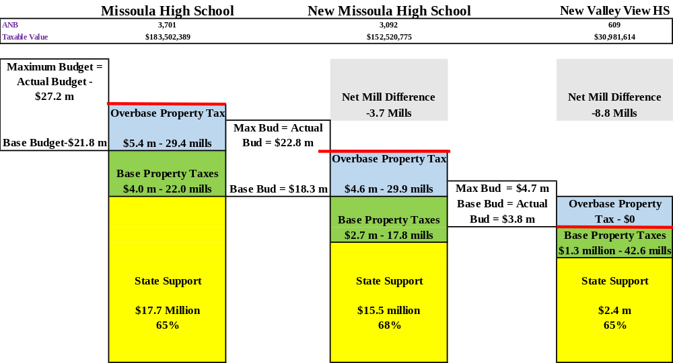
District General Fund Budgets – FY 2014 – Lowest Taxpayer Impact

Slide 9
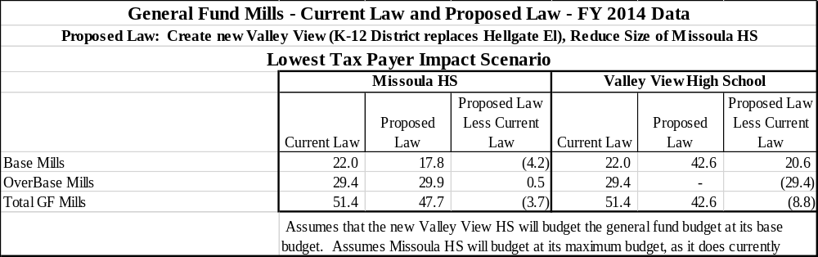
Create New Valley View High School – Mill Change Summary

Slide 10
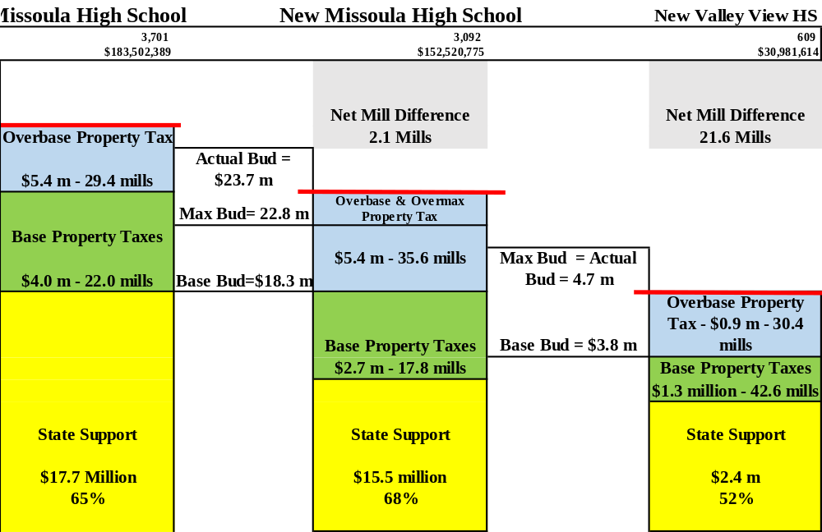
District General Fund Budgets – FY 2014 - Highest Taxpayer Impact (without a Vote)

Slide 11
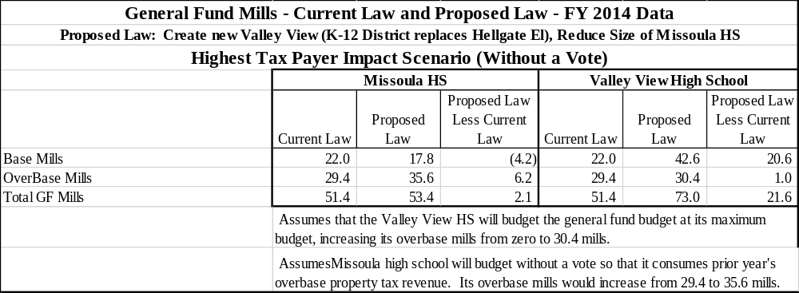
Create New Valley View High School – Mill Change Summary –Highest Taxpayer Impact (without a vote)

Slide 12
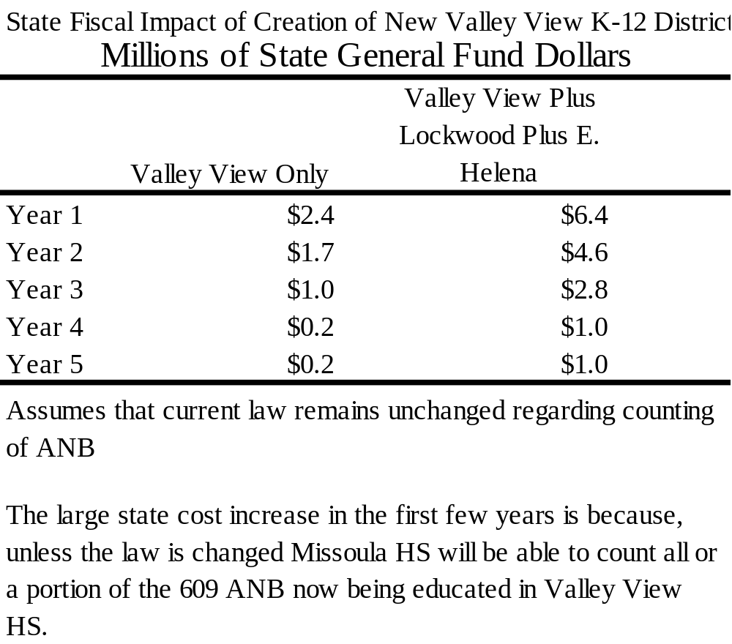
State Fiscal Impact of Creation of New Valley View K-12 District

Slide 13
Why do State Costs go up in the Long Run
The new Valley View HS will receive a new Basic Entitlement that is greater than the reduction in the basic entitlement that Missoula HS will experience ($290,000 for Valley View HS vs loss of $96,000 for Missoula HS). The state’s share will increase commensurately.
The per-ANB entitlement for Valley View HS is larger than it is for Missoula HS, because the decrement for Valley View HS is smaller than for Missoula HS.
Each Missoula HS student not counted would have given Missoula HS $6,155 per ANB in budget authority in FY 2014. The average student in the new Valley View High school will receive $6,403 per ANB in budget authority, an increase of $248 per ANB. The state’s share will increase commensurately.
Offsetting these cost increases, Valley View’s GTB per student will be lower than Missoula HS, because Taxable Value per student in Valley View is higher than in Missoula HS

Slide 14
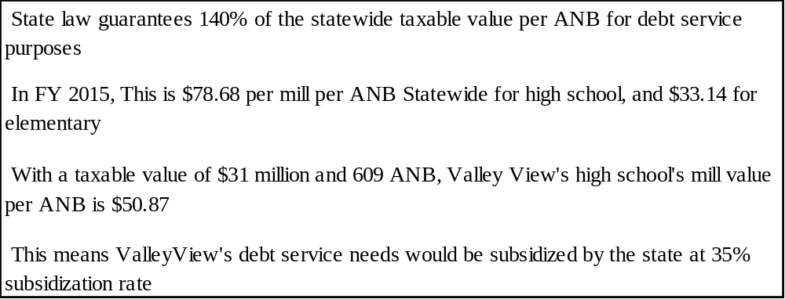
Debt Service Guaranteed Tax Base Aid
[20-9-366 MCA]

Slide 15
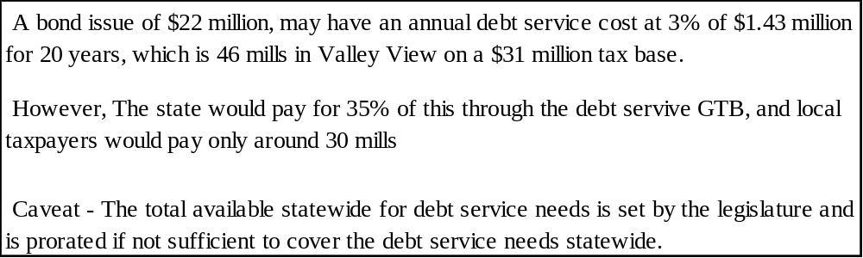
Debt Service Guaranteed Tax Base Aid

Slide 16
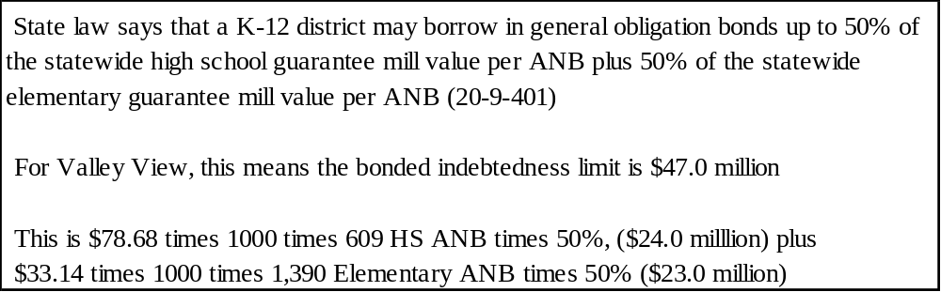
Bonded Indebtedness Capacity

