Slide 1
Free Market Economy

Slide 2
Markets
Market- an arrangement that allows buyers and sellers to exchange things.
Markets exist because no one is self-sufficient. Each of us produces just one or a few products
Specialization- the concentration of the productive efforts of individuals and firms on a limited number of activities.
How can specialization lead to the efficient use of the factors of production (land labor and capital.
What negative effects can specialization have on society?

Slide 3
Incentives
When paying someone to work for you in a specialized field, what risks are involved?
What are incentives?
Incentive- is the hope of reward or the fear of punishment that encourages a person to behave in a certain way. People respond predictably to both positive and negative incentives.

Slide 4
Late Pick Up Problem
A study shows that the average day care center has 8 late pickups per week. This causes the workers at these centers to spend more time waiting for the children and less time working efficiently.
  As an economist it is your job to come up with an incentive scheme that could alleviate this problem!
    Explain how your incentives will be implemented.
    Explain why they will be effective.

Slide 5
Why is it important to understand how incentives motivate people in different ways?

Slide 6
Free Market Economy-
In a free market system, individuals and privately owned businesses own the factors of production, make what they want, and buy what they want. In other words, individuals answer the three key economic questions of what to produce, how to produce it and who consumes that which is produced.

Slide 7
Free Market Economy
The players in the free market economy are households and firms.
A household is a person or group of people living in the same residence.
A firm is a business, or an organization that uses resources to produce a product, which it then sells

Slide 8
Factor Market
In the Factor Market firms purchase factors of production from households.
Firms purchase or rent land
They hire workers
They also borrow money to purchase capital

Slide 9
Product Market
Goods and services that firms produce are purchased by households in the product market.

Slide 10
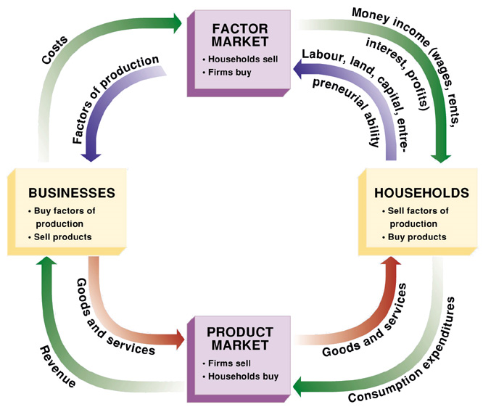

Slide 11
Self-Regulating nature of the marketplace
Self Interest- in each transaction, the buyer and seller consider only their self-interest, or their own personal gain. Self-interest is the motivating force in the free market.
How can self interest and incentive influence pricing?

Slide 12
Self-Regulating Nature of The Marketplace
Competition- The struggle among producers for the dollars of consumers.
Competition keeps business from raising prices for fear of losing business to competition.

Slide 13
The Invisible Hand of the Marketplace
Competition and self-interest helps keep prices relatively close to the cost of production without regulation.
This is called the Invisible hand of the marketplace.

Slide 14
Efficiency vs. Economics
Why are Hybrid cars so much more expensive?
Government wants American car companies to make more fuel efficient vehicles. Is this normal behavior in a free market economy? How does this contradict the notion of consumer sovereignty.
How might it be easier to move towards fuel efficient vehicles in a command economy, or mixed economy.
We have a mixed economy in the US. What could the government do to increase the demand for fuel efficient vehicles?

Slide 15
Brainstorm advantages and disadvantages of a free market system.

Slide 16
Possible Disadvantages
Go back and look at the economic goals. Which goals might be difficult to achieve in a Free Market economy.

Slide 17
Advantages of a Free Market System
Economic efficiency- because it is self-regulating (invisible hand) a free market economy responds efficiently to rapidly changing conditions.
Economic Freedom
Economic growth- because competition encourages innovation, free markets encourage growth (Always striving to create new products that people might like).
Free markets offer a wider variety of goods than any other system because producers have incentives to meet consumer demands.
Consumers have control over what gets produced. This is called consumer sovereignty.

Slide 18
Disadvantages of Free Market
Economic Security
Economic Equity

Slide 19
Vocabulary Assignment
Land
Labor
Physical Capital
Human Capital
Opportunity Cost
Specialization
Scarcity
Entrepreneur
Consumer Sovereignty
Three Economic Questions
Traditional Economic System
Free Market Economic System
Command Economic System
Mixed Economic System.

Slide 20
Quiz
Why are lobsters cheaper than hot dogs
List and define 4 factors of production
What are the three economic questions?

Slide 21
Land Traditional Economy
Labor Market Economy
Physical Capital
Human Capital Command Economy
Scarcity Mixed Economy
Entrepreneur Market
Specialization Household
Firm Self Interest
Opportunity cost Incentive
Competition Invisible hand
Three Economic Questions Consumer Sovereignty

