Slide 1
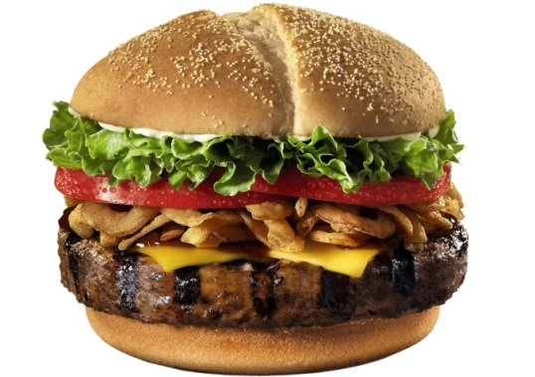
Economics Mini-Poster
Draw a product that you would like to create
Answer the 3 basic economic questions for it
List at least two examples of how your resources could become scarce and HOW it would affect you
Give THREE examples per factor of production
EXAMPLE: Creating Hamburgers
3 Economic Questions:
What to Produce: hamburgers
How to Produce: *Write step by step instructions* LONG AND SPECIFIC
For Whom to Produce: Hungry people in Destrehan that want a good hamburger
Scarcity:
If there is a drought, then the tomato plants won’t grow and I won’t have tomatoes for my hamburger because the price of tomatoes would go up and I couldn’t afford them.
If there is a cow disease and they die, I won’t have meat for my burger because the price of hamburger meat would go up and I couldn’t afford it.
Factors of Production:
Land: cow, lettuce, onions
Labor: farmer, chef, butcher
Capital: meat grinder, grill, spatula
Entrepreneur: Five Guys, Company Burger, McDonald’s

