Slide 1
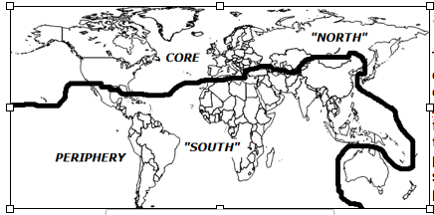
A. Draw the Brandt line. Shade the region known as the “North” and any countries on the south side of the line which are considered part of the “North.”

Slide 2
B. What does each of the following have to do with the Brandt Line? That is, define each of the following terms with relation to the line and the economies of either side of it.
1. Core-periphery (MDC-LDC)
Definition: The core is the wealthy countries, also called more developed countries, or MDCs. Because they are all in the Northern Hemisphere they appear – on a polar projection - as a core, surrounded by a periphery of poorer, less developed countries in the Southern Hemisphere.
The line between this “north” and “south” is sometimes called the Brandt Line.

Slide 3
B. What does each of the following have to do with the Brandt Line? That is, define each of the following terms with relation to the line and the economies of either side of it.
2. Neocolonialism
Definition - The idea that former colonial relationships have ended only politically, but that they continue to play an important role economically as the colonies remain dependent on the stronger economies of their former rulers.
Generally, raw materials from the primary sector flow from former colonies to the MDCs and finished products from the secondary economy and services of the tertiary flow back to them. The dependent colonies are in the “south” and the colonizers are in the “north.”

Slide 4
B. What does each of the following have to do with the Brandt Line? That is, define each of the following terms with relation to the line and the economies of either side of it.
3. Trickle-down theory of economics where increased wealth for the upper class means benefit for the lower class.
Applied - This is the theory where money that is invested in the northern core will eventually have a positive influence on the southern periphery.
A related idea is that of technology-transfer; that technological developments of the core will also make their way down to the LDCs.

Slide 5
B. What does each of the following have to do with the Brandt Line? That is, define each of the following terms with relation to the line and the economies of either side of it.
4. Transnational Corporations
Definition – are companies that operate in multiple countries.
Generally, the headquarters are in an MDC in the “north” while some operations which require cheap labor – assembly, for example – are located in LDCs of the “south.” Most transnational headquarters are in the US, Britain, France, and Japan.

