Slide 1
Do Now – 5 minutes
Find your assigned seat.
Journal Entry – What are you passionate about? What do you always want to know and learn more about? How did you first become interested? Why is it important to you?
Continue writing until I say to stop.
Be prepared to share (5 minutes)!

Slide 2
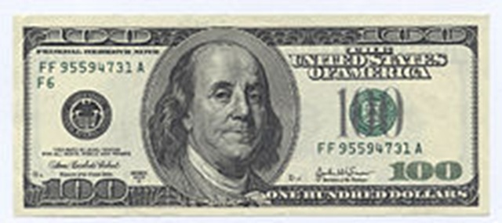
Ben Franklin
SSUSH2b – Identify Benjamin Franklin as a symbol of social mobility and individualism.

Slide 3
European Enlightenment
Definition – an intellectual movement in the 16th and 17th century that believed all problems could be solved using human reason.
  Challenged traditional thoughts on science, religion, and government.
Scientific Revolution – must be measurable and observable through experiments.

Slide 4
European Enlightenment
Philosophers applied Scientific Revolution principles to government, society, economics.
  Jean-Jaques Rousseau – “Radical Direct Democracy”
    “Man is born free and everywhere is in chains.”
  John Locke – “Social Contract”
    Government has certain responsibilities to its citizens, and the citizens have responsibility to support the government.
      If government doesn’t do its part, people can rebel.
    “Life, liberty, and the pursuit of property.”

Slide 5
Enlightenment in America
Major influence on colonists.
  One reason – the colonists could read
  Puritans & others – importance of reading the Bible
    Literacy rates – 85% of men, 50% of women
    By far the highest in the world
  New colleges – Harvard, Yale, William and Mary
Example - Benjamin Franklin
  Intellectually inquisitive - Wanted to understand everything.

Slide 6
Ben Franklin
Published Poor Richard’s Almanac (1732-57)
Almanac – combination calendar, astrological guide, and medical and farming tips
  Promoted useful, practical, and diverse knowledge
  Brought Enlightenment ideas to the common people
Inventor, scientist, philosopher, politician….

Slide 7
Stations – 30 minutes
We will use three stations to explore various parts of Benjamin Franklin’s life, and will take additional notes on Franklin in these stations.

Slide 8
The Great Awakening
SSUSH2c – Explain the significance of the Great Awakening.

Slide 9
Decline of Religion
Early 1700s – only 1/5 Northerners belonged to a Church & only 1/15 Southerners.
Increasing tolerance
Enlightenment conflicts with predestination
  Humans were not just God’s pawns; they had choice
Deism - a belief in God based on reason rather than revelation and involving the view that God has set the universe in motion but does not interfere with how it runs.
  Ben Franklin major proponent

Slide 10
Great Awakening
Churches would welcome anyone
  Even without evidence of conversion
Condemned establishment church officials
  Called for piety and purity.
Appealed to emotions; abandoned ‘spiritual coldness’
  “Fire and brimstone”
  Based on fear and hope
Jonathan Edwards – “Sinners in the Hands in an Angry God” (http://www.youtube.com/watch?v=jPyTvE2iQbE)

Slide 11
Great Awakening (cont)
Jonathan Edwards – “Sinners in the Hands in an Angry God” (http://www.youtube.com/watch?v=jPyTvE2iQbE)
In your notes, write at least 5 images/pictures that Edwards uses.
Also, write any strong emotions you feel at any point throughout the sermon (at least 5).

Slide 12
Great Awakening (cont)
Travelling revivalists
One of the first national events in American history
Converted many slaves to Christianity
  Some whites and blacks worshipped together

Slide 13
Great Awakening (cont)
Number of churches more than doubled from 1740-1780
  BUT – the colonial population nearly tripled in this time period
Biggest impact – young people

Slide 14
Exit Quiz – 7 minutes
1.) Which of the following would NOT likely be included in an almanac?
Weather forecasts
Bible verses
Astrological calendar
Medical advice
2.) How is Benjamin Franklin an example of an Enlightenment thinker?

Slide 15
Exit Quiz
3.) With which of the following statements would a Deist be most likely to agree?
  God has chosen some people to go to Heaven, and others to go to hell.
  God does not exist.
  Organized religion cannot explain God.
  We can understand God by reading the Bible directly.
4.) Define “the Great Awakening.”
5.) Who wrote Poor Richard’s Almanac?

