Slide 1
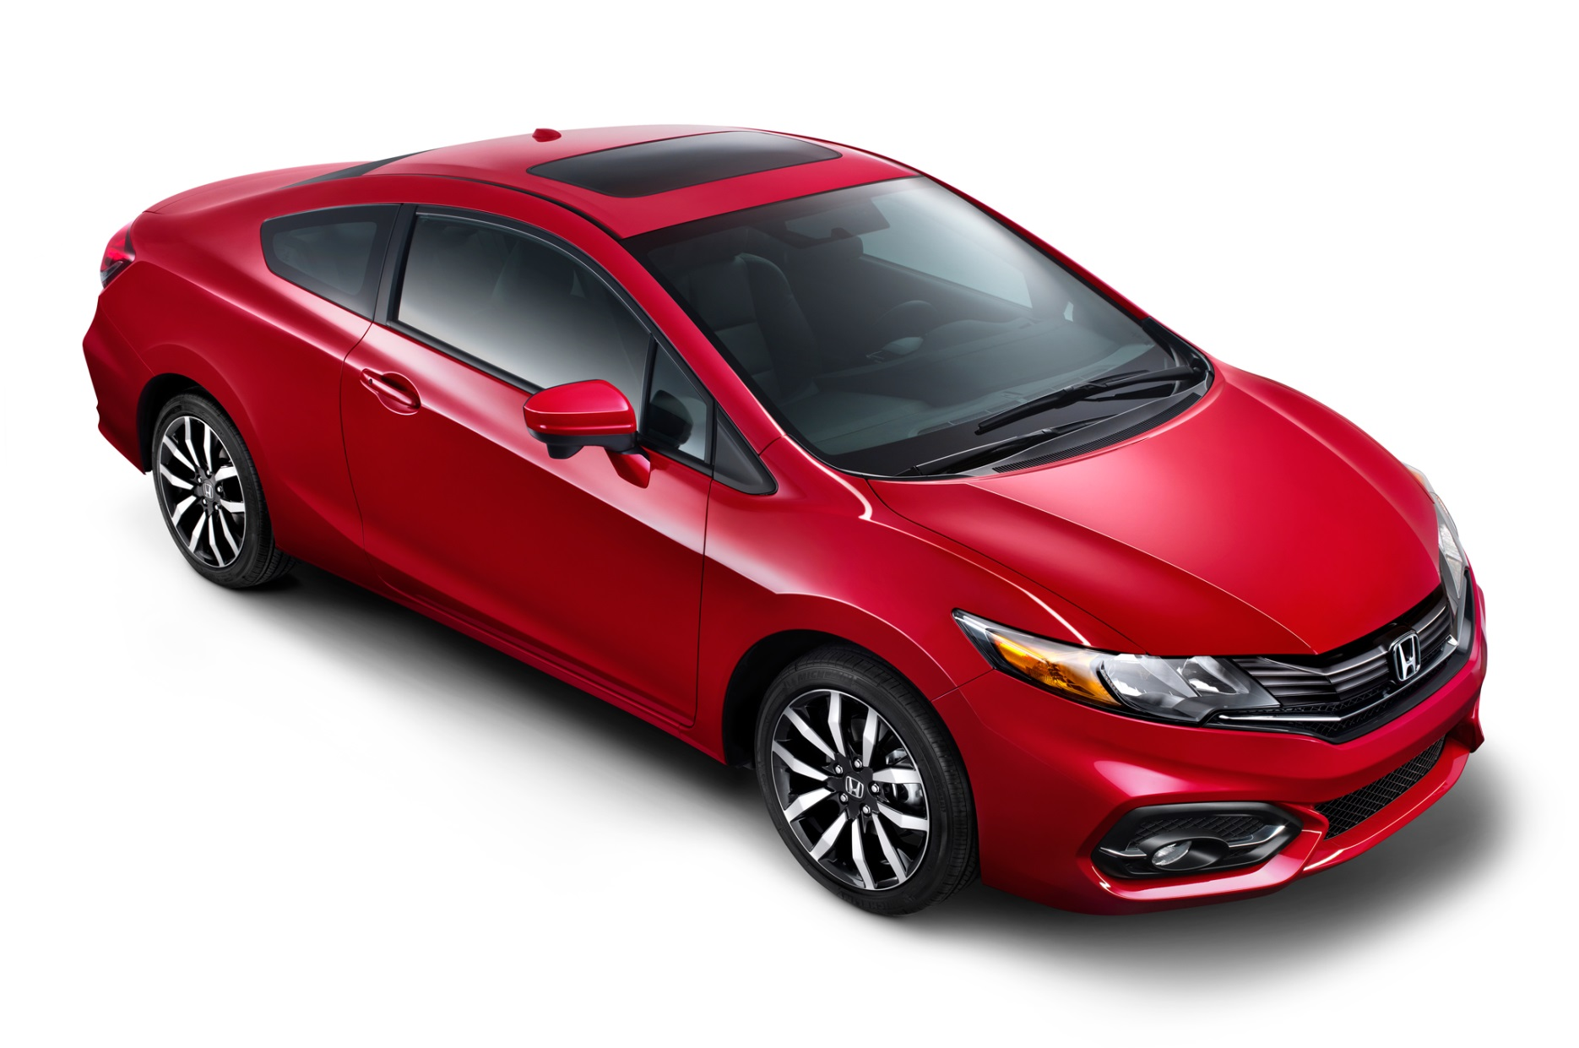
List everything that is needed to create the picture below-

Slide 2

Intro to Economics
How Economic Systems Work & Factors of Production

Slide 3
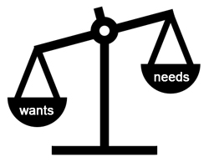
Needs vs. Wants
Needs are things we must have to survive
  Food
  Water
  Shelter
  Clothes
Wants are things we desire to make life more comfortable and enjoyable
  Entertainment
  Vacations
  Toys

Slide 4

What is Economics?
Economics is the study of how we make decisions in a world in which resources are limited
  Our wants vs. our needs
Economics also includes how things are made, bought, sold and used

Slide 5
Micro- and Macroeconomics
Microeconomics- look at the small picture; study the behavior of individuals and businesses
Macroeconomics- look at the big picture; study the economy in whole countries, whole industries, or societies
Economic Model- the theory that tries to explain human economic behavior

Slide 6

Factors of Production
Land (Natural Resources)- Gifts of Nature; Natural Resources or property
  Renewable- can be replaced
    Crops, solar energy, animals
  Non-renewable- cannot be replaced
    Oil, coal, natural gas, minerals

Slide 7

Factors of Production continued…
Labor (Work)- Any form of human effort exerted in production; Also called human resources
  Human Capital- A person’s potential for economic productivity
  Human Capital is developed by natural talents, education, training, & good habits
    Blue Collar and White Collar

Slide 8
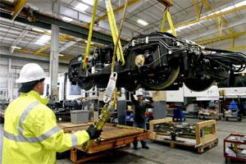
Factors of Production continued…
Capital (Goods)- A man-made factor of production used by labor in making other products
  Basic assets used in production
  Capital goods = products used to produce the final product
    Examples include machinery, tools, buildings, raw materials, factories, company car
  Consumer goods = the final product which is sold to consumers

Slide 9

Factors of Production continued…
Entrepreneurship- The individual responsible for combining and organizing natural resources, capital goods, and labor to produce a good or service
  Starting, operating, and expanding a business
  Operate businesses to make a profit

