Slide 1
Dzi[ Diyingo Hadadiilyaa
Objective: TSW
-Name the four Sacred mountains in Din4 Bizaad.
-Locate the four Sacred Mountains according to its direction on a map.
-Describe the four Sacred Mountains.

Slide 2
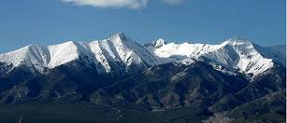
Sisnaaj7n7 Dzi[ - Yoo[gai Dzi[
Ha’a’aah
{igai

Slide 3
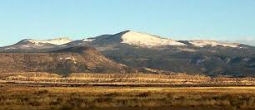
Tsoodzi[ - Doot[‘izhii
Shadi’11h
Doot[‘izh

Slide 4
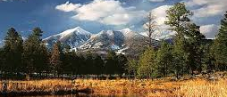
Dook’o’oos[77d – Diichi[7 Dzi[
E’e’aah
{itsoh

Slide 5
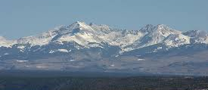
Dib4 Nitsaa – B11shzhinii Dzi[
N1hook-s
{izhiin

