Slide 1
Dual Enrollment Dual Credit
Guide to Completing the Process/ Forms Correctly

Slide 2
Guidance Packet
Read the Guidance Packet in its entirety to ensure understanding of all expectations
By signing the various dual enrollment dual credit documents, understanding is expressed

Slide 3
Approved Course Replacement List
Pg. 5
These are the only courses approved for dual credit. Utilize this list when looking for courses to take for dual credit.

Slide 4
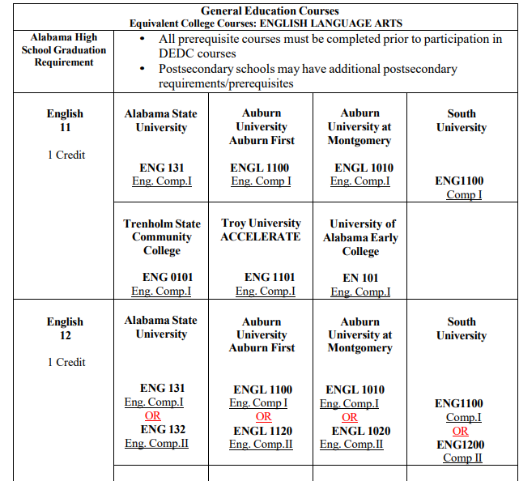



How to Read the Replacement List
Understanding the Table
Alabama High School Graduation Requirement – This column list the specific courses needed for graduation that has a dual enrollment dual credit course to substitute in place of that specific course.
This arrow demonstrates an example of the postsecondary institutions that offer a course to replace the required graduation requirement listed in the row
This number identifies the course number utilized at the specific postsecondary institution.
This arrow identifies the specific course name that should be recorded on your Approval and Scholarship forms.

Slide 5
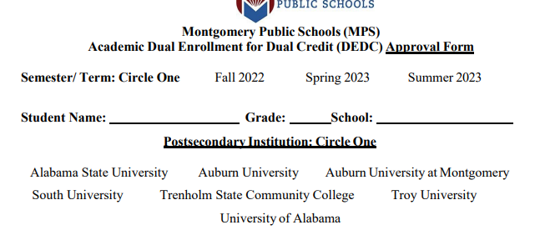
Approval Form
Completion
Semester/ term: Circle One
Circle the semester or term you will take a dual credit course.
Student: Complete legal name Grade: Grade level School: High school
Postsecondary Institution: Circle the one postsecondary institution you have been admitted, or in the process of seeking admission..

Slide 6
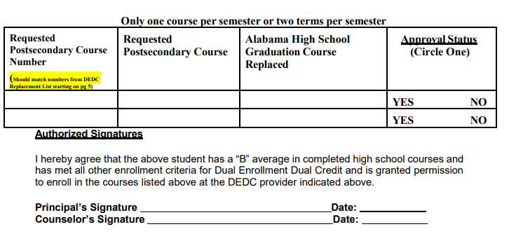
Approval Form
.
Completion
Requested Postsecondary Course Number – Look back at the Approved Course Listing that starts on page 5. Place the NUMBER of the course utilized by the specific postsecondary institution that you are seeking approval.
Requested Postsecondary Course – Utilize the Approved Course List that starts on page 5 to obtain the exact course NAME listed by the postsecondary institution for the course you are seeking approval.
Alabama High School Graduation Course Requirement – List the REQUIRED graduation course this dual enrollment course will replace. Example: English 11, math 4, science 3.
Principal and counselor’s signature is required.

Slide 7
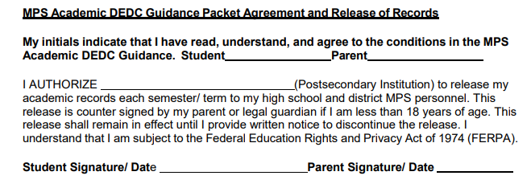
Approval Form
.
Signatures
Signing this document indicates you have read, understand, and agree to the guidelines and expectations that are laid out. You are also releasing grades to MPS that will be utilized for the dual enrollment dual credit course.

Slide 8
Follow the Steps!!!
Quick Steps
Schedule a meeting with high school counselor to discuss eligibility and establish college/course options from the MPS Academic DEDC Approved Course Replacement List (beginning on page 5 of guidance document)
Research and review postsecondary options, application process, enrollment procedures, available courses and various deadlines for both MPS and the postsecondary institution of choice.
Complete the postsecondary enrollment process.
Complete and submit the MPS academic DEDC approval and scholarship forms to the high school counselor for consideration and principal approval prior to registering for any DEDC course(s). Copies of signed approval and scholarship forms will be given back to students within 7 working days.
Students are to provide copies of their approval and scholarship form to their postsecondary dual enrollment contact. Their postsecondary contact will work with them to complete the enrollment/registration process adhering to MPS scheduling guidelines. (Complete and submit DEDC scholarship and student driver form as needed.) Students will not receive high school credit or scholarship funding for ANY COURSE taken that is not on the approval form.
Students will provide the high school counselor with proof of college course enrollment (e.g. college course schedule) no later than 7 working days after enrolling to ensure that DEDC courses are reflected on student schedules.
Steps 1 and 4-6 should be completed each fall, spring, or summer semester/ term.

Slide 9
Dual Enrollment Postsecondary Contacts
Alabama State University | Auburn University
Shannon Burton Dual Enrollment Coordinator 334-229-4808 sburton@alasu.edu | Alli Bracewell Auburn Online 334.844.8732 smallaj@auburn.edu

Slide 10
Dual Enrollment Postsecondary Contacts
Auburn University Montgomery | University of Alabama
Lucas Carroll, Admissions Counselor 334-394-5657 – lcarrol3@aum.edu | Leslee Griggers | Academic Advisor Phone 205-348-7083 lagriggers@ua.edu

Slide 11
Dual Enrollment Postsecondary Contacts
South University | Troy University
Steele, PhD Campus Director and Dean of Academic Affairs & Operations Office: 334-395-8817 ksteele@southuniversity.edu | Korrie Lynn James Coordinator of Dual Enrollment Office: (334) 808 – 6707 kljames@troy.edu

Slide 12
Questions
Contact your school counselor
Contact your school principal

