Slide 1
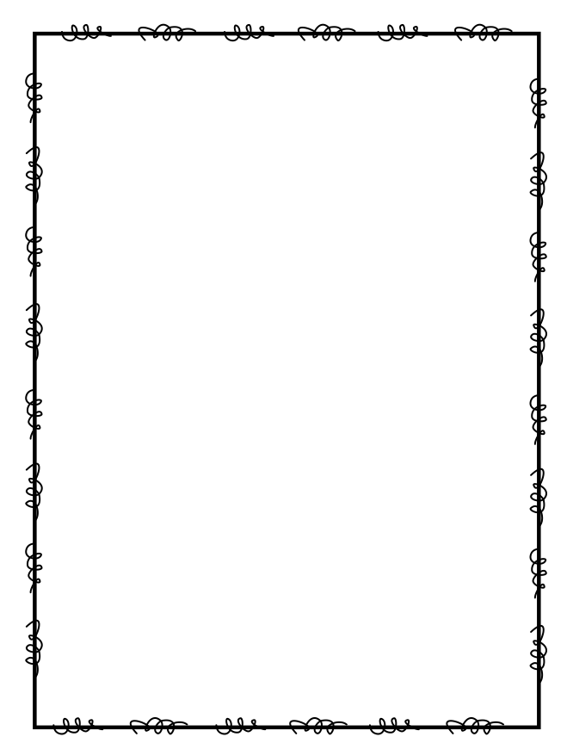
Name ____________________
Week 9
Day 1
1) While organizing the books at the library, Eric put 4 books in the first pile, 8 books in the second pile, 16 books in the third pile, and 32 books in the fourth pile. If this pattern continues, how many books will Eric put in the fifth pile? | 2. Carrie’s mom needs 94 multi-colored balloons for her birthday party. She already has 19 orange balloons and 21 green balloons. How many more balloons should Carrie’s mom buy?
3. List the factors for 8, 12 and 16. What is the greatest common factor? | 4. Multiply to find the product of 43 X 5.
Day 2
1. Is 145,989,242 divisible by 2? What digit can you look at to quickly tell you the answer? | 2. The fourth grade class has a pet guinea pig and a pet ferret. The pet guinea pig weighs 4 times as much as the pet ferret. The pet ferret weighs 9 ounces. How much does the pet guinea pig weigh?
3. Find the first 4 multiples of 6. 6, _____, _____, _____, _____ | 4. Look at the numbers below. Which two numbers can be multiplied together to get the product 63? 10, 7, 9, 5

Slide 2
Day 3
1. Danielle had $125 in her piggy bank. Then she made $42 from babysitting and spent $6 on a magazine and $19 on a board game. How much does Danielle have left? | 2. On Friday Pat’s Pastries sold 210 pounds of bread dough. On Saturday they sold twice that amount. On Sunday they only sold 130 pounds. How much more bread dough did they sell on Saturday than Sunday?
3. Which of the following numbers when rounded to the nearest ten becomes 170? a). 158 b). 169 c). 180 d). 179 | 4. Solve to find the difference: 808,425 – 456,569 = _____________
Day 4
1. Dylan has 9 video games and Robert has 54. How many times more video games does Robert have than Dylan? | 2. Write the numbers in order from greatest to least: 67,989; 76,898; 64,623; 74,123; 73,673; 76,988; 65,123; 66,455
3. Multiply to find the product: 62 x 30 = | 4. Ms. Jones has 32 students in her class. Each student shows up on the first day of school with four red folders. Write an equation that represents how many red folders Ms. Jones will collect. Solve to find the answer.

