Slide 1
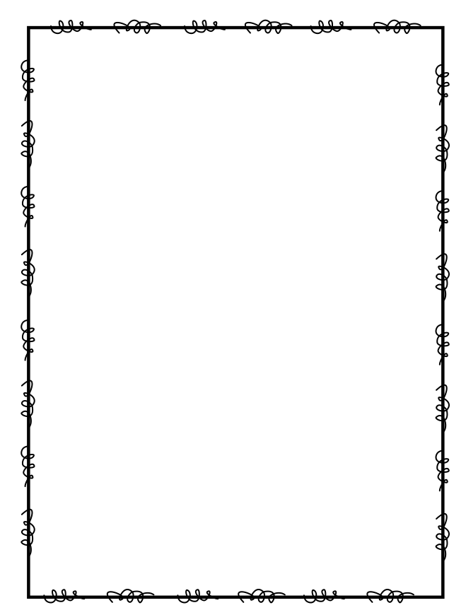
Name ____________________
Week 29
Day 1
1) Draw an acute angle. | 2) Order the decimals from least to greatest: 1.34, 1.43, 1.03, 1.3, 1.4, 1.44, 1.04, 1.33
3) Jenny’s gift box is 7 feet wide and has an area of 35 square feet. What is the length of Jenny’s gift box? | 4) Which fractions below are equivalent to 6/8? There may be more than one correct answer. a). 3/4 b). 12/24 c). 18/24 d). 2/6
Day 2
1) Draw a pair of perpendicular line segments below: | 2) George lives 4 5/10 miles from the gym. Write this amount as a decimal.
3) Multiply to find the product: 89 X 73 = | 4) How many hundreds are in 9,000?

Slide 2
Day 3
Tony drew 7 heptagons. How many line segments did Tony draw? | 2). Multiply 3/9 x 9. Write the product then draw a picture to show your answer. Simplify your answer if necessary.
3) Each side of a square painting is 9 feet long. A frame shop charges $2.00 per foot for a wood frame. How much would it cost to buy a frame for the painting? | 4) Divide to find the quotient: 6734 -:- 4 =
Day 4
1) Jayden drew a shape with 8 angles, 8 vertices and 8 sides. What shape could he have drawn? | 2) Write 0.968 as a fraction.
3) Stephanie buys 18 baseball hats for $12 a piece and 4 baseball gloves for $32 a piece. She hands the cashier $400. How much change should Stephanie get back? | 4) Brendan went with his twin brother and sister to the doctor to be weighted. His brother weighted 19 1/8 pounds. His sister weighted 18 3/4 pounds. How much more does Brendan’s brother weigh than his sister?

