Slide 1
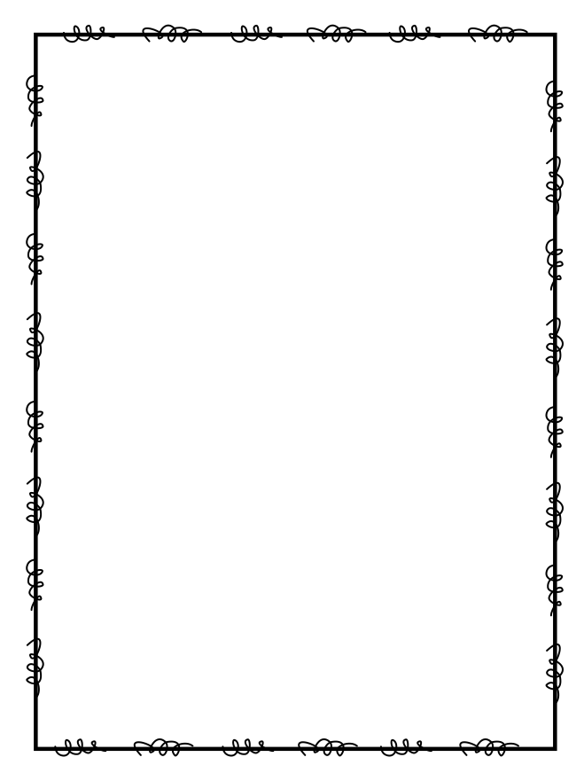
Name ____________________
Week 28
Day 1
1) The students in Mrs. Smith’s class kept a record of the number of pages they read in their books during spring break. There were 3 students that read 28 pages, 4 students that read 19 pages, 1 student that read 34 pages and 5 students that read 29 pages. Use this data to make a line plot. | 2) Jason, Benny, Dan and Sam each bought 640 baseball cards which come in packs of 20, How many packs of baseball cards do they have in all?
3) Multiply to find the product: 49 x 64 = | 4) Plot and label points to show locations of 8/10 and 0.4 on a number line.
Day 2
1) Henry and his friends played miniature golf. Their scores are shown below. Make a line plot using the list below: 43, 56, 70, 48, 46, 42, 43, 43, 56 | 2) Use the symbols <, >, or = to compare the decimals below. 0.07 ______ .1
3) Find two equivalent fractions to the fraction 3/5. | 4) There are 118 rose bushes currently in the park. The park gardeners will plant 117 more rose bushes today. How many more rose bushes will they need to plant to reach their goal of 500?

Slide 2
Day 3
Write the decimal 0.08 as a fraction in simplest form. | 2) A beach store sold 567 bottles of sunscreen last week. How many bottles on average were sold each day?
3) Write a number with a 2 in the hundredths place, 7 in the tens place, 4 in the hundreds place, 1 in the tenths place, and 8 in the ones place. | 4) Is the shape below a quadrilateral? How do you know?
Day 4
1) How can you classify the shape below? Write all of the names that apply. | 2) Turn 4/10 into a decimal.
3) There are 87 students in 4th grade. Each student will get 25 pencils. How many pencils will the teachers have to give out? | 4) Draw a hexagon below. How many vertices and how many sides does a hexagon have?

