Slide 1
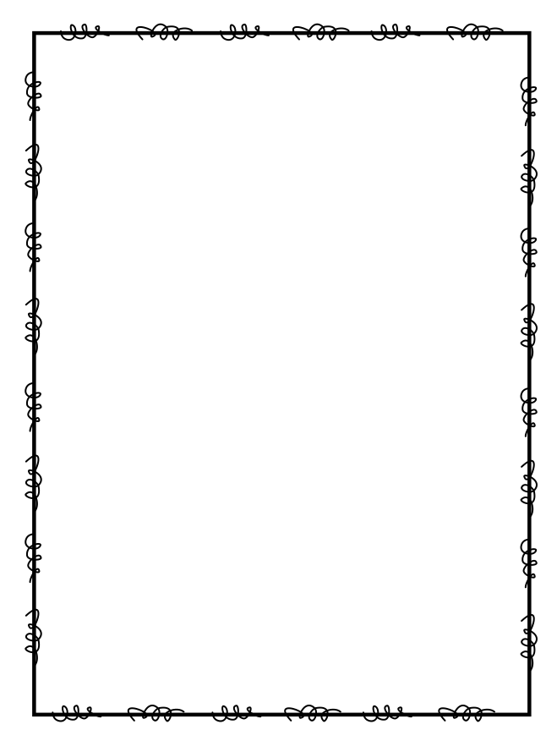
Name ____________________
Week 25
Day 1
1) Mr. Kenny wants to divide 465 students into 3 equal groups. Is this possible? Show your thinking. | 2) Multiply to find the product: 6,839 x 7 = ______
3) Complete the chart by labeling the place of each digit. What is the value of the digit in the ten-thousands place? | 4) Subtract the fractions and simplify if possible: 7 6/12 – 5 9/12 = ________
2 | 8 | 4 | 3 | 7 | 6
Day 2
1) Rename the fraction 60/100 as a fraction with a denominator of 10. | 2) Mrs. Thompson has 28 students in her class. Each student shows up on the first day of school with $136 for their school supplies. Write an equation that represents how much money Mrs. Thompson collected on the first day of school. Solve to find the answer.
3) Which place value would you use to compare the numbers 18,365 and 18,462? | 4) For the school bake sale, Amy made pastries. She baked two dozen cupcakes and forty-eight cookies. After the sale, she had 12 pastries to take home. How many pastries did she sell?

Slide 2
Day 3
1) Michael bought 16 roses for his mother. ¾ were red and the rest were white. How many roses were white? | 2) Ben has 148 trophies and he wants to put an equal number of trophies on 4 shelves. How many trophies will he have on each shelf?
3) Find the missing addend: 5/5 + 2/5 + _____ = 2 2/5 | 4) Will invited all 89 classmates to his birthday party, but 14 couldn’t come. If he wanted to buy enough silly string so each person could have exactly 3, how many should he buy?
Day 4
1) Divide to find the quotient: 8,358 -:- 7 = | 2) Natalie is making donuts. For each batch of donuts, she needs 2/3 cup of sugar. How much sugar will she use if she makes 8 batches of donuts?
3) Which number below is a factor of 90? There could be more than one answer. a) 2 b) 3 c) 4 d) 6 | 4) Find the least common multiple between 6 and 9.

