Slide 1
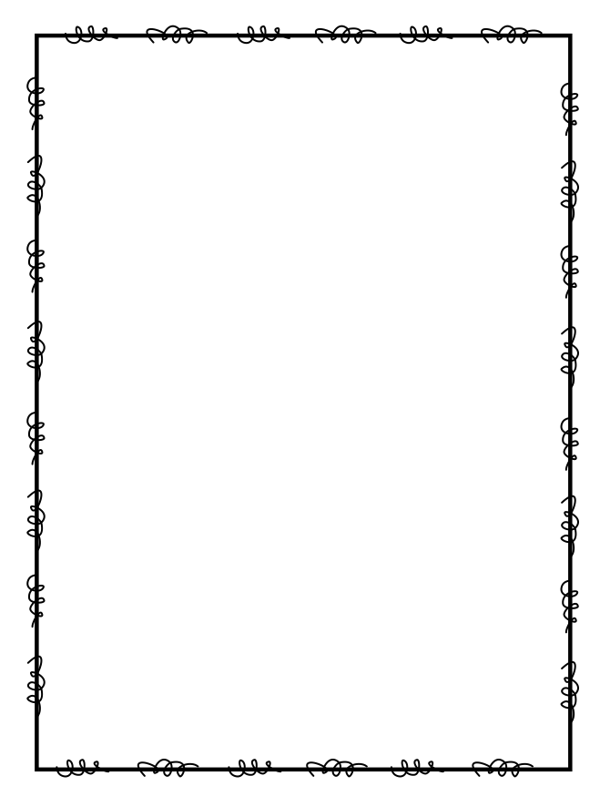
Name ____________________
Week 20
Day 1
There are 70 tables set up for a banquet. After the banquet, the tables will be placed on carts to be stored away. Each cart can hold 4 tables. How many carts will be needed to store all 70 tables? | Henry has 15 apples. Jenny has 2/3 as many apples. How many apples does Jenny have?
3. A group of 1st graders went on a field trip. They took 3 buses and 4 vans. There were 7 people in each van and 54 people on each school bus. How many people went on the field trip? | Which of the numbers below are multiples of 9? There may be more than one correct answer. a.) 3 b.) 27 c.) 81 d.) 1
Day 2
John cut up 16 oranges to give to the soccer players on Saturday. On Monday, John cut 3/4 of that amount. How many oranges did John cut up on Monday? | 2. Divide to find the quotient: 243 -:- 3 =
Write the number in standard form and word form: 500,000 + 8,000 + 200 + 9 = | 4. Mary wants new soil for her garden. Her garden is 16 yards by 25 yards. How many bags does Mary need to buy if each bag will cover 4 square yards?

Slide 2
Day 3
Bob forgot the number of people at the football game. He does remember that the number had a 9 in the ten thousands place and an 8 in the hundreds place. Which number could he be thinking of? a.) 79,843 b.) 86,900 c.) 90,877 d.) 98,200 | 2. Multiply to find the product: 98 x 76 =
3. A package of dog food costs $3.50 for 2 pounds. A package of bird seed costs $2.40 for 3 pounds. What is the difference in the cost per pound? | 4. Which fraction below is equivalent to 6/9? There may be more than one answer. a.) 1/6 b.) 8/12 c.) 2/3 d.) 12/18
Day 4
Rachel’s living room is 12 meters wide and 7 meters long. Rachel wants to install a new wood floor. It will cost $11.00 per square meter. How much will Rachel’s new floor cost? | 2. Put the fractions below in order from least to greatest: 7/8, 2/2, 3/4
3. Is 31 prime or composite? How do you know? | 4. On Friday evening a pizza shop had orders for 4 pepperoni, 97 vegetable, and 335 cheese pizzas. If the 4 cooks each made an equal number of pizzas, how many pizzas did each cook make?

