Slide 1
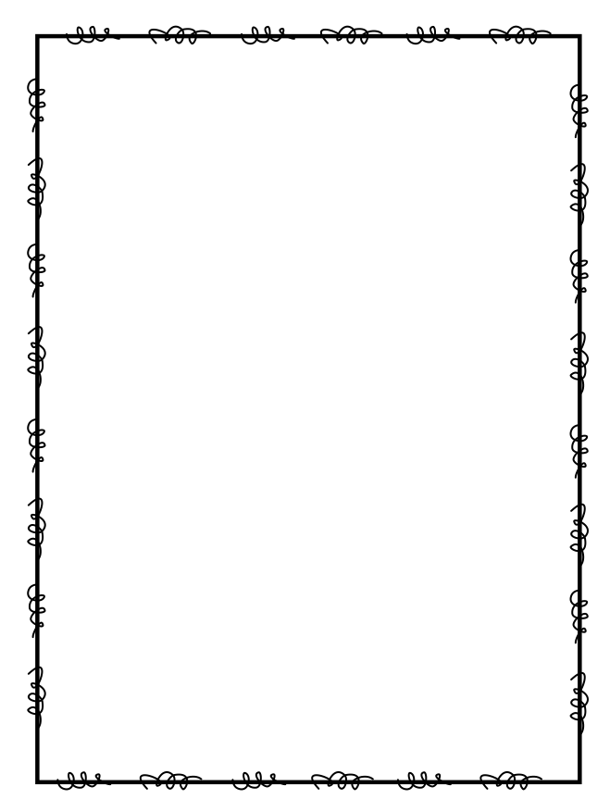
Name ____________________
Week 16
Day 1
1) A total of 58 awards will be given away at the soccer banquet. Each box holds 9 awards. How many awards will be in the partially filled box? | 2) What is 139,685 rounded to the nearest ten thousands place?
3) Identify the pattern in the series of numbers: 2, 6, 8, 24, 26 | 4) In one day, Trattoria sold $765 worth of casseroles. Each casserole cost $15. How many casseroles were sold?
Day 2
1) Jimmy weighs 90 pounds and his little sister Fiona weighs ½ as much as Jimmy. How much does Fiona weigh? | 2) Tyler wants to put a fence around his chicken coop. He measured the length of his backyard to be 36 feet and the width to be 23 feet. How many feet of wire fencing does Tyler need to buy?
3) Don is giving his rare coins to his grandchildren. He has 24 coins and 8 grandchildren. Each coin has a value of $18. If Don splits his coins evenly among the grandchildren, what is the total value of the coins each grandchild gets. | 4) Which of the following numbers when rounded to the nearest ten becomes 2,190? 2178 2184 2189 2195

Slide 2
Day 3
1) Todd is a professional photographer. He has taken 79 photos for a family and wants to put them into an album. The album has 15 pages and each page holds 5 photos. How many photos will not fit in the album? | 2) Multiply to find the product: 43 x 67 =
3) Our class is collecting bottled water for a service project. The goal is to collect 300 bottles of water. On the first day, Max brings in 3 packs with 6 bottles in each container. Sarah wheels in 6 packs with 6 bottles in each container. How many bottles of water still need to be collected? | 4) 1,935 people are invited to the hockey banquet. At the banquet, 9 people will sit at each table. How many tables are there?
Day 4
1) Susan is trying to explain to her friends that 6/6 is larger than 9/10. Is she correct? Write to explain your thinking. | 2) Will is at the library helping put books away. There are one hundred books to put away total but a librarian comes and takes 19 and leaves Will with the rest. If he can fit 7 books on a shelf, how many shelves will he need?
3) Divide to find the quotient: 9,896 ÷ 8 = | 4) My grandma left ½ of a cake on the counter. The doorbell rang and one of my friends came over. If we cut what’s left into equal parts, what fraction of the whole cake did we each eat?

