Slide 1
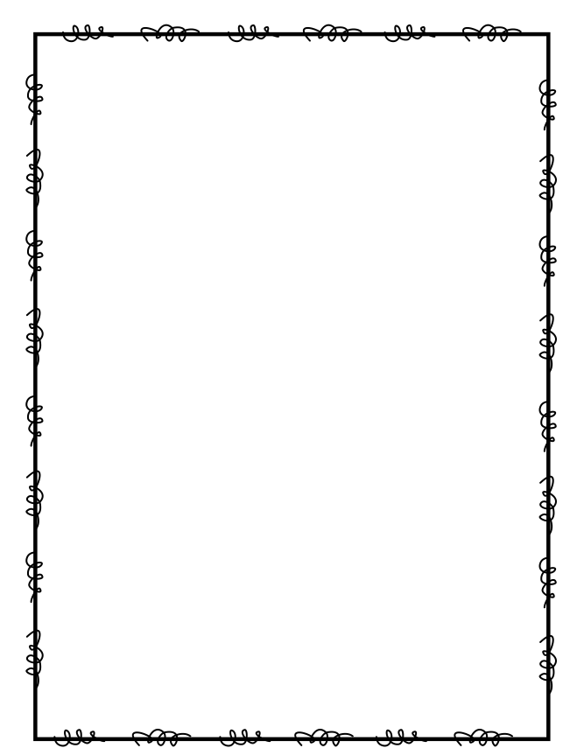
Name ____________________
Week 10
Day 1
1. Silvia had 32 stickers in her sticker book. She had 4 times as many stickers as Karen. How many stickers did Karen have? | 2. Using the rule: multiply by 3, subtract 1, what is the next number in the pattern below? 6, 18, 17, _____
3. List the factors for 15 and 30. What is the greatest common factor between these two numbers? | 4. Which place value would you use to compare the numbers 25,877 and 24,879? Then use the symbols >, <, or = to compare. 25,877 _______ 24,879
Day 2
1. Katie babysits 15 kids at the park. Each kid shows up to the park with 7 toys. Write an equation that represents how many toys the kids will bring to the park then solve the equation. | 2. Which number below is a factor of 32? a). 3 b). 16 c). 6 d). 10
3. Write the number below in standard form: 300,000 + 400 + 90 + 8. | 4. Add to find the sum: 9,654 + 13,786 =

Slide 2
Day 3
1. A group of fourth grade students and their parents went on a field trip. They took 9 vans and 3 buses. There were 12 people in each van and 54 people on each bus. How many people went on the field trip? | 2. Multiply to find the product 34 x 56 =
3. Round the number 765,999 to the place of the underlined digit. | 4. If 546 x 5 = 2,730, then 2,730 ÷ _____ is _______.
Day 4
1. Look at the series of numbers below. Which two numbers have a sum of 370? 240, 60, 190, 130 | 2. Subtract to find the difference: 55,647 – 23,898
3. Elizabeth said the product of two prime numbers will not be a prime number. Is she correct? Defend your response with examples. | 4. Peter has invited 25 of his friends to his birthday party. For the party favors, Peter would like each guest to receive 32 pieces of candy. How many total pieces does Peter need to buy? Write the equation that represents the problem and solve.

