Slide 1
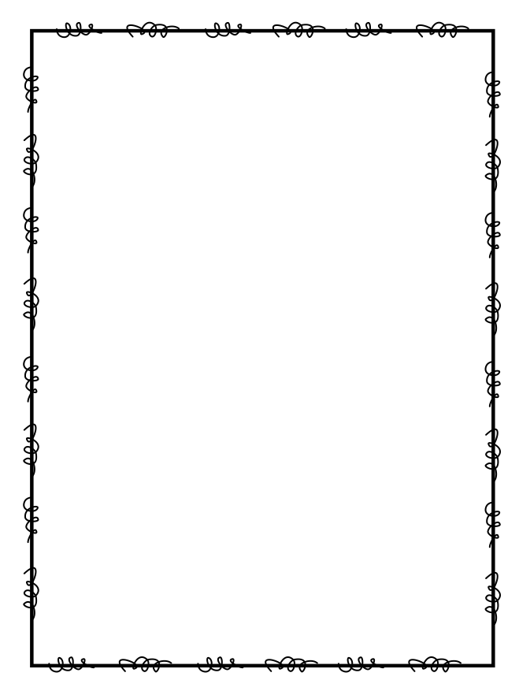
Name ____________________
Week 1
Day 1
1) 500 equals how many tens? Write to explain your thinking. | 2) Which place would you use to compare the numbers 17,422 and 17,923? Write to explain your thinking.
3) What is the greatest four-digit number you can write? What is the smallest four-digit number you can write? How did you arrive at your answer? | 4) Write a number that has 724 in the ones period and 628 in the thousands period.
Day 2
1) Write to explain how you know the 4 in the number 647,135 is not in the thousands place. | 2) A total of 77,216 people visited the Six Flags Amusement Park last year. What is the value of the underlined digit in 77,216?
3) Write a six-digit number with a 8 in the ten thousands place and a 4 in the tens place. | 4) 6,000 equals how many hundreds? Write to explain your thinking.

Slide 2
Day 3
1) Fill in the place-value chart below by labeling each place value. Write 195,234 in the place-value chart. What is the value of the digit in the tens place? ____________ | 2) Jaden said that in the number 609,100 the 9 has the greatest value because 9 is greater than the 6 and the 1. Is he correct? Write to explain your thinking?
3) Write the number “one hundred twenty thousand, three hundred four” in standard form and in expanded form. _______________________________________ (standard form) ______________________________________________________________________________ (expanded form) | 4) Write the numbers from least to greatest: 45,859; 4,936; 43,958; 43,396; 34,976; 4,396.
Day 4
1) How do you write 600,000 + 60,000 + 6 in standard form? | 2) Write the number 983,124 in word form and in expanded form. ______________________________________________________________________________ (word form) ______________________________________________________________________________ (expanded form)
3) Think about what you know about comparing numbers. When you compare the numbers on the left, you need to look at the ones digit. When you compare the numbers on the right, you do not need to compare the ones digits. Write to explain. 6,497____6,493 2,689____2,642 | 4) Macie is thinking of a 3-digit number. It uses the digits 2,8, and 6. You may use each digit once. How many numbers can you make that are even?

