Slide 1
COS Standard 6
Describe relations of the United States with Britain and France from 1781 to 1823, including the XYZ Affair, the War of 1812, and the Monroe Doctrine.

Slide 2
War of 1812
America: ill-trained, ill-disciplined, insufficient troops and equipment, lacked money; maneuvers were poorly conceived and executed
  Navy faired better than army:
    Army tried to invade Canada 3 times and failed; navy attacks at Lake Champlain and Lake Erie: British retreat
Britain and Canadians: energetic, well-trained military and navy

Slide 3
The War at Sea
Young U.S. Navy
16 Ships (Three 44-gun frigates/”Warships”
  The President, The United States, The Constitution
British fleet Outnumbers the U.S. fleet heavily
  British Blockades leave American ships in port

Slide 4
Washington D. C. Burned
The British landed in America; rushed to Washington D. C. burning public buildings.
In retaliation to the American’s victory at the Battle of York where they burned several British buildings, the British burned:
  White House
  Capitol
American troops in Washington fled, but those troops in Baltimore held strong.
Rain saved the rest of Washington D. C. from burning.

Slide 5
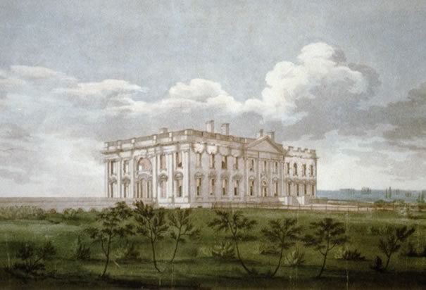
White House

Slide 6
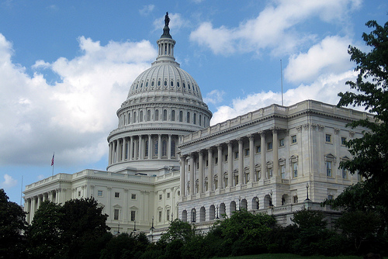
Capitol

Slide 7
Fort McHenry
British leave Washington D. C. and move to Baltimore.
British attack Fort McHenry and try to take the fort.
Americans keep the fort; they take down the small tattered flag and replace it with a large American flag that lets everyone know who is in charge of the fort.
Francis Scott Key wrote The Star-Spangled Banner once he saw the flag still in the sky.

Slide 8
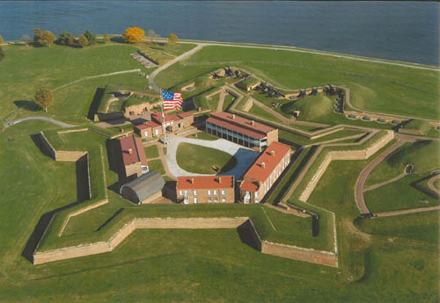
Fort McHenry

Slide 9
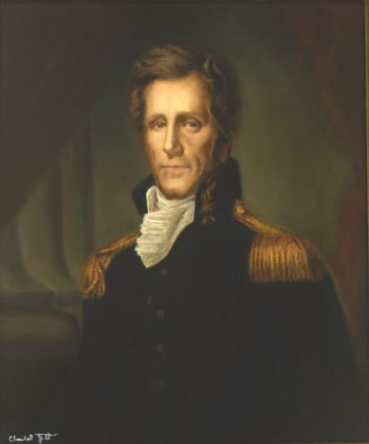
New Orleans
January 8, 1815
Jackson leads the American troops.
British attack in a frontal attack.
  Big Mistake: American troops are entrenched and protected by cotton bales. Heavy losses for the British because they forgot their ladders.

Slide 10

New Orleans continued
Andrew Jackson becomes a war hero.
Battle takes place after the Treaty of Ghent was signed.
Victory gives Americans a new sense of nationalism (pride in your country, patriotism)

Slide 11
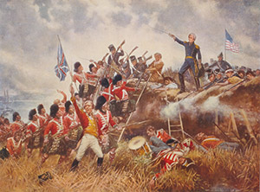
New Orleans continued

Slide 12
Treaty of Ghent
December 24, 1814
Ends War of 1812
Restored prewar boundaries, no territory changed hands

Slide 13
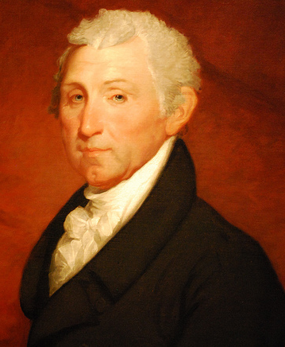
James Monroe
5th American President- served from 1817-1825
  Age at inauguration:58
Democratic-Republican
Born: Virginia/Died: New York
FAMOUSLY known for his Monroe Doctrine

Slide 14
James Monroe cont….
Pre-presidency
Revolutionary War
Father dies when James is 16 forcing him to provide for the family
Enrolled in the College of William and Mary, but his education was cut short when the Revolutionary War broke out
Lawyer-learned from Thomas Jefferson
Served as the Governor of Virginia as well as Secretary of State and Secretary of War for President James Madison
Helped TJ with the Louisiana Purchase negotiations
Fought for the Virginia Militia and the Continental Army
  He served as a Major under General Washington
Wounded at the Battle of Trenton (shoulder), but recovered the following winter at Valley Forge

Slide 15
Monroe as President
During his presidency:
  Five new states were admitted: Mississippi, Illinois,Alabama/1819 Maine, and Missouri
Added to the expansion of the U.S. by buying the territory of Florida from Spain
Passed the Missouri Compromise and The Monroe Doctrine

Slide 16
Era of Good Feeling-National Pride
These times were filled with national pride
British was now forced to recognize the US as an expanding national power
US has new found confidence in their young expanding nation
Star Spangled Banner-this song made Americans really believe that the US was “the land of the free and the home of the brave”
New endless opportunities in a country with boundless lands and riches

Slide 17
Era of Good Feelings
Started by the end of the War of 1812 and the demise of the Federalist Political Party.
  Hartford Convention
Democratic-Republicans split into northern-dominated Republicans and the southern-dominated Democrats
  Since both originated from same political party, there was a more stable government with minimal political fighting.
Finally at peace with Great Britain
  Could now focus/explore the land purchased under the Louisiana Purchase 1803-France(Napoleon)
Built new transport systems
Boom in the manufacturing industry

Slide 18
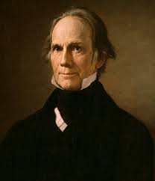
The American System
An economic plan created by Henry Clay
  Provided CREDIT enabling the building of new factories, new roads and canals
  Helped decrease U.S. dependence on foreign goods

Slide 19
Era of Good Feelings cont…
Protective Tariff of 1816
1817 Rush-bagot Treaty
Placed a 20-25% tax on all foreign goods
Demilitarized the Great Lakes regions
  Signified the start of an improvement of diplomatic relations between the U.S. and Great Britain

Slide 20
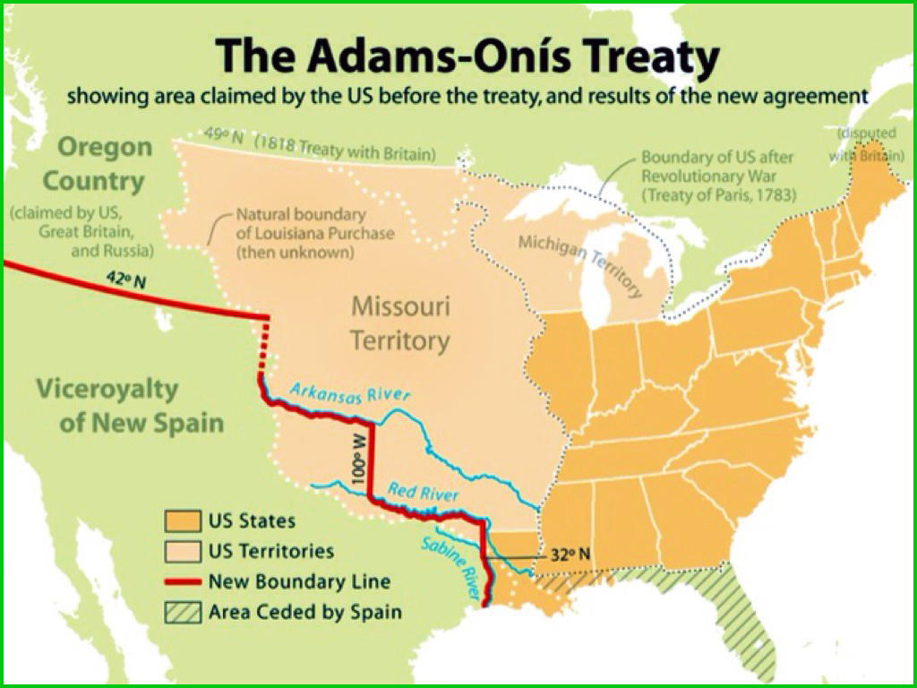
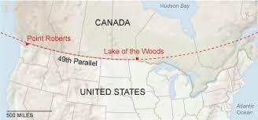
Era of Good Feelings cont…
Convention of 1818
Adams-Onis Florida Treaty-1819
Meetings between the U.S. and Great Britain where the 49th parallel was set as the border with Canada
Treaty between the U.S. and Spain resulting in Spain ceding Florida to the U.S.

Slide 21
Missouri Compromise of 1820
Settlement reached between the pro-slavery and anti-slavery factions in Congress and their opposing views on the extension of slavery
Admitted Missouri as a slave state….
and Maine as a non-slave state at the same time
  Result- balance in power retained between slave and free states (Congress/voting)

Slide 22
Era of Good Feelings cont…
Transportation
Industrial Revolution
Boom in steamboat usage which made travel by river much easier
Cumberland Road (1811-1837)- first national road that served as a gateway to westward settlement.
Santa Fe Trail (1822)-Independence Missouri to Santa Fe New Mexico
Eire Canal 1825- Albany to Buffalo-longest canal in western world at the time
The invention of Eli Whitney’s cotton gin helped start the Industrial Revolution
  The cotton gin was followed by the ideas of Samuel Salter and his cotton mils

Slide 23
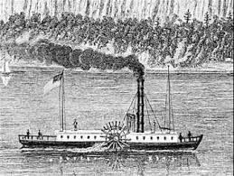
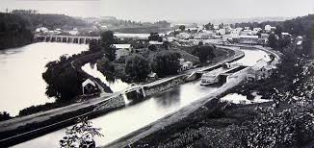
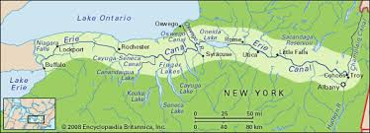

Slide 24
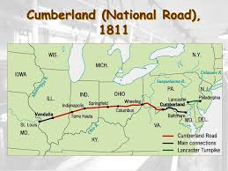
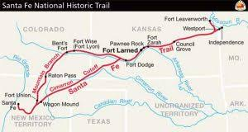

Slide 25
Monroe Doctrine -2 Major Points
That the United States would not allow European countries to start new colonies or to interfere with independent countries in the continents of North America or South America
That the United States would not interfere with existing European colonies nor get involved with conflicts between European countries

Slide 26
Causes for the Monroe Doctrine
Many countries in South America had just gained their independence from European Empires (Spain and Portugal)
With Napoleon’s defeat, Madison was afraid of European colonization in North America
Madison wanted to let European monarchies know that they would not be able to regain power in the Americas

Slide 27
Effects of the Monroe Doctrine
1865- overthrew Mexican Emperor Maximilian I who had been placed to power by the French
1904-Theodore Roosevelt adds the Roosevelt Corollary to help Central and South American countries of their “wrongdoings”
1962-John F. Kennedy uses doctrine during Cuban Missile Crises to place a naval quarantine around Cuba from the Soviet Union
1982-Ronald Regan uses doctrine to fight communism in the Americas (Nicaragua and El Salvador)

