Slide 1
COS Standard 5
Evaluate the impact of social changes and the influence of key figures in the United States from World War I through the 1920s, including Prohibition, the passage of the Nineteenth Amendment, the Scopes Trial, limits on immigration, Ku Klux Klan activities, the Red Scare, Susan B. Anthony, Margaret Sanger, Elizabeth Cady Stanton, the Harlem Renaissance, the Great Migration, W. C. Handy, the Jazz Age, and Zelda Fitzgerald.

Slide 2
Determining the relationship between technological innovations and the creation of increased leisure time
Chapter 21 Section 2

Slide 3
Technological Innovations
Products will start being mass produced.
  Large scale manufacturing done by machines.
  Increases supplies and decreases cost.
Assembly lines increases manufacturing efficiency by dividing up operations into simple tasks that unskilled workers could perform.
  Henry Ford’s Model T: affordable automobiles
  Garages and gas stations opened.
  Petroleum industry expands.
  People can live further away from work: isolation ended.

Slide 4
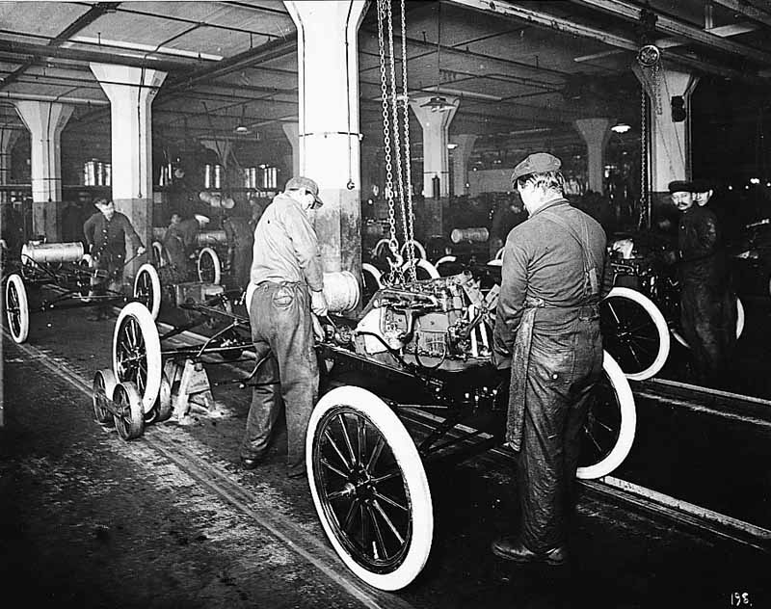
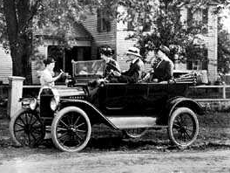
Technological Innovations continued

Slide 5
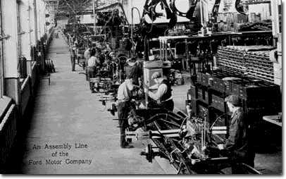
Technological Innovations continued

Slide 6
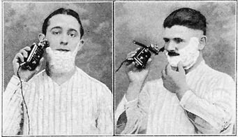
Technological Innovations continued
More disposable income made innovations affordable.
  Electric razors
  Frozen food
  Household cleaning supplies
  Labor saving devices
Used income to make life easier.

Slide 7
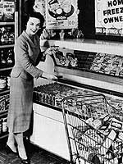
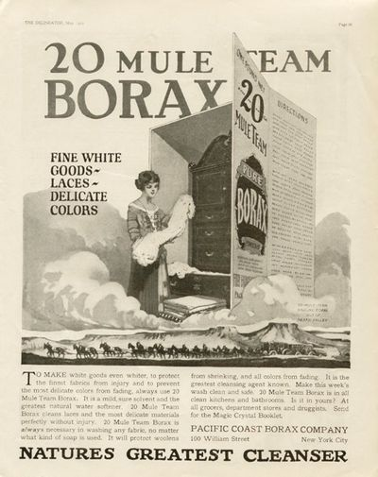
Technological Innovations continued

Slide 8
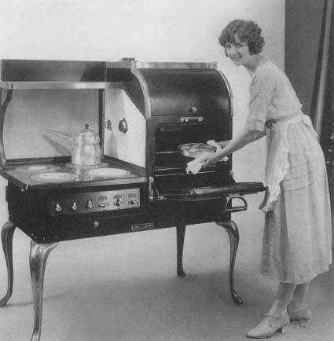
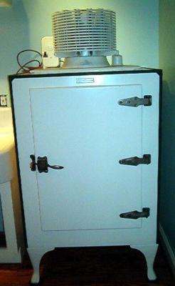
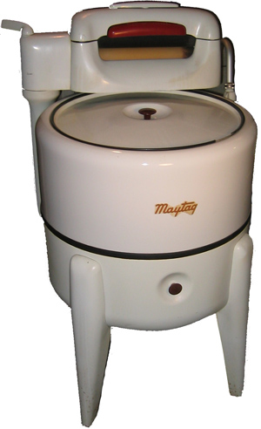
Technological Innovations continued

Slide 9
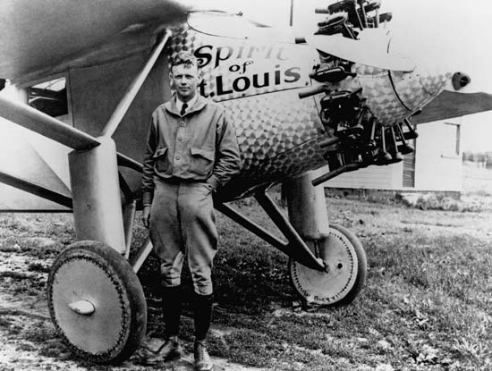
Technological Innovations continued
The Postal Service used the Railroad to get mail to people faster.
Charles Lindbergh flew a transatlantic solo flight in 1927.
By end of 1928, 48 airlines flew to places in America.
NBC (1926) and CBS (1928) set up daily programming radio stations.

Slide 10
Consumer Society
Americans bought things on credit and the ideas of thrift shifted (standard of living changed).
Americans thought they could pay back what they bought on credit.
Advertising convinces Americans they need new products to make their lives better.
Americans want these new conveniences because they want more leisure time.
  Sports: Baseball, college football, boxing
  Movies: silent or talking
  Radios
  Theatre
  And other forms of entertainment

